Slide 1
Selective Power Point Slides Dr. William Marsiglio Society and the Individual

Slide 2
Mead’s Theoretical Model of Mind, Self, and Society
Society (organized social community
characterized by members’ intersubjectivity)
Selfhood: reflexivity (subject and object),
developmental phases—imitation, play, and game
Mind: acquired when person uses symbols, not merely signs; process involves internal conversation of significant gestures
Taking the role of the other: interpret meaning
Significant gestures: respond to perceived intent
Social acts (minimal social grouping)

Slide 3
Exercise to Illustrate Symbolic Exchange and Relationship Between SI and SE
Think of two platonic friends whom you’ve met since graduating from high school, and have known for roughly the same amount of time, but one (Friend A) you consider to be a close friend and the other (Friend B) is not.
List 1-2 significant favors you have done for “A” that you have NOT done for “B”.
List 1-2 significant favors “A” has done for you that “B” has NOT done for you.
Name 1-2 new and different favors that you might ask “A” to do but would probably not ask “B” to do.
Describe what led you to be willing to have certain types of exchanges (favors) with “A” that you don’t have with “B”?

Slide 4
IRC MODEL
Physical
Copresence
+
Common Focus
of Attention and
Mutual
Awareness
Group
Membership
Symbols
+
Stratified:
power/resources
Common
Emotional
Mood
Civil War
Re-enactment Footage

Slide 5
Interaction Ritual Encounter
Person A
Person B
Market opportunities
Cultural capital
Emotional energy
Market opportunities
Cultural capital
Emotional energy
Interaction
Ritual

Slide 6
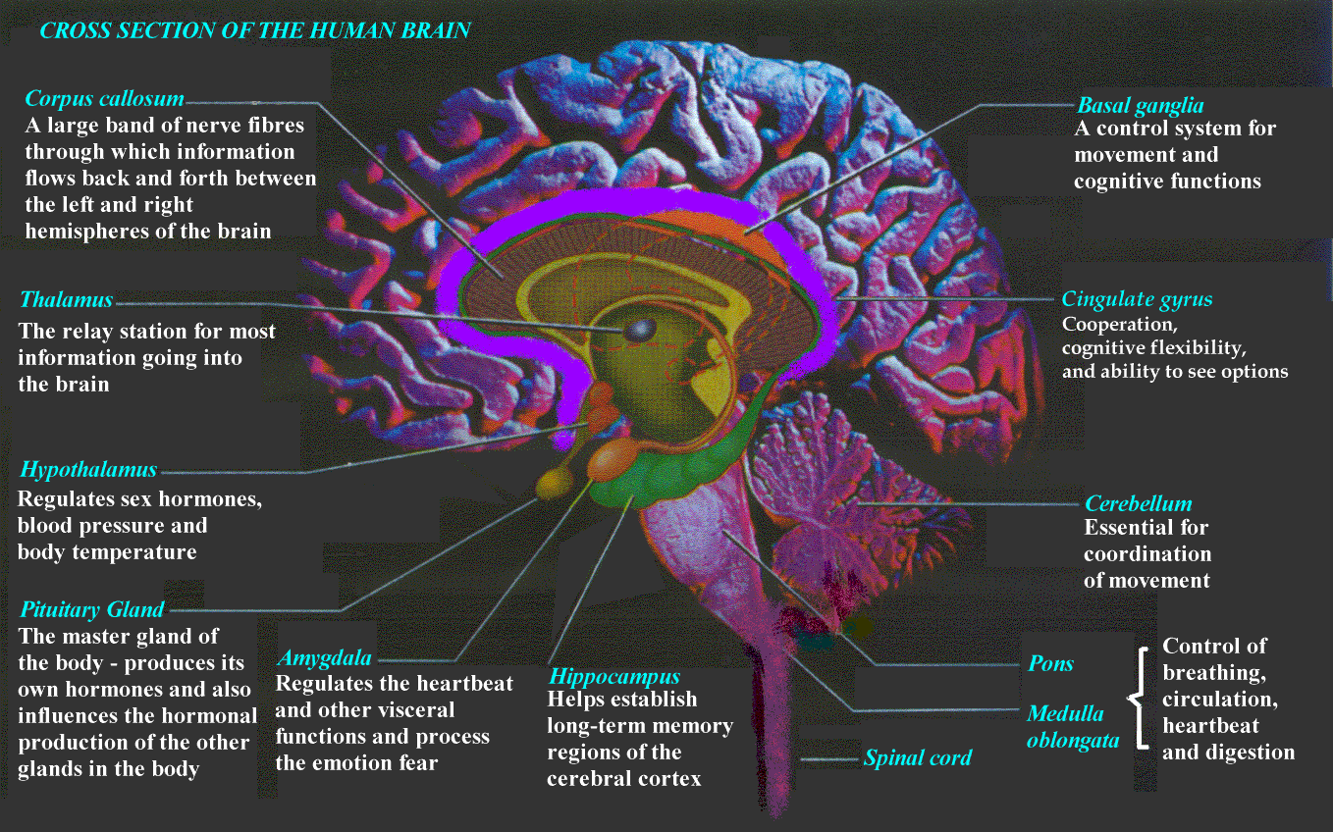
Amygdala

Slide 7
Self Structure: Master Identity/Core
Father
Worker
Husband
Godly Man
Friend
Neighbor

Slide 8
Self Structure: Hierarchy
High
School
Senior
Romantic Partner
Student
College
Junior
Friend
Worker
Student
Activist
Son/
Daughter
Son/
Daughter
Worker
Friend
Activist
Romantic Partner

Slide 9
Self Structure: Balanced/Hierarchy
Contingent on Situation
Romantic Partner
Friend
Student
Son/
Daughter
Worker
Activist

Slide 10
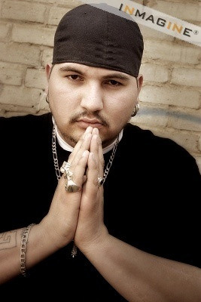
View of identities as cybernetic control systems
Identity Settings
“Self Meanings”
Desired
State
Congruency
Adjustment
Behavior
Perceptions
Reflected
Appraisals

Slide 11
Few People
Many Threads
Many People
Many Threads
Many People
Few Threads

Slide 12
First Doubts
Further reinforcement
of doubts
Seeking role
alternatives
Positive reactions
of others
Reinforcement
of doubts
Negative
interpretation
of subsequent
events
First Doubts
--organizational
changes
--burnout
--changes in
relationships
--events
Cuing behavior
Seek out individuals to
reinforce doubts
Negative Reactions
of others
Reevaluate situation, temporarily halt doubting process

Slide 13
Seeking Alternatives
Turning
point
Role
rehearsal
Shifting reference
groups
More serious
weighing of
pros and cons
of specific
choices
Positive
social
support
Realization
of freedom
choice
Focus on
specific
choice
Conscious
cuing
Negative social
support
Interrupt or
retard process

Slide 14
Turning Point
Role
exit
New
Bridges
Mobilization of
resources
“the vacuum”
Turning points
--specific events
--final straw
--time factors
--either or situations
Reduction of
cognitive
dissonance
Announcement to
others

Slide 15
Model 3
Primary Network
Properties
Size
Kin/Non kin ratio
Overlap
Substitutability
Interaction
Rituals
Dynamic Aspects
of Relationships
Development
Decision-making
dialectics
Personal
Well-Being
And
Development

Slide 16
Model 4
Societal Context:
Cultural/Structural
Processes and Patterns
Social Movements,
Interest Groups, and
Secondary Networks
Factors Affecting
Person’s Ability to
Control Life
Primary Network
Properties
Dynamic Aspects of
Relationships
Development
Decision-making dialectics
Personal Well-Being
And
Development
[Interaction]
Rituals

