Slide 1
Writing a Teaching Statement
Catherine Paolucci
cpaolucci@coe.ufl.edu

Slide 2
Getting StarteD
Using Jamboard – slide 1,
add a post-it note with at least 1 way to finish this statement:
My approach to teaching mathematics is grounded in the belief that…

Slide 3
GoalS of a Teaching Statement
Give the search committee a sense of who you are as an educator and what you can bring to their courses, faculty, and students
Help future colleagues determine whether you
fit in with the culture of the department
are the right person to help achieve future goals regarding course development, grant proposals, and new initiatives

Slide 4
What Should be in a Teaching Statement
Discuss your philosophy on teaching and learning and connect it to evidence-based learning theories and instructional strategies (including assessment)
Illustrate key aspects of your philosophy with specific examples, ideally from your own experience. Don’t just use jargon – demonstrate that you know what it means and illustrate what it looks like in practice.
Note any future goals and plans related to continued growth as an educator (grant proposals, current work, collaborating with new colleagues). Whenever possible, link this to a prospective position (job description, research on the department)
Discuss how your philosophy, supporting experience and future goals would benefit the department and institution to which you are applying.

Slide 5
Activity 1: What Kind of Educator Do I strive to Be?
This is a BIG question!
Let’s start with a smaller one…
If someone stopped into your class, what would you want them to see?
Jamboard - Slide 2
If you need some help, think about something you’ve done or seen done that generated energy and enthusiasm for learning among students and/or raised achievement levels for ALL students
Try not to limit this to things that were effective for YOU. Also, think about something that helped someone else overcome a challenge they had.

Slide 6
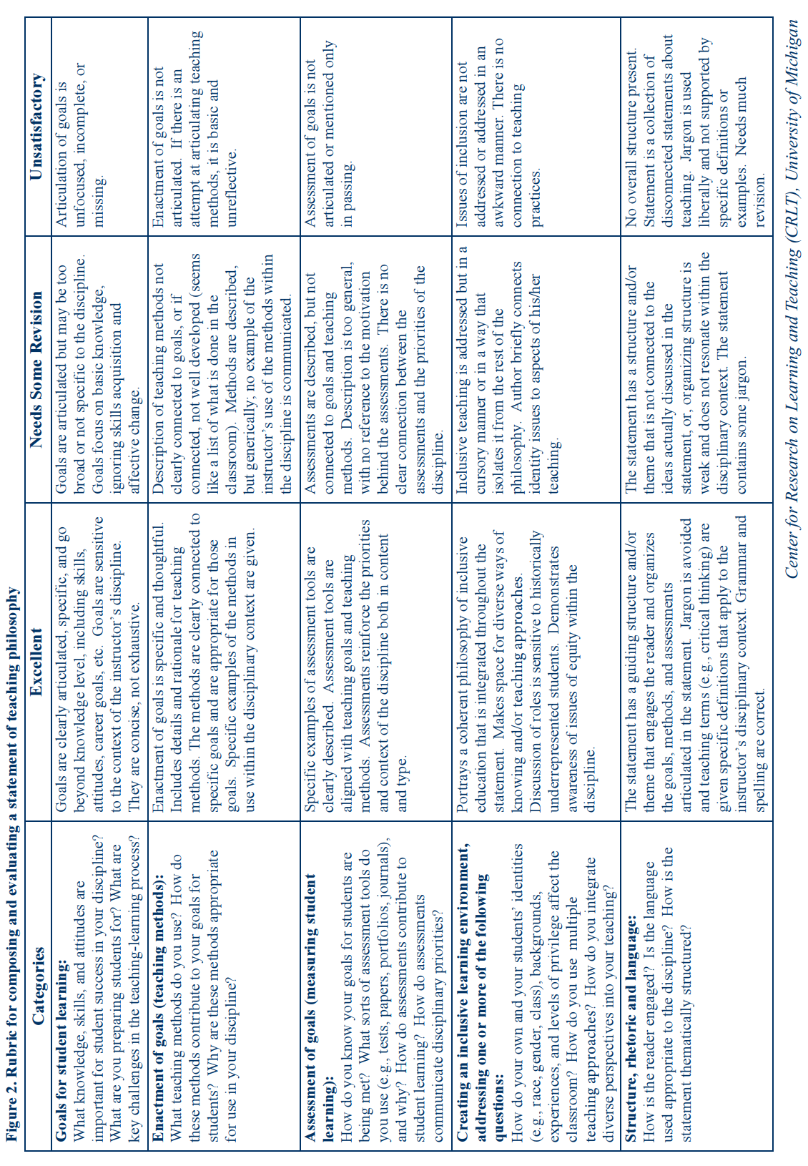

Slide 7
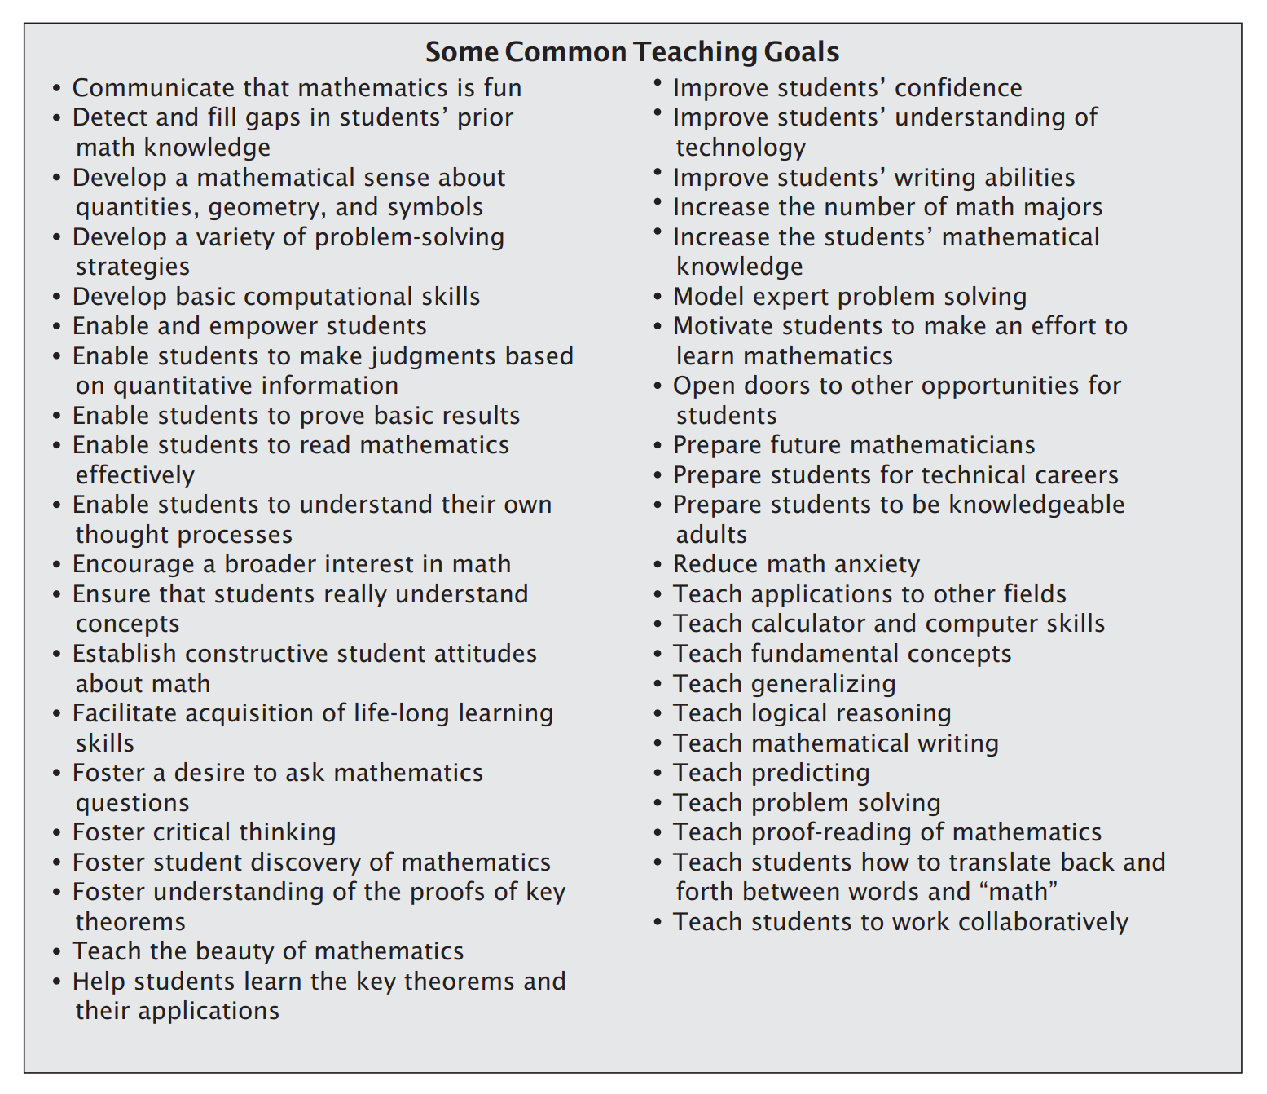
Focus on the Learning Goal and the ‘How’…
This is a great set of teaching goals, to get you thinking about student learning goals.
A balance of teaching and learning language is important!
Let’s look at a few of these and think about two things:
1. What is the student learning outcome? (If you meet your teaching goal, what will your students be able to do?)
2. What specific activities or experiences will support this student learning outcome?

Slide 8
Activity 2: Reflecting on Key InstructionAl Activities
How we approach key instructional activities is central to our goals as educators and how students experience our instruction.
Jamboard – Slide 3
Identify 1-3 things you try to do during each of the following instructional activities:
Planning for instruction
Facilitating learning activities
Assessing student learning
Providing feedback to students

Slide 9
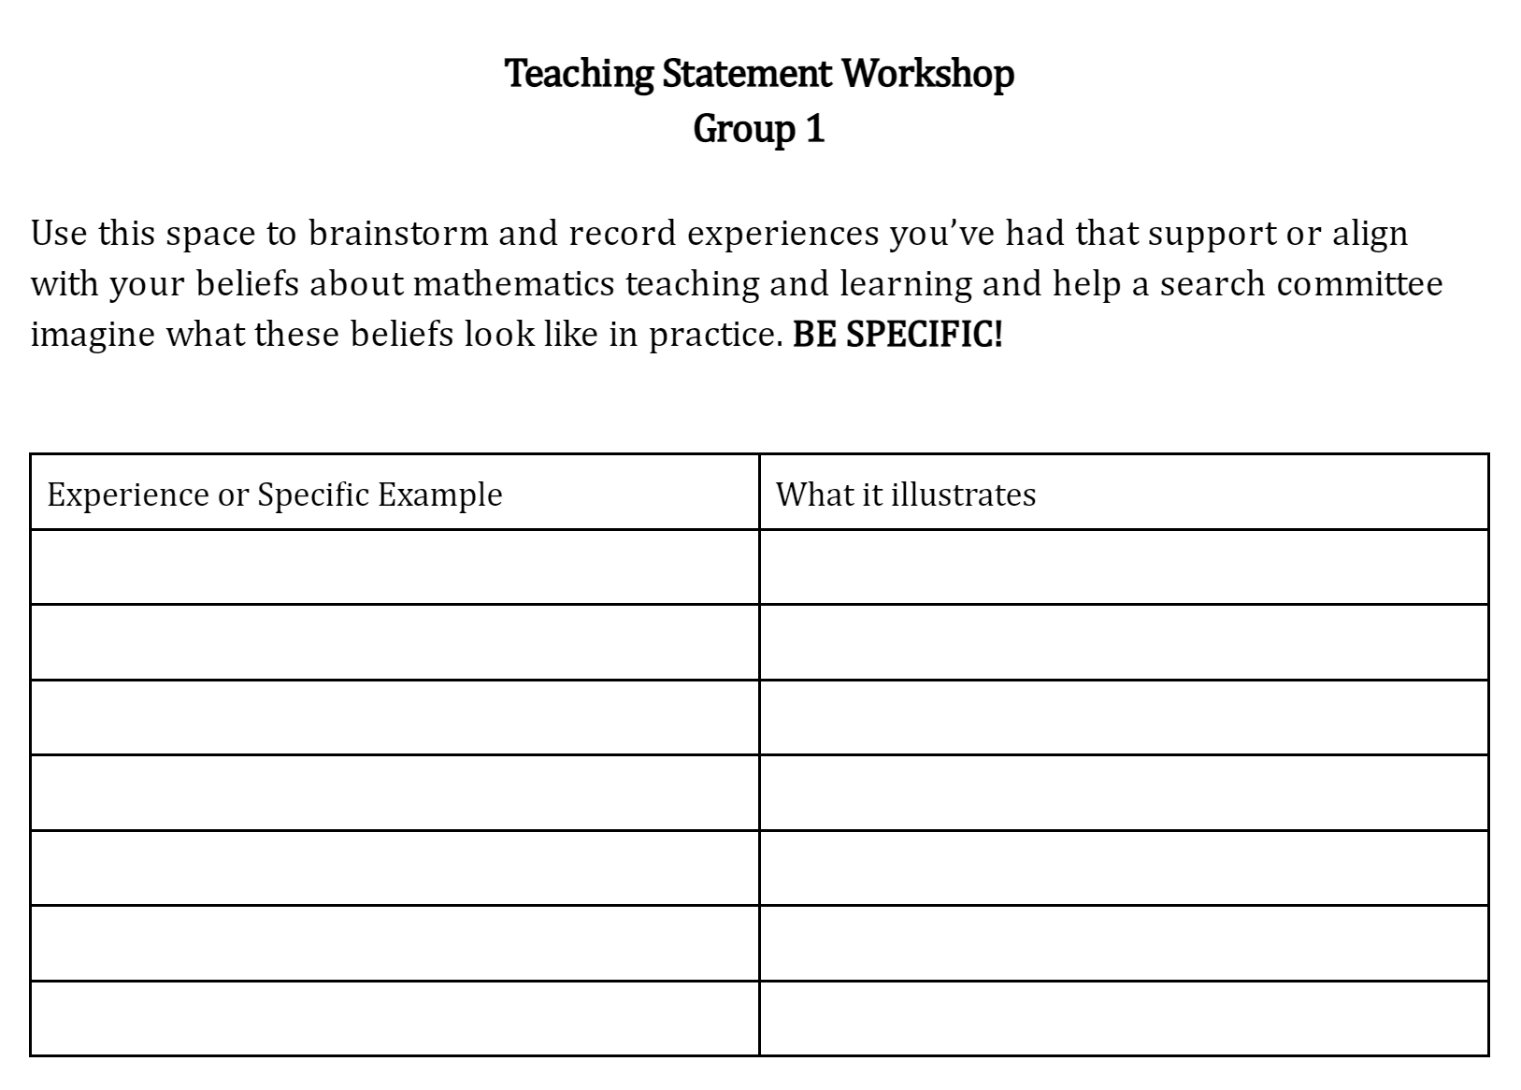
Activity 3: experiences that Offer examples of the type of Teacher You STRIVE to be
In small groups, discuss some experiences you’ve had that support or align with your beliefs about mathematics teaching and learning and help a search committee imagine what these beliefs look like in practice.
Use the following Google Docs to record your ideas – BE SPECIFIC:
Group 1: Link
Group 2: Link
Group 3: Link

Slide 10
Equity-Focused Teaching… What Is it, and What does it look like in Practice?
Sample definition of Equity
Attainment of comparably positive outcomes for all groups…through implementation of policies, practices, and procedures that remove barriers and provide the supports needed to ensure full and successful participation for everyone in the system.
Equity exists when race, ethnicity, language, religion, gender identity, sexual orientation, age, national origin, physical or cognitive ability, socioeconomic status, and other such characteristics are not predictors of outcomes for any group or the individuals in it.
(Adapted from https://www.wested.org/equity/)
What are some policies, practices, and procedures that can create barriers or prevent everyone’s full and successful participation in learning mathematics?

Slide 11
Further Resources
Final Advice
There are many, many sample teaching statements online. The best examples are
Short (1-2 pages)
Narrative (tell a story of who you are as an educator – don’t be afraid to share your own experiences, if they’ve shaped your beliefs about teaching and learning)
Thematic (clearly organized into sections – e.g. instruction, assessment, work with co-requisite pathways, advanced coursework, working with diverse student groups, etc.)
Grounded in real examples (draw on what we did here today)
General: https://cft.vanderbilt.edu/guides-sub-pages/teaching-statements/
Math Specific: http://www.ams.org/notices/200611/comm-grundman.pdf
Rubric: https://crlt.umich.edu/sites/default/files/resource_files/CRLT_no23.pdf

