Slide 2
Miami U. at U. of Florida, 9-4-10

Slide 3
Triangular Diasporic Modes in Luso-Afro-Brazilian Studies (Migration, Literature, Music)
Charles A. Perrone
University of Florida

Slide 4
Comunidade de Países de Língua Portuguesa Community of Portuguese-Language Countries

Slide 5
Brazilian edition

Slide 6
University of Wisconsin Press

Slide 7
Comunidade de Países de Língua Portuguesa Community of Portuguese-Language Countries

Slide 8
1980 - 2008- present

Slide 9
1982

Slide 10
Migrant Portuguese as Critical Topic

Slide 11
Sample USA Academic Event

Slide 12
Portuguese Studies UK

Slide 13
Recent Scholarship, L-A-B Migration, UK +

Slide 14
Portuguese Studies (UK)

Slide 15
Clearing-house for Migrant Information

Slide 16
Luso-Canadian Web Site

Slide 17
Gateway

Slide 18
Anthropology of Migration

Slide 19
More Brazilians in New York

Slide 20
Margolis, new ed.

Slide 21
Recent Scholarship, Brazil USA

Slide 22
Recent Scholarship, Brazil USA

Slide 23
1980 - 2008- present

Slide 24
Frank Fagundes, Univ. of Massachusetts, Amherst

Slide 25
Rutgers University Press, 2011

Slide 26
Diaspora Literature, Fiction (1996/2005)

Slide 27
First World Third Class (2005) by Regina Rheda
trans. of Pau-de-Arara Classe Turística (1996)
Part One: Brazil
In the late twentieth century, Brazil experienced a phenomenon quite unprecedented in its five-hundred-year history. Many young middle-class Brazilians decided to swap their university diplomas for mops, their designer clothes for aprons, their cars for kitchen sinks, their prosperity for tips, and Brazil for the First World. Our country, ruined by an unbroken succession of parasitic politicians, disowned, like a negligent, submissive and ignorant mother, more than one generation of university graduates and liberal professionals who, deprived of their identities, smuggled their dreams out to subordinate areas of Europe, Japan, Canada and the United States

Slide 28
Young people who would never have dreamed of washing dishes in their own country went off to do just that overseas, where their wages surpassed the salaries of teachers back in Brazil. Actresses fresh out of drama school, with no prospect of finding work in Brazil, took jobs as dancers in New York nightclubs. Educators went to Paris to be waitresses. Psychologists wielded dusters in London, and sociologists did manicures in Milan. Professors of mathematics and physics who were the grandchildren of Japanese immigrants became manual laborers in Japan. // The news that the descendants of foreigners were entitled to passports from the countries of their forefathers spread like hot gossip through the ranks of the young. For Brazilians resentful of their fate, obtaining a European Community passport meant upgrading their social status and getting a good job in Europe. … This flight of youth, in its instinctive reaction to national depression, was individualistic, ingenuous and inept.

Slide 29
Literature of Diaspora, Poetry

Slide 30
Reynaldo Valinho Alvarez, Diáspora ou aprendiz de galego
Ledos e verdes montes que o meu pai
percorreu cando neno inxenuo e inquedo
………..
Así se conta o conto deses dias
que a diáspora tirou ás augas frías
e que agora se apaga en sombra eterna.
------------------------------------------
Alegre e verde monte percorrido
por meu pai quando infante ingênuo e ledo
…………
Assim se narra a história desses dias
que a diáspora lançou às águas frias
e que agora se apaga em sombra eterna.

Slide 31
O Poeta de Minas Gerais

Slide 32
Literature of diaspora, criticism

Slide 33
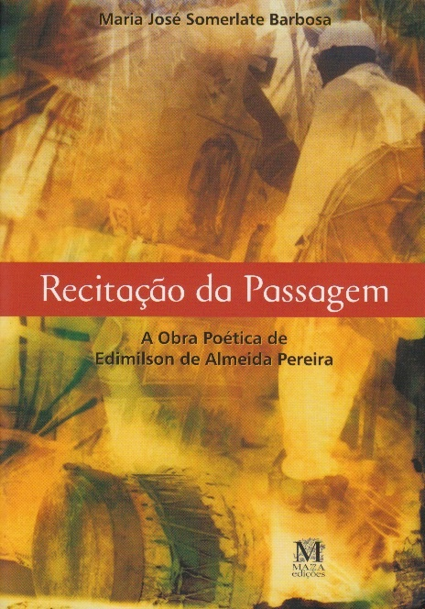

Slide 34
University of Nebraska Press

Slide 35
Distribution of African Diaspora

Slide 36
By the numbers…

Slide 37
Afro-diasporic Populations

Slide 38
African Diaspora, Pie Chart %s

Slide 39
Institutional Promotion of Heritage

Slide 40
Institutional Growth, Salvador

Slide 41
Duke U P, 2010

Slide 42
Music Abroad…

Slide 43
National Public Radio Special

Slide 44
NPR follow-up 1

Slide 45
NPR follow-up 2

Slide 46
Sample University Brazilian-Music Ensemble

Slide 47
Duke U P, Indiana U P

Slide 48
Triangular Diasporic Modes in Luso-Afro-Brazilian Studies (Migration, Literature, Music) FIM
Charles A. Perrone
University of Florida

