Slide 1
Beardsley Caricatures and Pictures, and Punch Cartoons, Part 2 Chris Snodgrass @ 2014

Slide 2
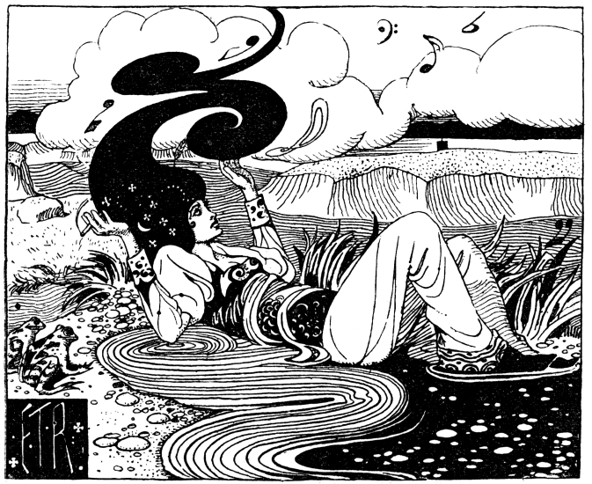
Punch cartoon, Vol. 106 “SheNotes Reclining” [referencing Egerton]

