Slide 1
Beardsley Caricatures and Pictures, and Punch Cartoons, Part 2
Chris Snodgrass @ 2014

Slide 2
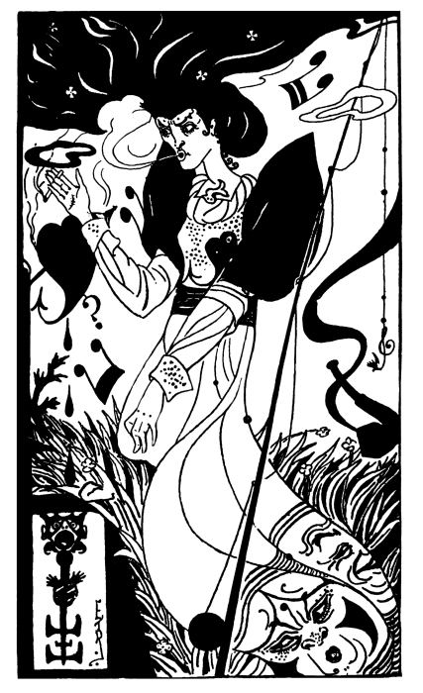
Punch cartoon, Vol. 106
“SheNotes” [referencing Egerton]

Slide 3
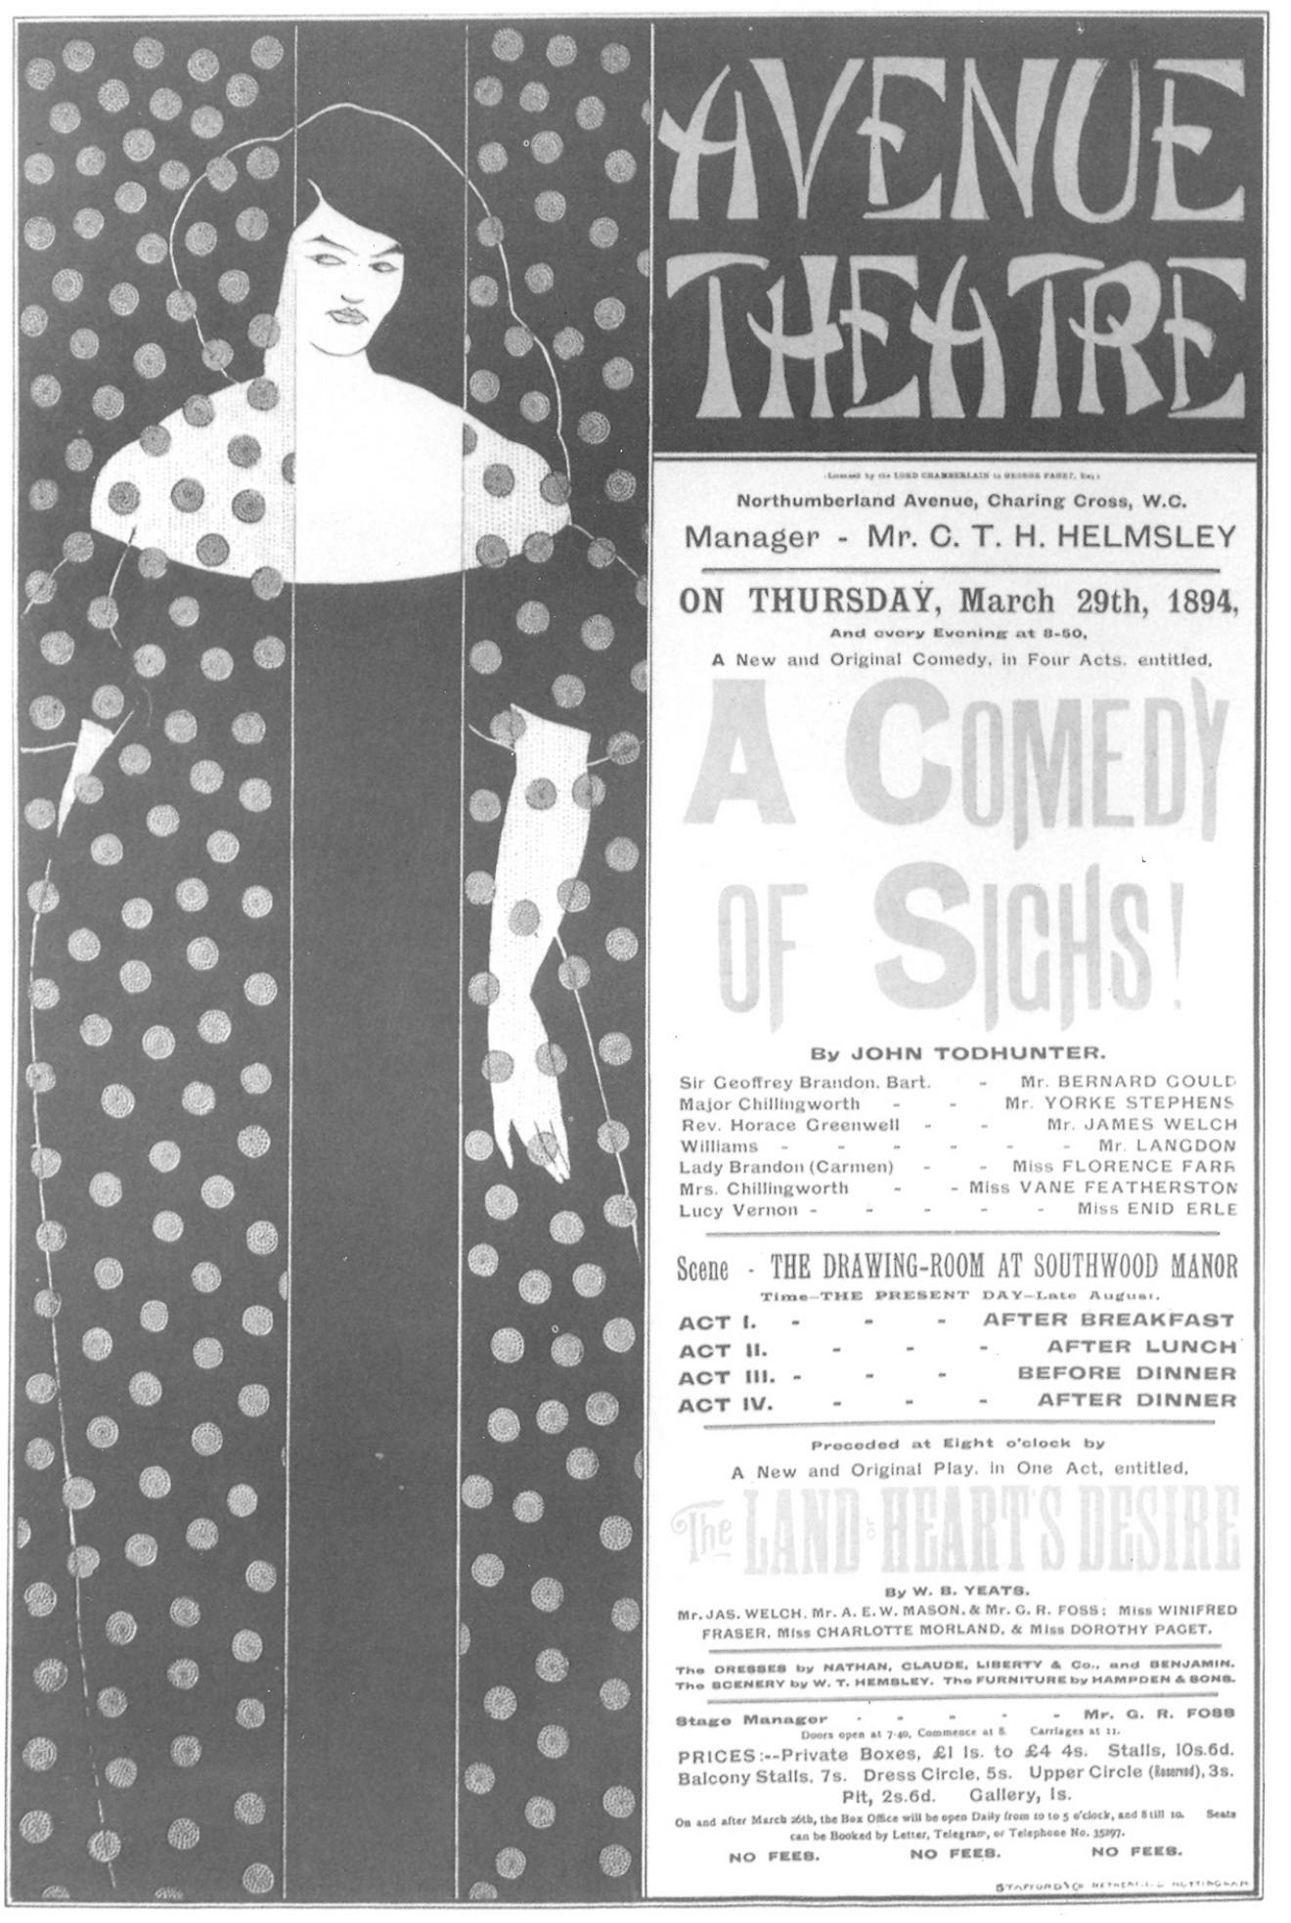
Aubrey [Vincent] Beardsley (1872–98)
Poster for A Comedy of Sighs (1894)

Slide 4
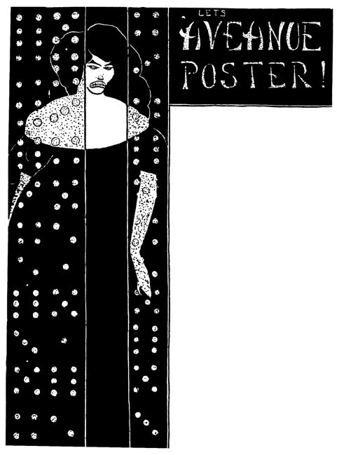
Punch cartoon, Vol. 106
“Ars Postera”

Slide 5
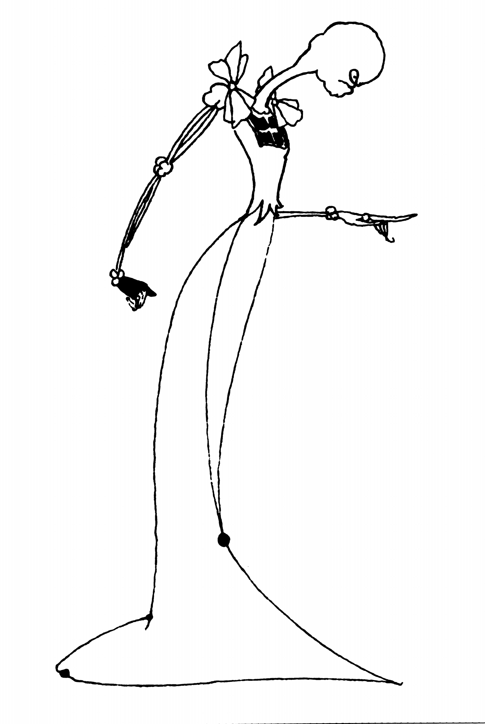
Aubrey [Vincent] Beardsley (1872–98)
Vignette for p. 44 in Bon-Mots of Samuel Foote and Theodore Hook (1894)

Slide 6
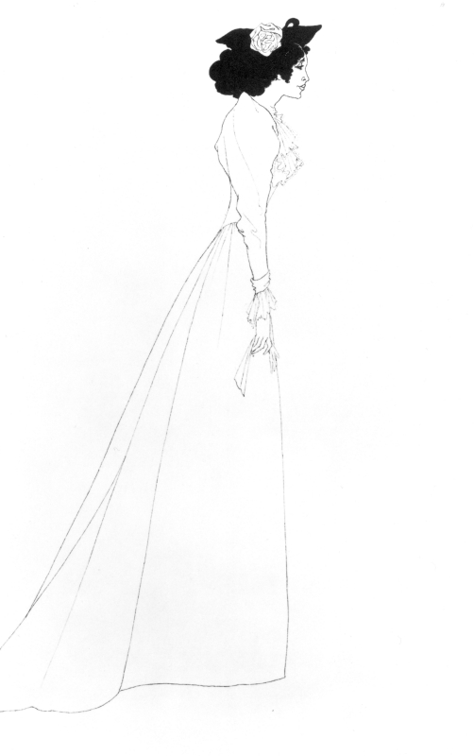
Aubrey [Vincent] Beardsley (1872–98)
Mrs. Patrick Campbell (1894)

Slide 7
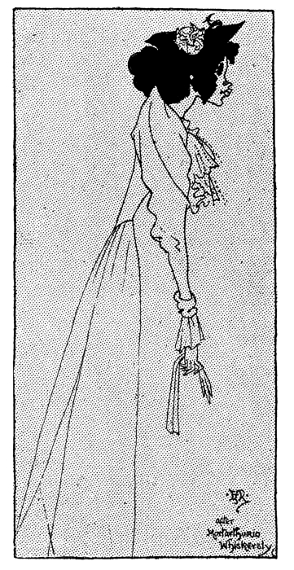
Punch cartoon, Vol. 106
2nd Mrs. Tanqueray Played Out (1894)

Slide 8
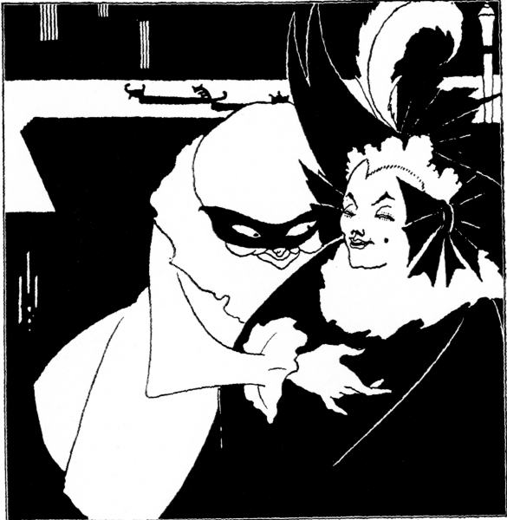
Aubrey [Vincent] Beardsley (1872–98)
Pierrot Tickling a Demimondaine (1894)

Slide 9
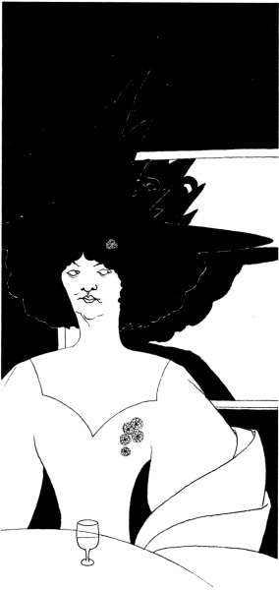
Aubrey [Vincent] Beardsley (1872–98)
Drawing for full-page grotesque on p. 171 in Bon-Mots of Samuel Foote and Theodore Hook (1894)

Slide 10
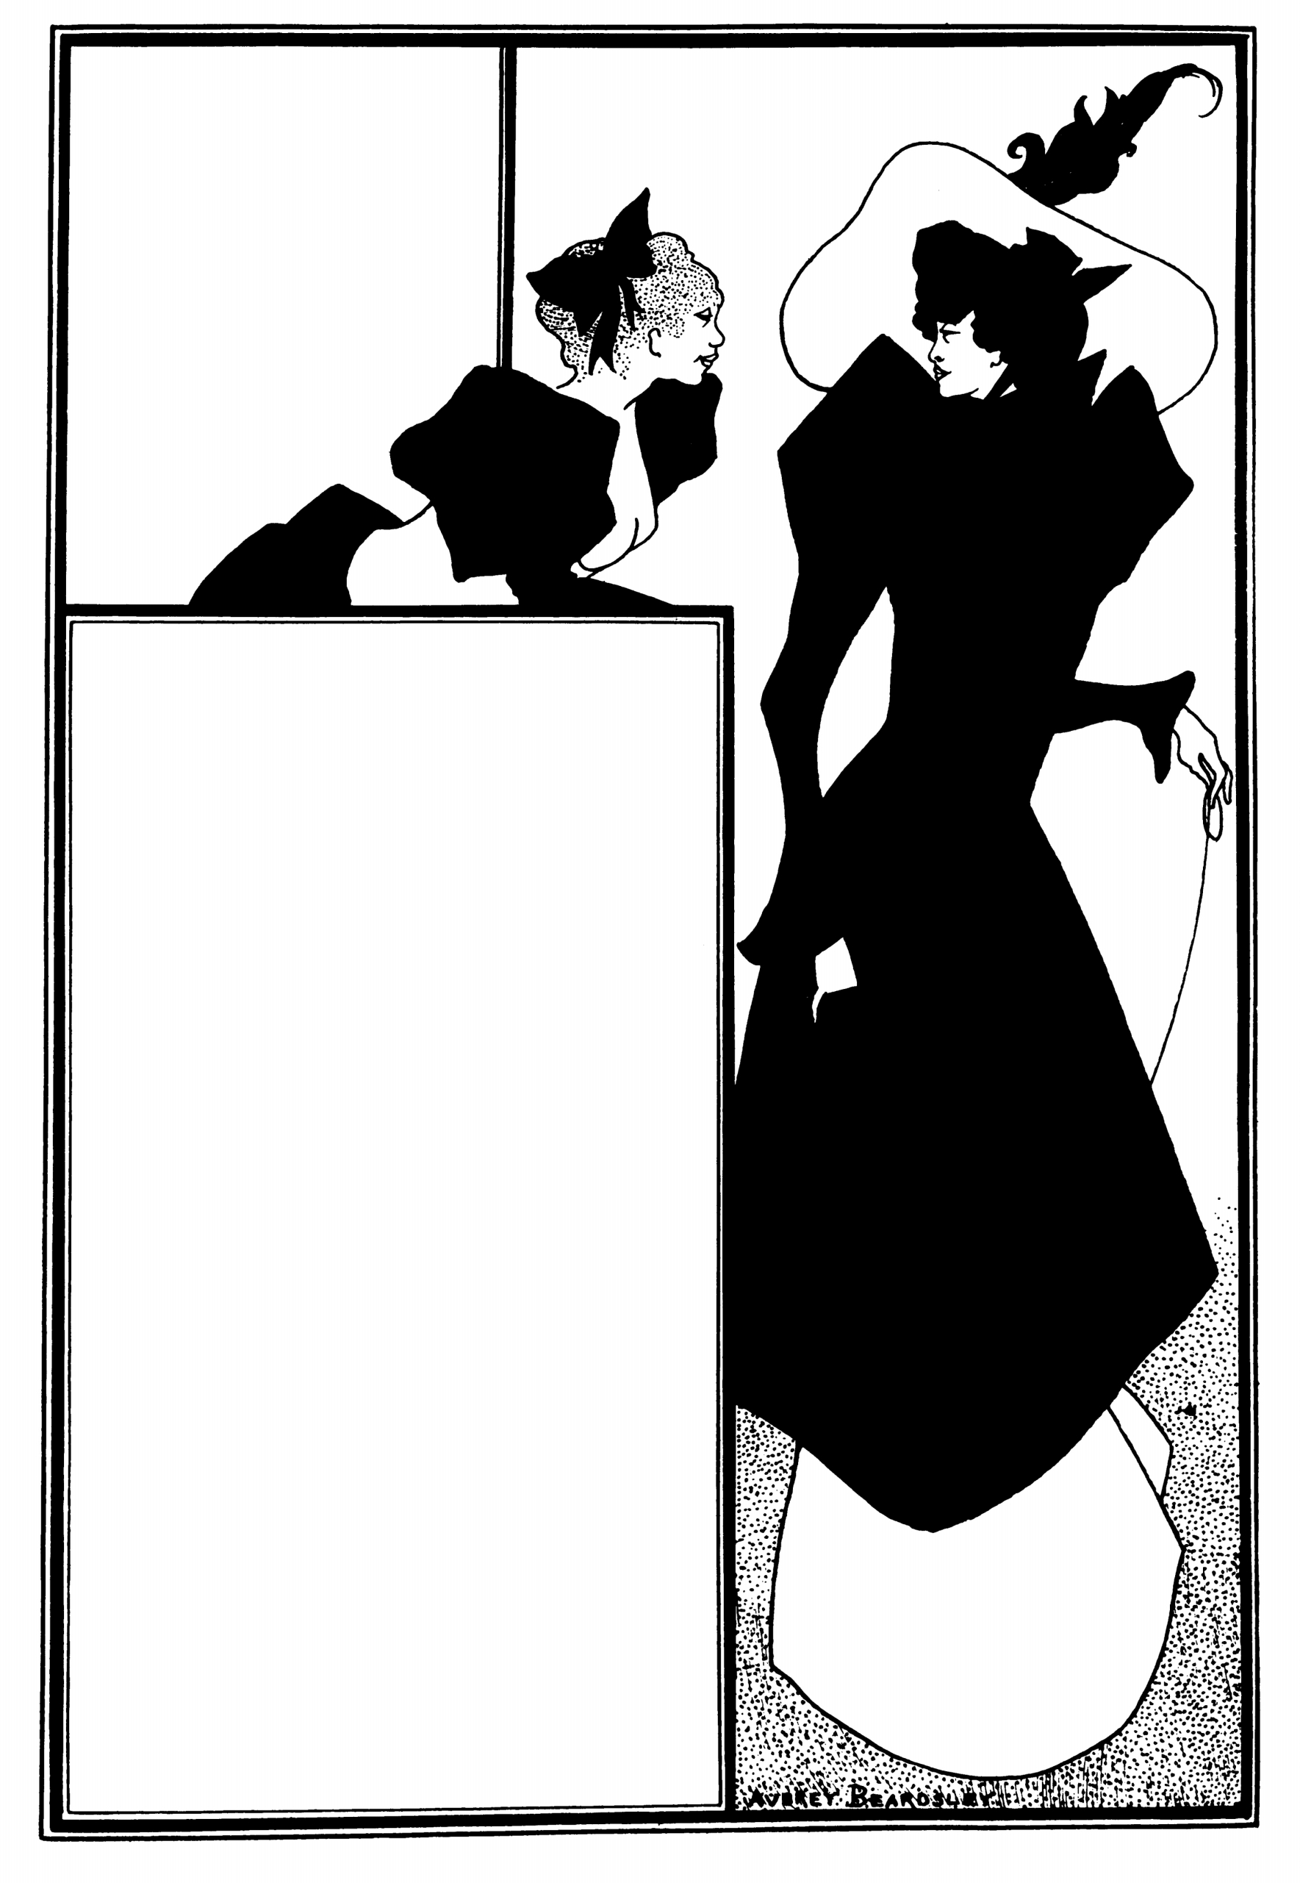
Aubrey [Vincent] Beardsley (1872–98)
Design for a Poster Advertising
The Spinster’s Scrip (1894)

Slide 11
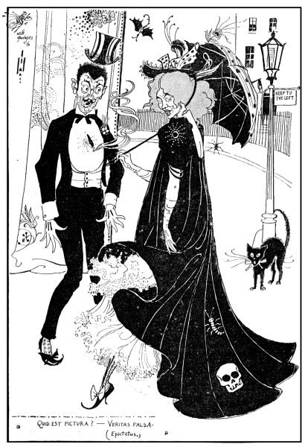
Punch cartoon, Vol. 107, p. 47
“Quid Est Pictura? — Veritas Falsa” (1894)

Slide 12
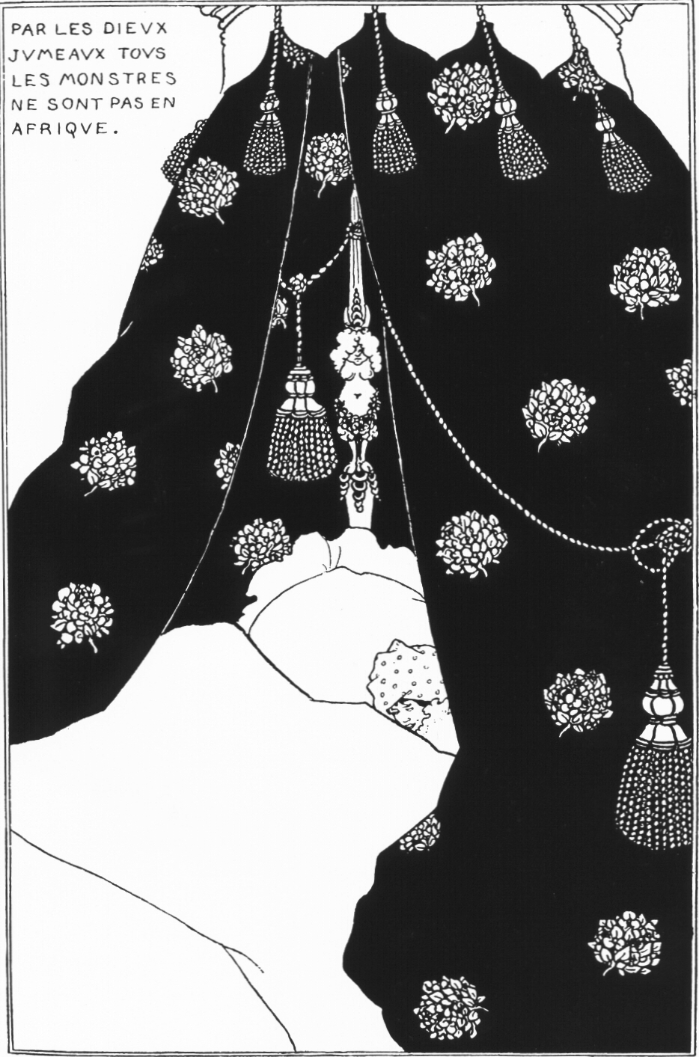
Aubrey [Vincent] Beardsley (1872–98)
Portrait of Himself (1894)

Slide 13
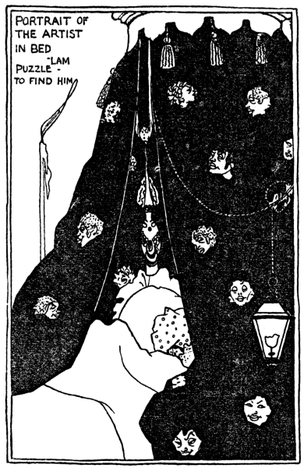
Punch cartoon, Vol. 107, p. 205
“Ars Presumptera” (1894)

Slide 14
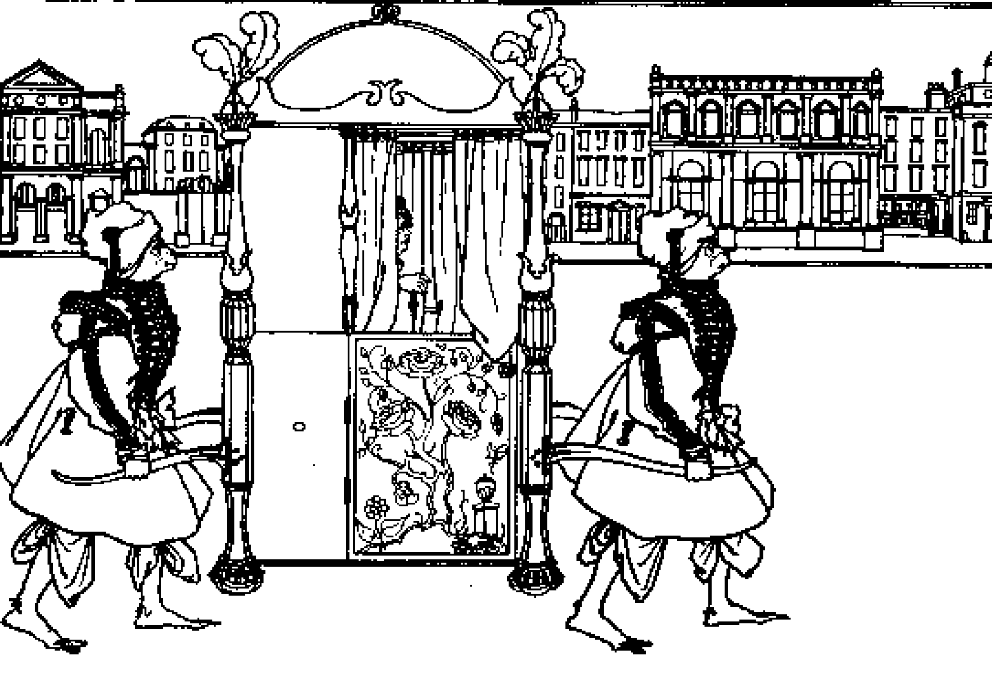
Aubrey [Vincent] Beardsley (1872–98)
Frontispiece of Juvenal (1895)

Slide 15
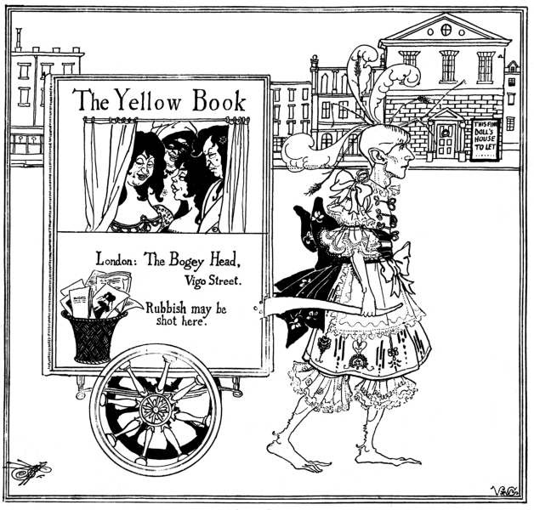
Punch cartoon, Vol. 108
“Beardsley Pulling Carriage”

Slide 16
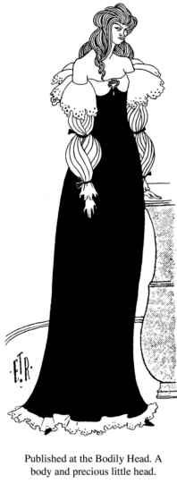
Punch cartoon, Vol. 108
“Published at the Bodily Head” (1895)

Slide 17
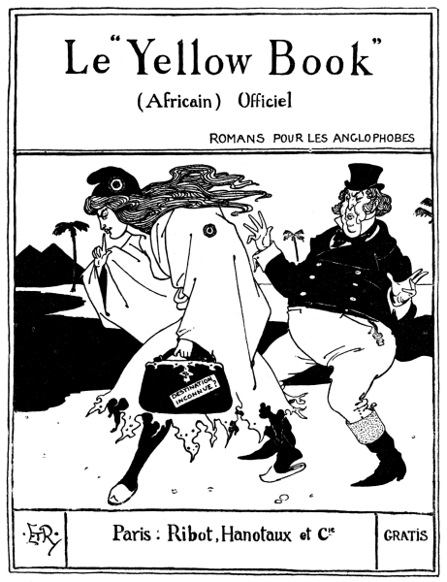
Punch cartoon, Vol. 108
“Le Yellow Book” (1895)

