Slide 1
Beardsley Caricatures and Pictures, and Punch Cartoons, Part 3
Chris Snodgrass @ 2014

Slide 2
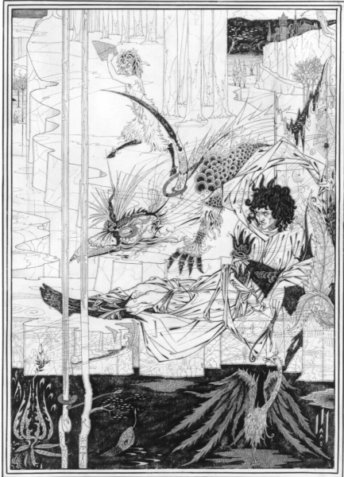
Aubrey [Vincent] Beardsley (1872–98)
How King Arthur Saw the Questing Beast (1893)

Slide 3
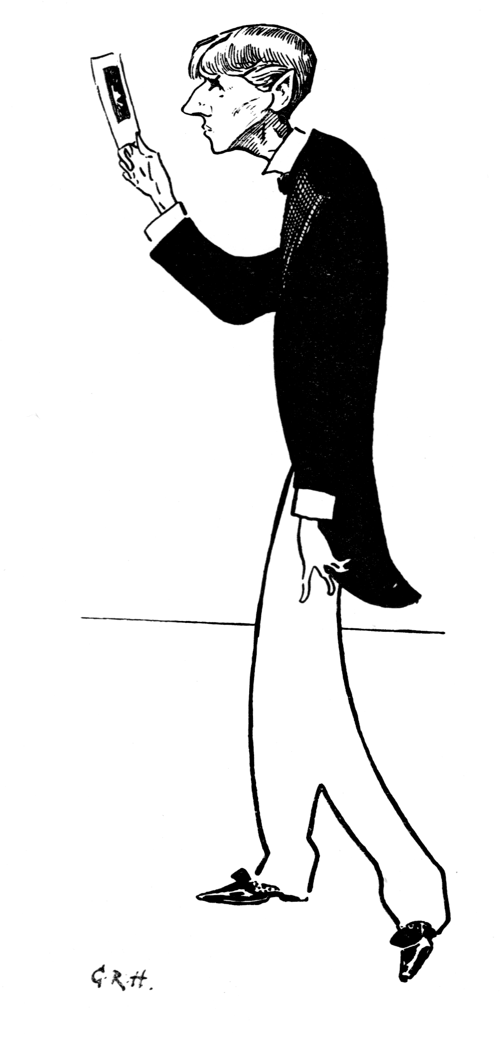
Caricature
“Beardsley Admiring Himself”

Slide 4
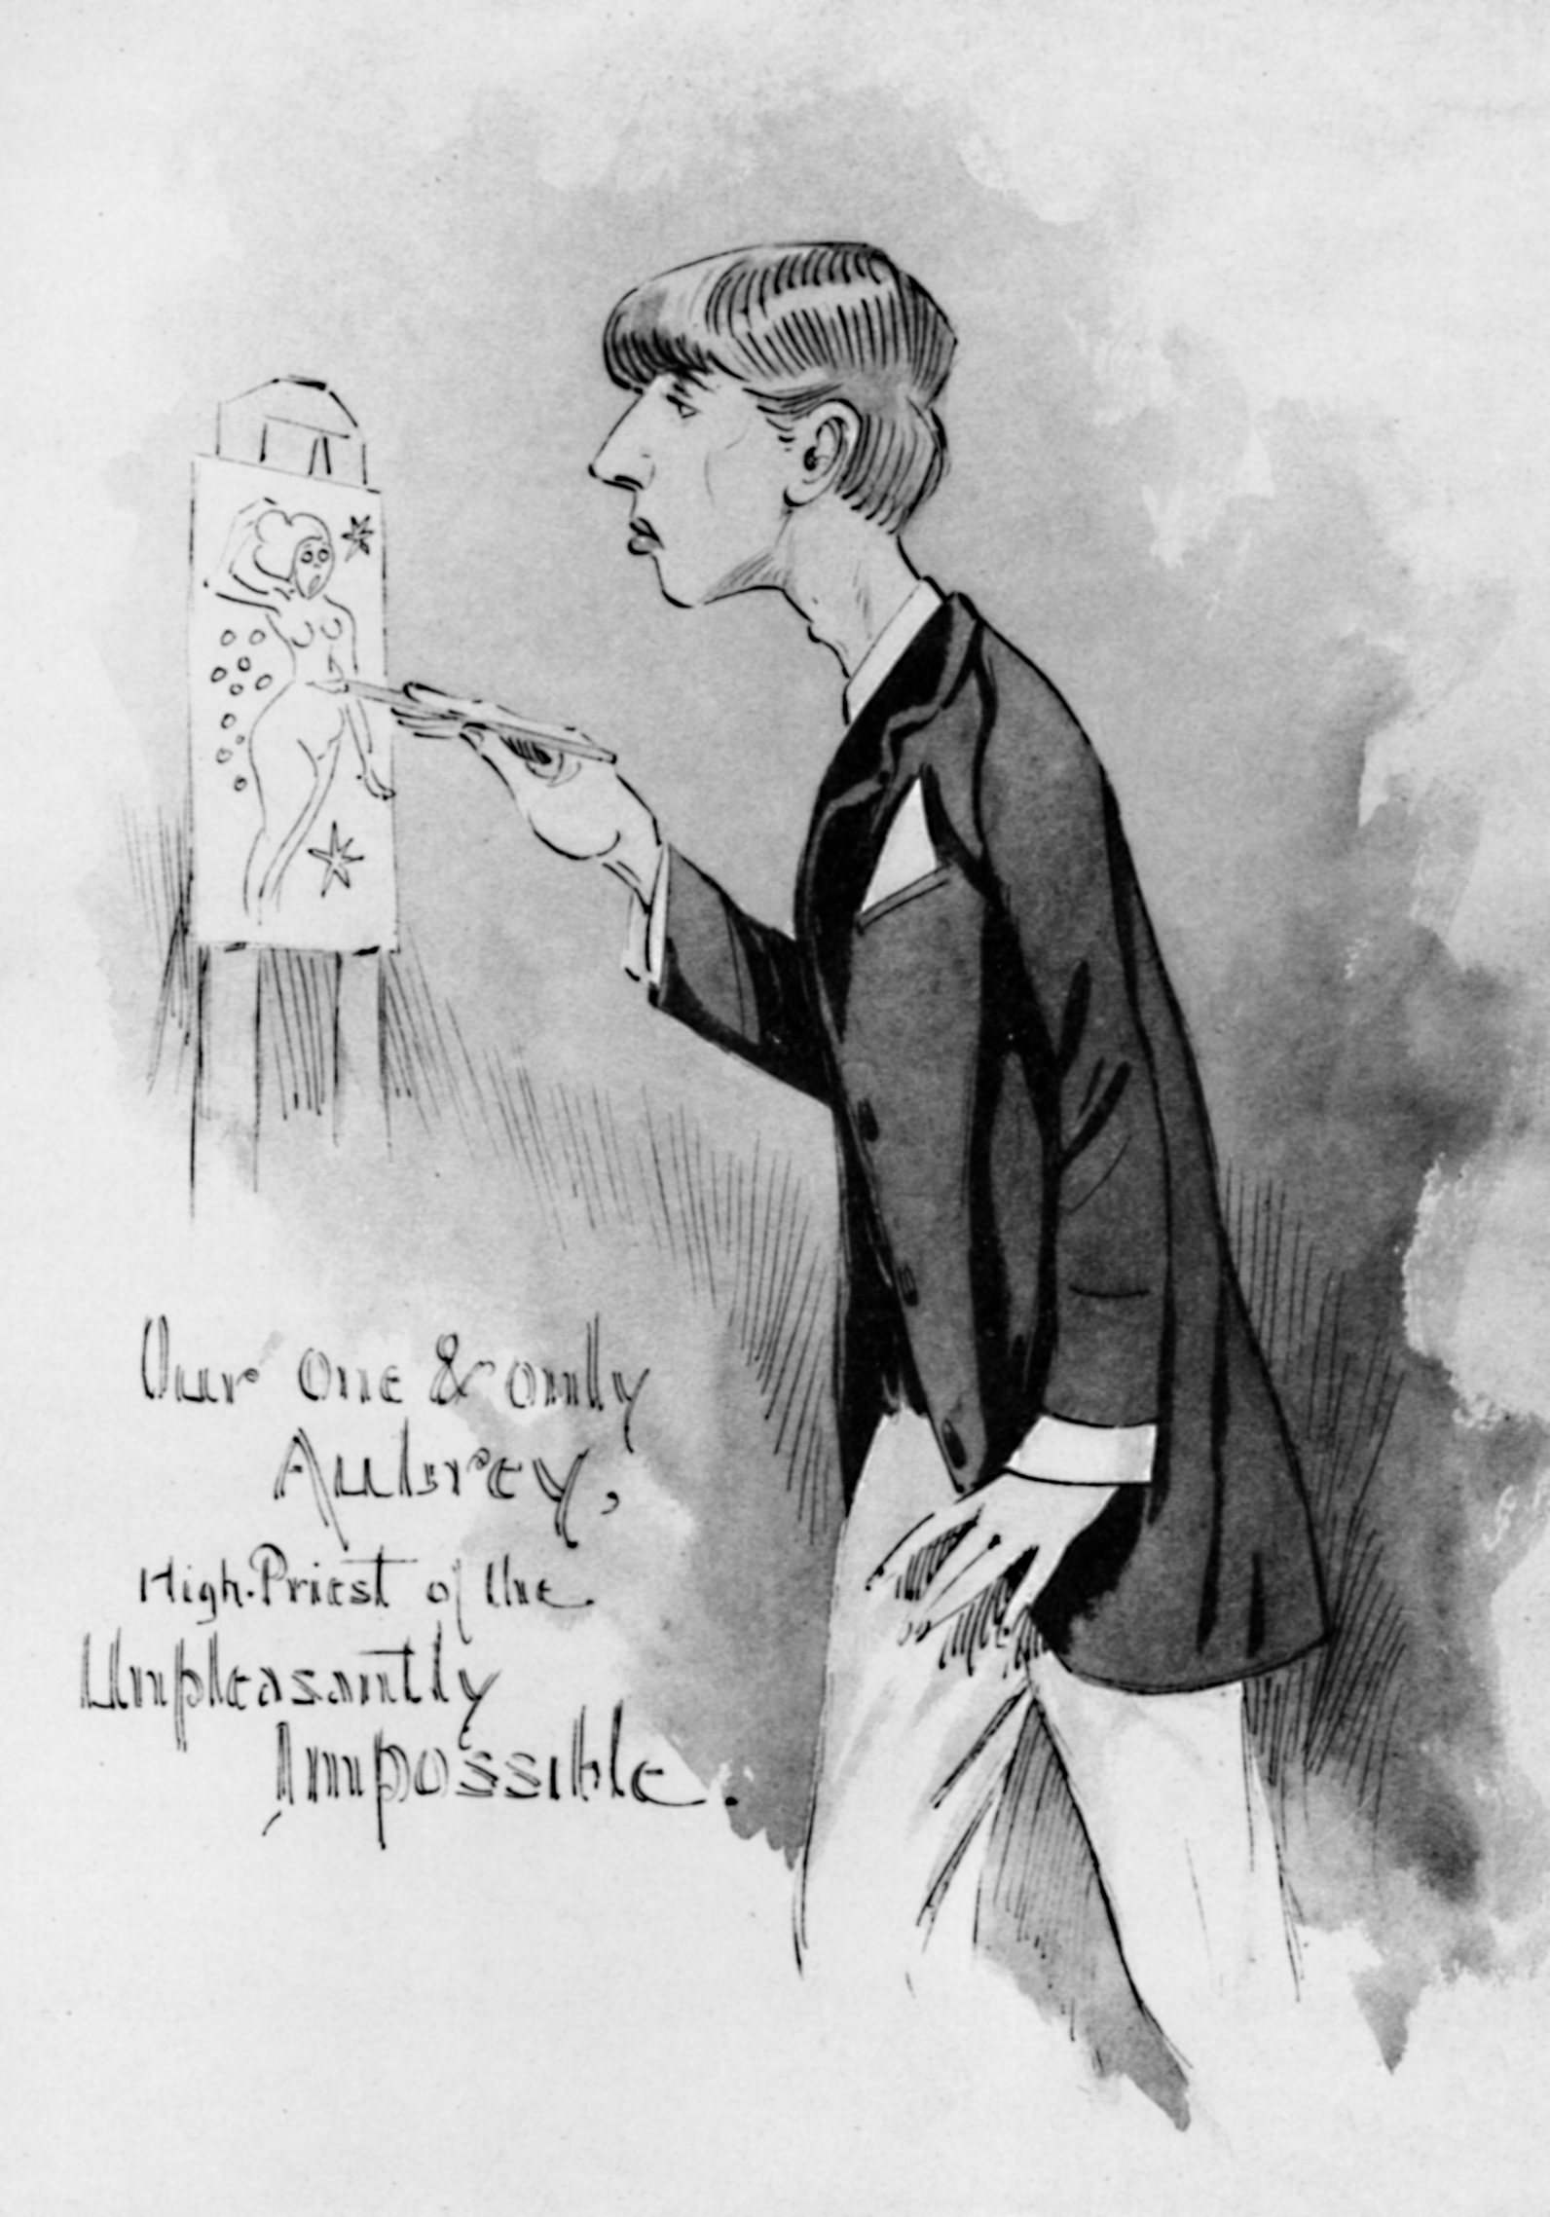
Caricature
“One and Only Aubrey”

Slide 5
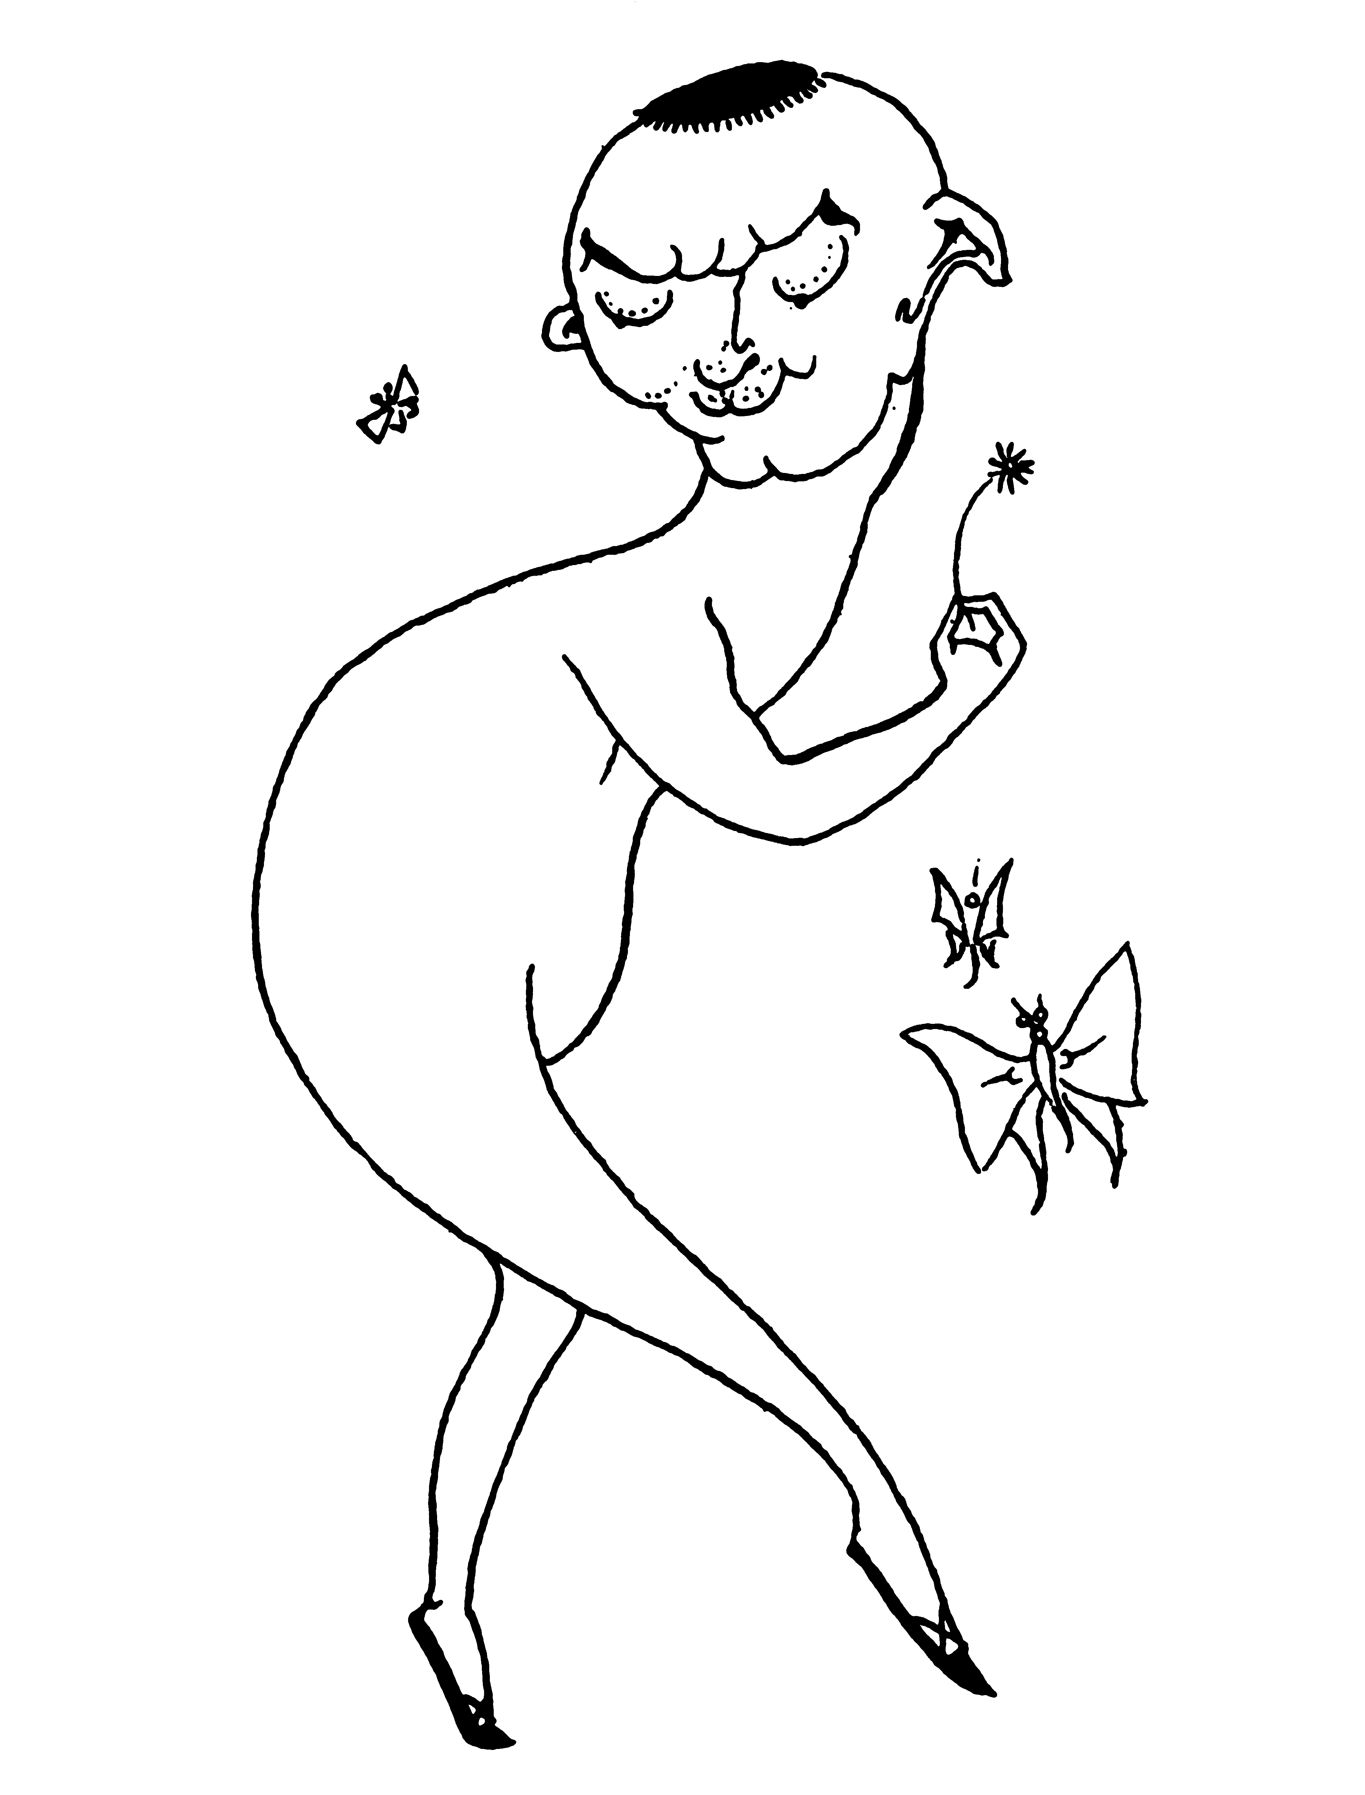
Aubrey [Vincent] Beardsley (1872 –98)
Vignette intended for the Bon-Mots series (1893–94)
[Reputed Caricature of Max Beerbohm]

Slide 6
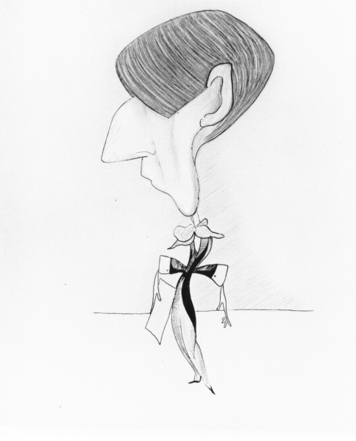
[Henry Maximilian] "Max" Beerbohm (1872–1956)
Caricature “Aubrey Beardsley”

Slide 7
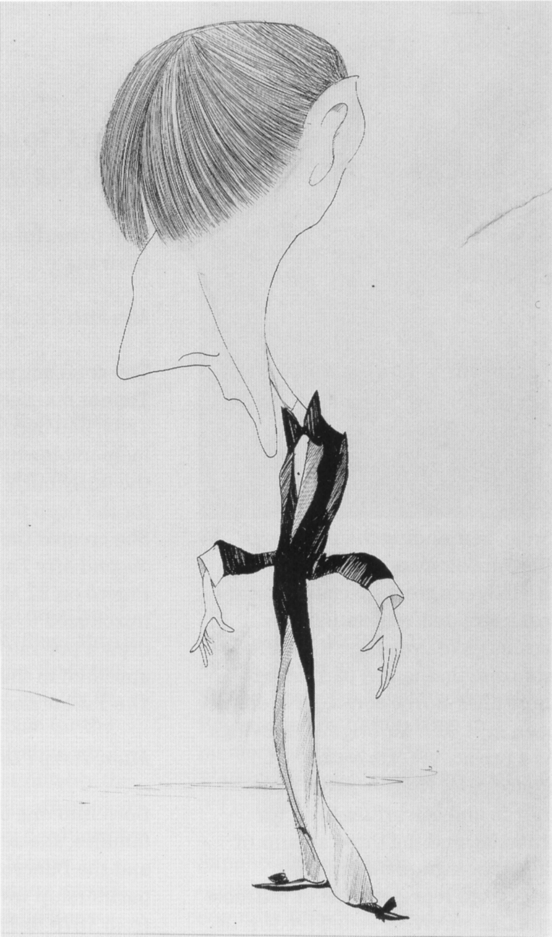
[Henry Maximilian] "Max" Beerbohm (1872–1956)
Caricature 2 “Aubrey Beardsley”

Slide 8
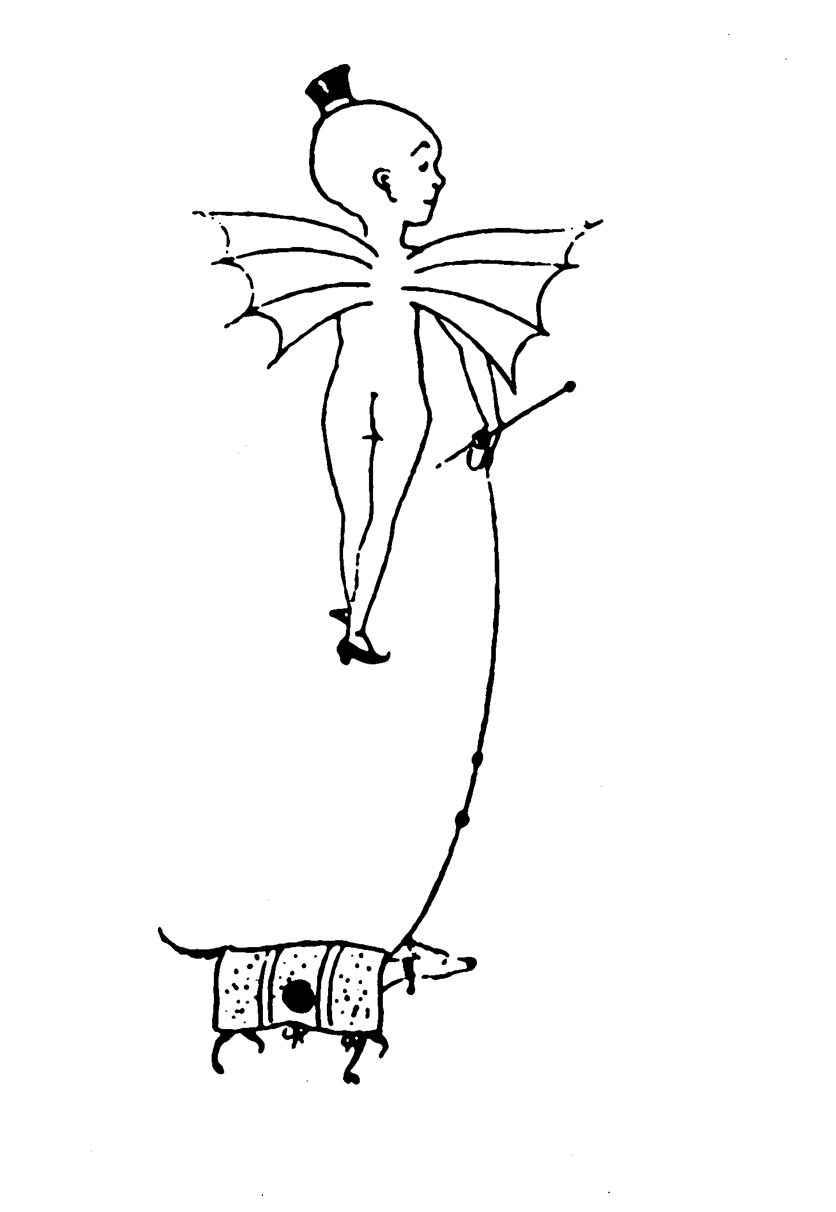
Aubrey [Vincent] Beardsley (1872 –98)
Grotesque with half-title on p. 15 of Bon-Mots of Samuel Foote and Theodore Hook (1894) [Reputed Caricature of Max Beerbohm]

Slide 9
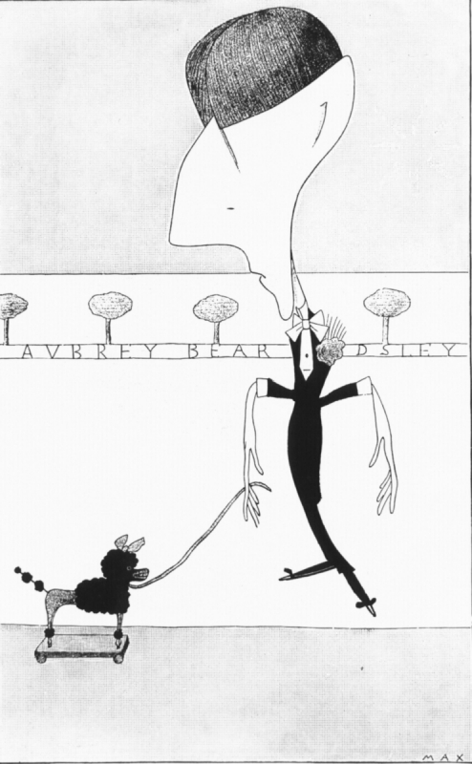
[Henry Maximilian] "Max" Beerbohm (1872–1956)
Caricature “Aubrey Bear-dsley”

Slide 10
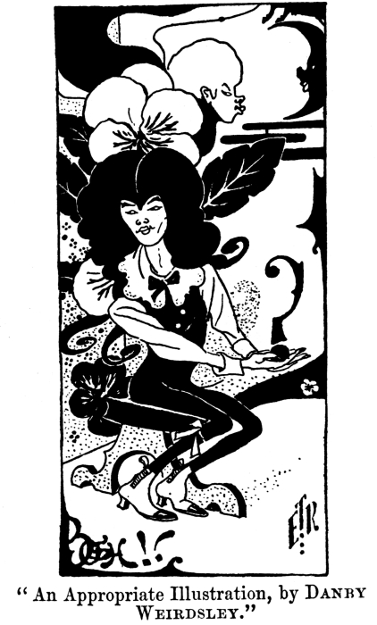
Punch cartoon, Vol. 106
“An Appropriate Illustration, by Danby Weirdsley”

Slide 11
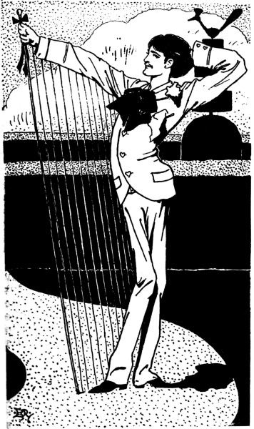
Punch cartoon, Vol. 108
“Sylvia Scarlet”

