Slide 1
19th-century Paintings: Homosexuality
Chris Snodgrass @ 2014

Slide 2
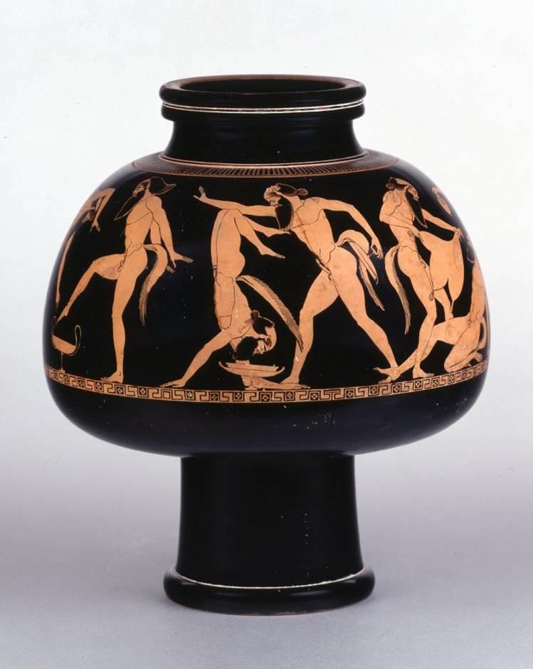
DOURIS [Greek Vase Painter] (c. 500–460 BCE)
Male Tumbling Athletes

Slide 3
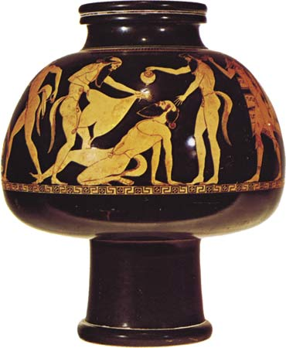
DOURIS [Greek Vase Painter] (c. 500–460 BCE)
Reveling Satyrs

Slide 4
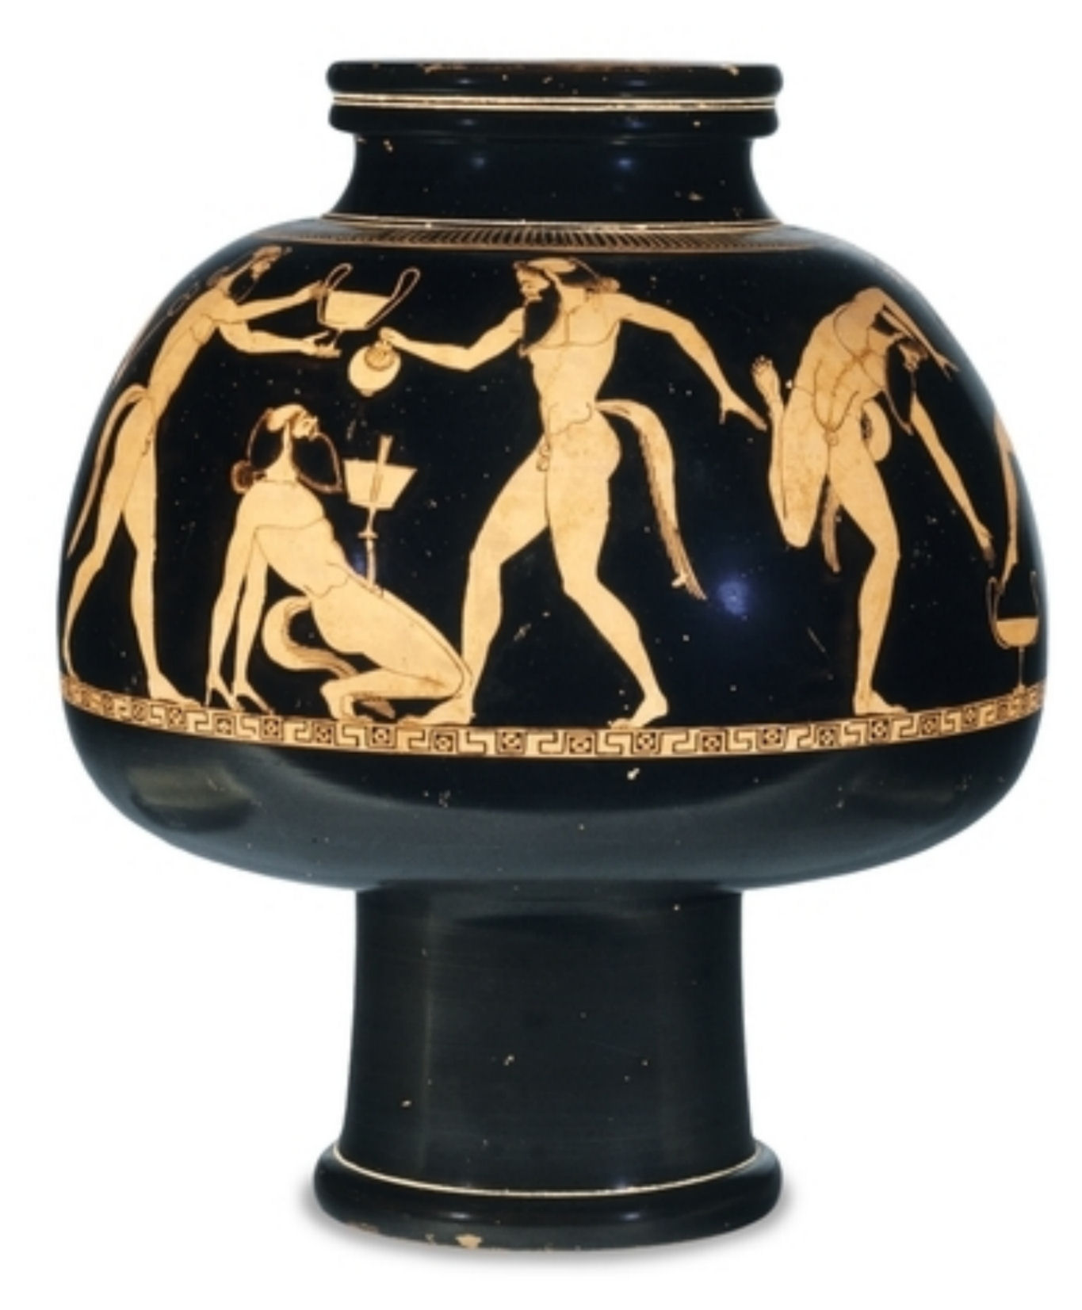
DOURIS [Greek Vase Painter] (c. 500–460 BCE)
Reveling Satyrs 2

Slide 5
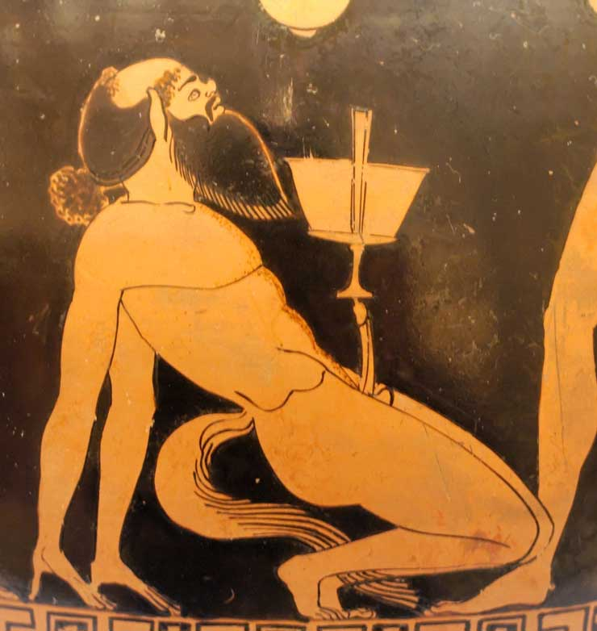
DOURIS [Greek Vase Painter] (c. 500–460 BCE)
Reveling Satyrs/Balancing Act, Detail

Slide 6
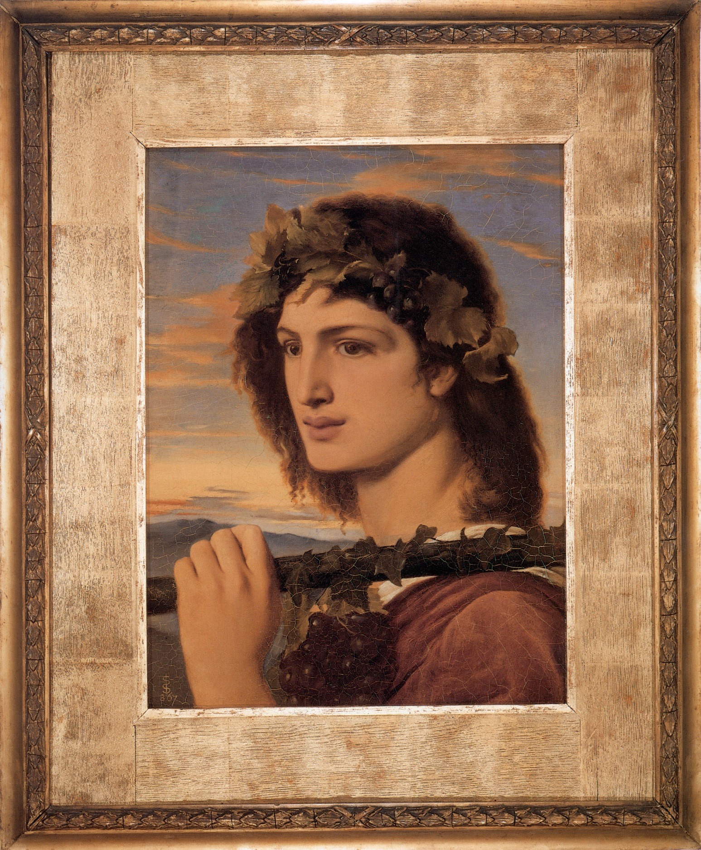
Simeon SOLOMON (1840–1905)
Bacchus (1867)

Slide 7
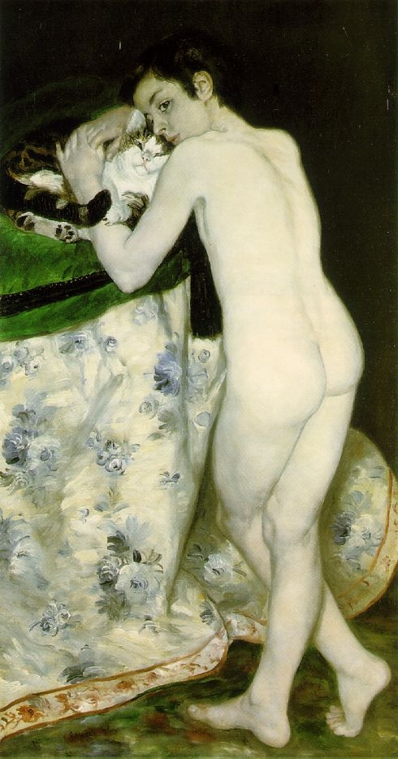
Pierre-Auguste RENOIR (1841–1919)
Young Boy with a Cat (1868–69)

Slide 8
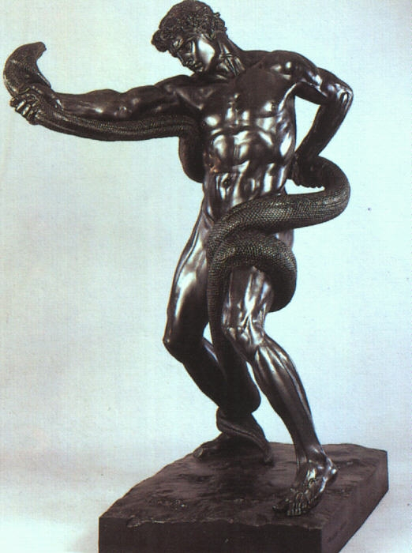
Fredric LEIGHTON (1830–96)
Athlete Struggling with a Python (1874-77)

Slide 9
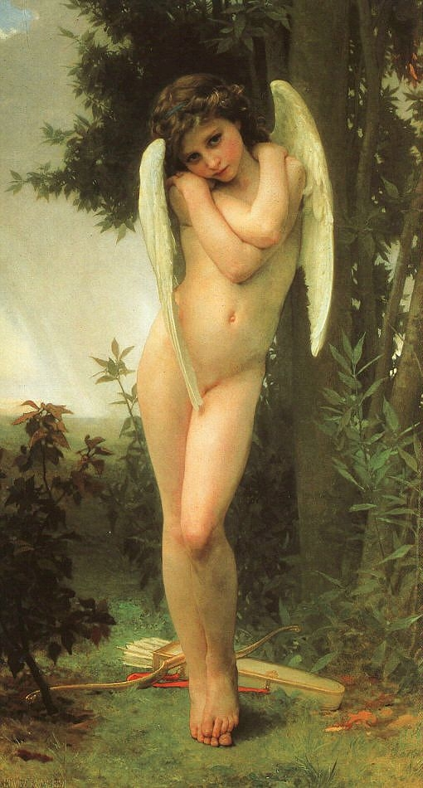
William BOUGUEREAU (1825–1905)
Cupidon (1875)

Slide 10
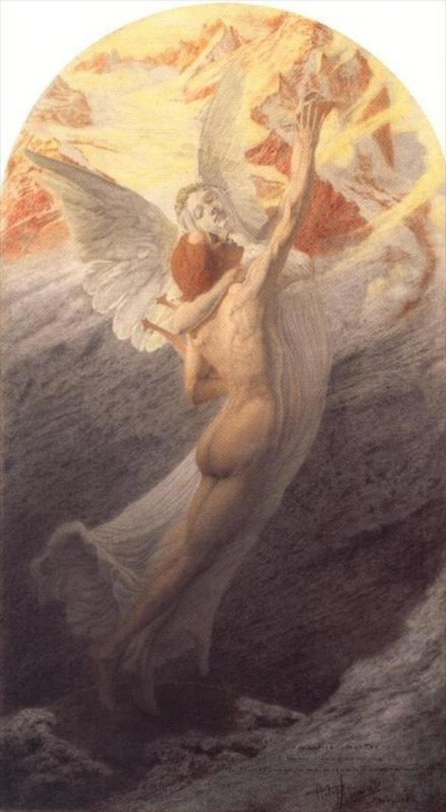
Carlos SCHWABE (1866–1926)
Les noces du poete avec la muse ou l’ideal (1902)

