Slide 1
19th-Century Paintings: Late-Victorian Aestheticism, Decadence, &
Sexual Politics
Chris Snodgrass @ 2014

Slide 2
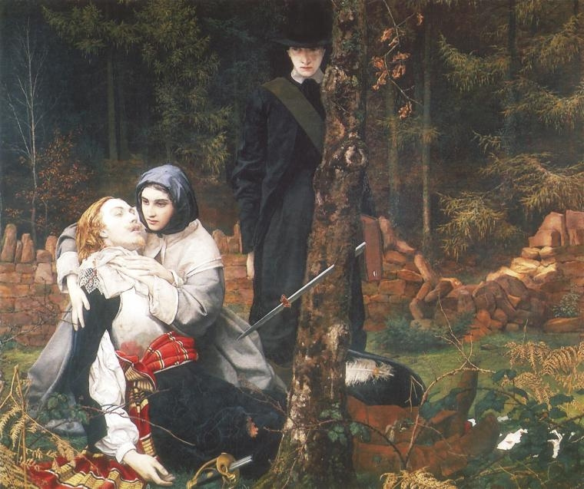
William Shakespeare BURTON
(English:; 1 June 1824 – 26 January 1916)
The Wounded Cavalier (1855)

Slide 3
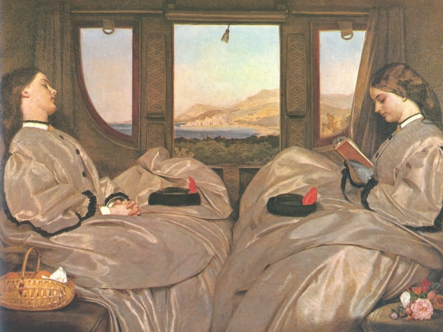
Augustus [Leopold] Egg (English; 2 May 1816 – 26 March 1863)
Travelling Companions (1862)

Slide 4
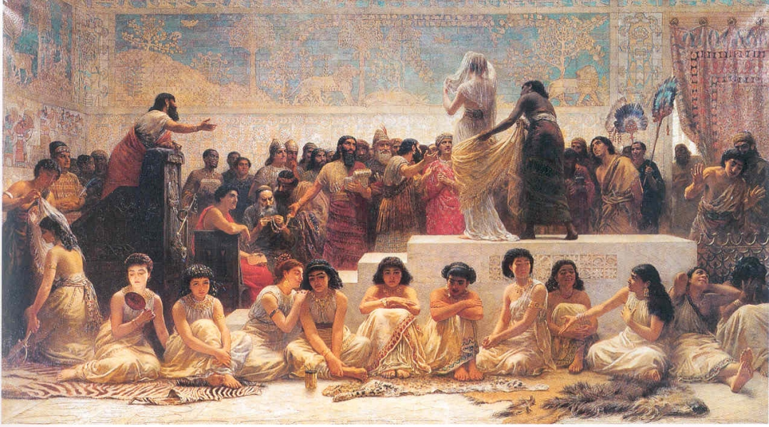
Edwin [Longsden ] LONG
(English; 12 July 1829 – 15 May 1891)
The Babylonian Marriage Market (1875)

Slide 5
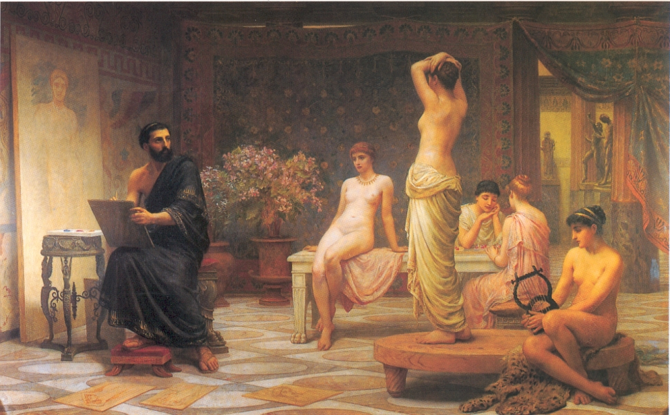
Edwin [Longsden ] LONG
(English; 12 July 1829 – 15 May 1891)The Chosen Five (1885)

Slide 6
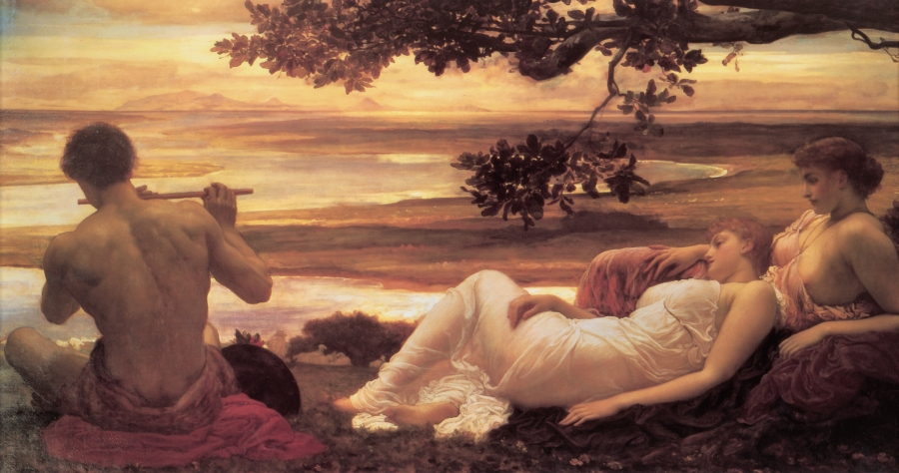
Frederic LEIGHTON (English;
3 December 1830 – 25 January 1896)
Idyll (1880–81)
Notes:
Change

Slide 7
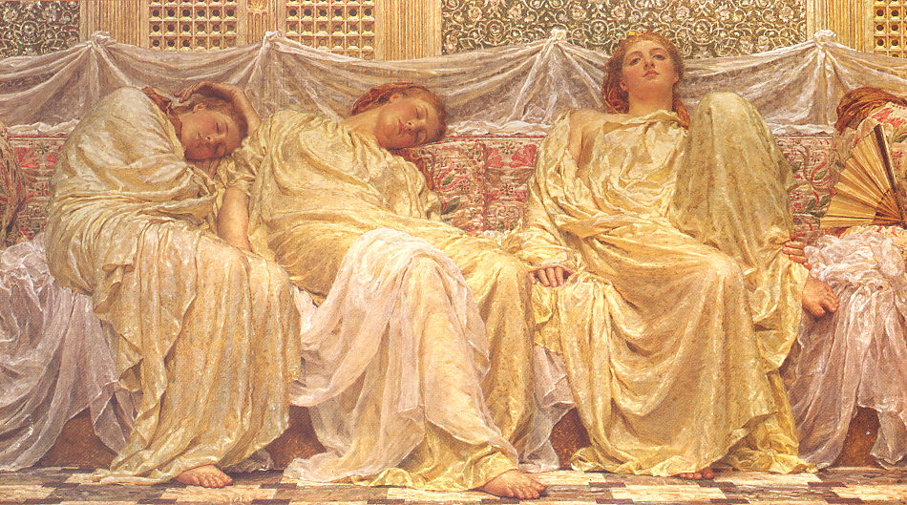
Albert Joseph MOORE
(English; 4 September 1841 – 25 September 1893)
Dreamers (1879–82)

Slide 8
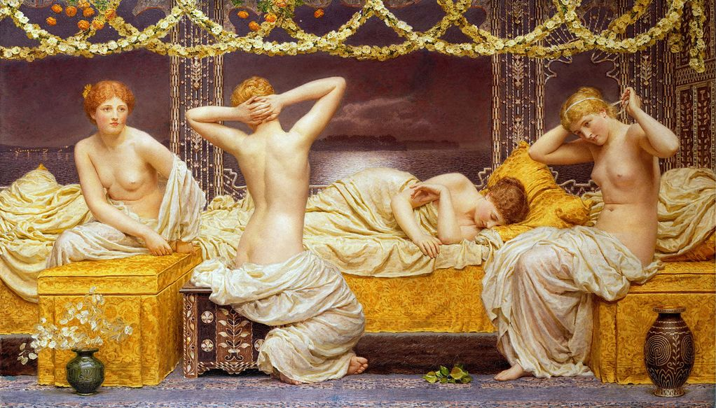
Albert Joseph MOORE
(English; 4 September 1841 – 25 September 1893)
A Summer Night (1887–90)

Slide 9
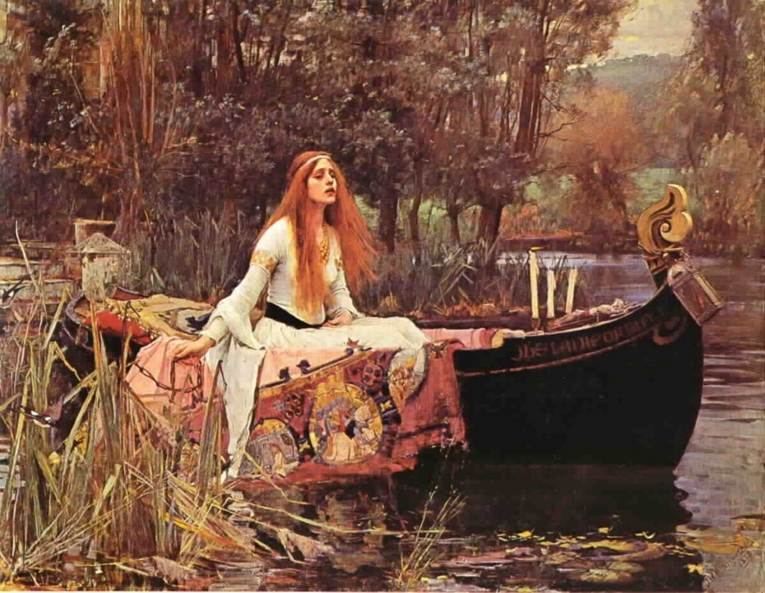
John [William] WATERHOUSE
(English; baptised, 6 April 1849 — died, 10 February 1917)
The Lady of Shalott (1888))

Slide 10
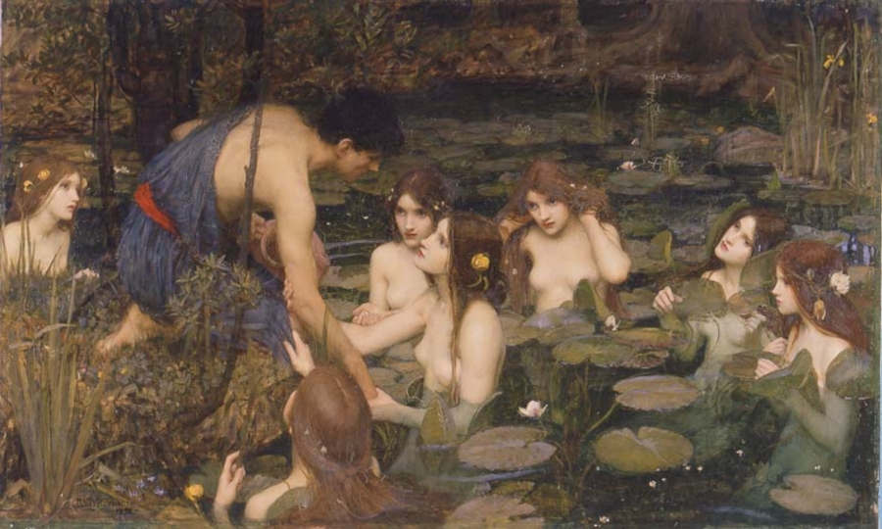
John [William] WATERHOUSE (English; baptised, 6 April 1849 — died, 10 February 1917)
Hylas and the Nymphs (1896)

Slide 11
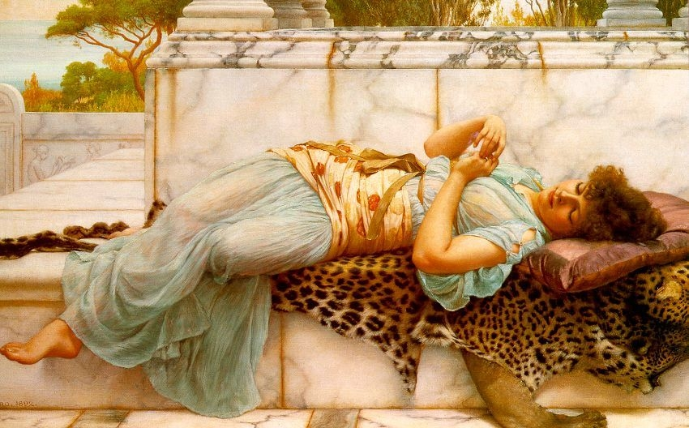
John William GODWARD (English; 9 August 1861 – 13 December 1922)
The Betrothed (1892)

Slide 12
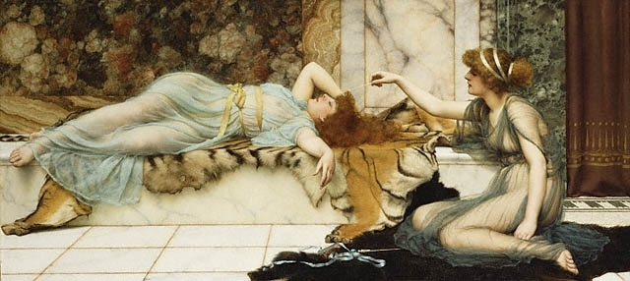
John William GODWARD
(English; 9 August 1861 – 13 December 1922)
Mischief and Repose (1895)

