Slide 1
19th-Century Paintings: Late-Victorian Aestheticism, Decadence, &
Sexual Politics
Chris Snodgrass @ 2014

Slide 2
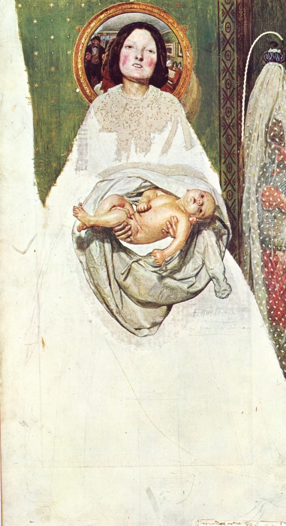
Ford Madox BROWN
(English; 16 April 1821 – 6 October 1893)
“Take Your Son, Sir!” (1851–92)

Slide 3
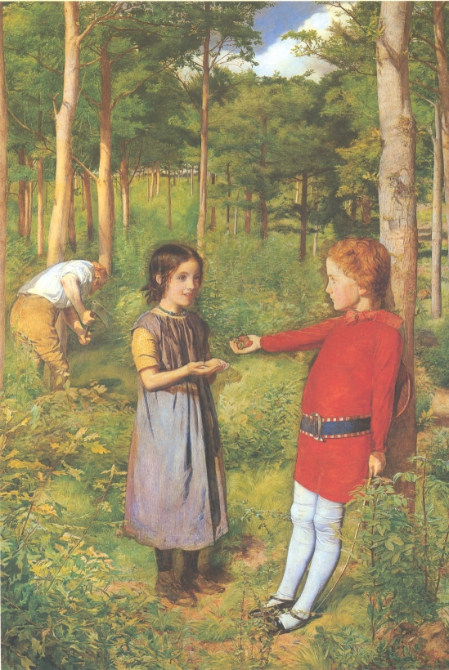
John Everett MILLAIS (English;
8 June 1829 – 13 August 1896)
The Woodman’s Daughter (1851)

Slide 4
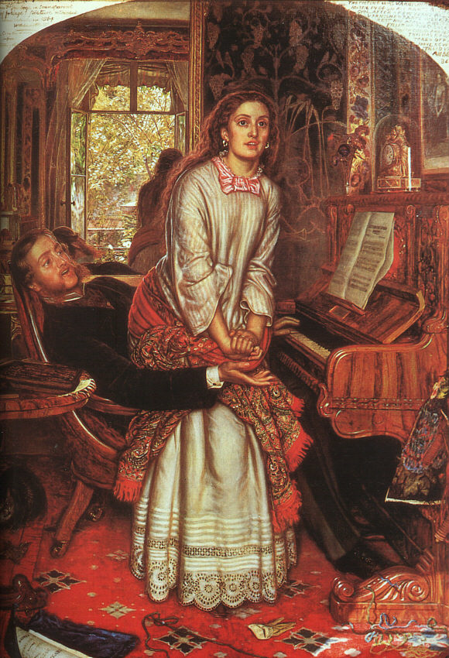
William Holman HUNT (English;
2 April 1827 – 7 September 1910) The Awakening Conscience (1853)

Slide 5
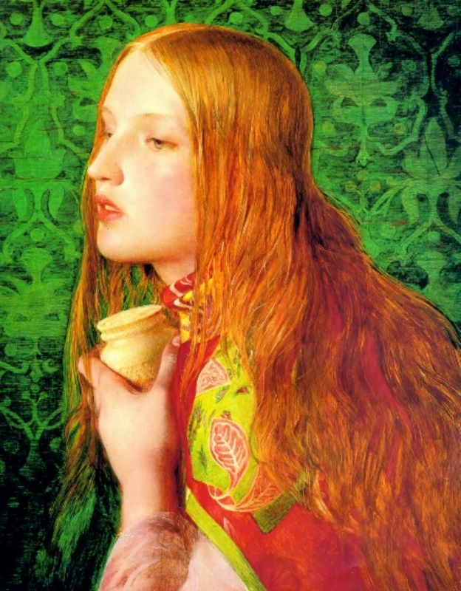
[Anthony] Frederick [Augustus] SANDYS
(born Antonio Frederic Augustus Sands)
(English; 1 May 1829–25 June 1904)
Mary Magdalene (1858–60)

Slide 6
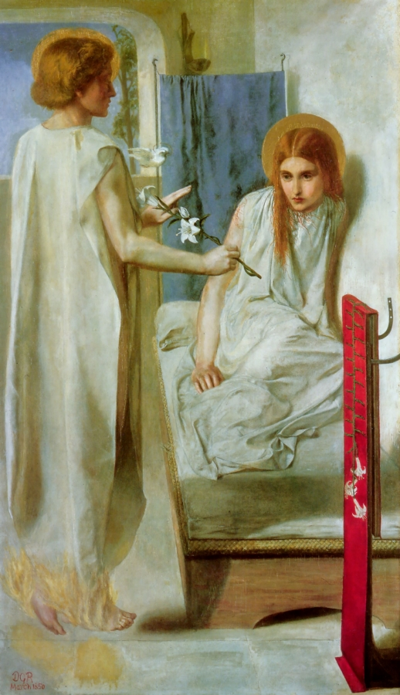
Dante Gabriel ROSSETTI (English;
12 May 1828 – 9 April 1882)
Ecce Ancilla Domini (1850)

Slide 7
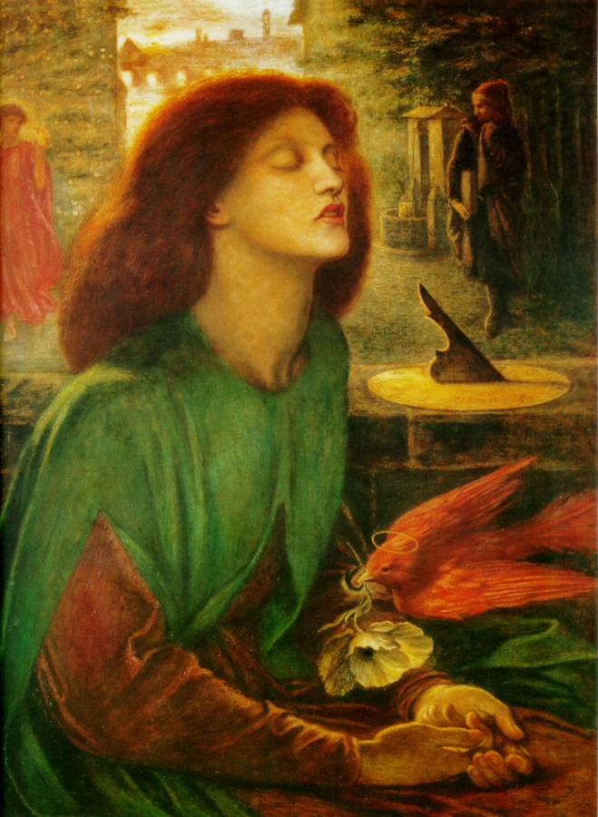
Dante Gabriel ROSSETTI (English;
12 May 1828 – 9 April 1882)
Beata Beatrix (1864–70)

Slide 8
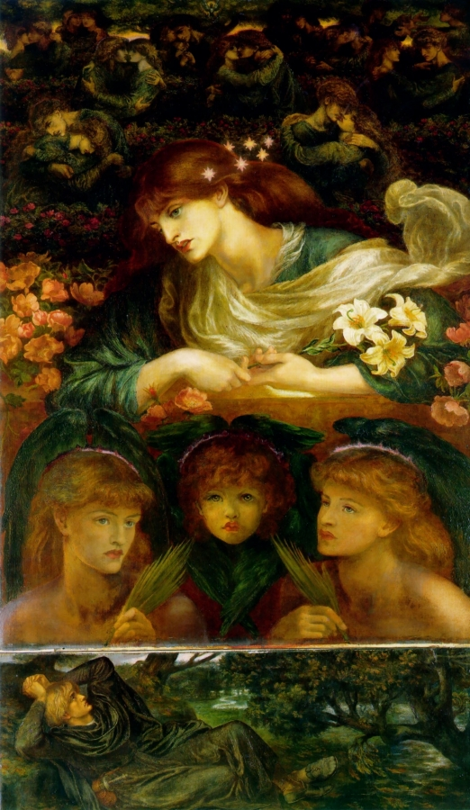
Dante Gabriel ROSSETTI (English;
12 May 1828 – 9 April 1882)
The Blessed Damozel (1875–78)

Slide 9
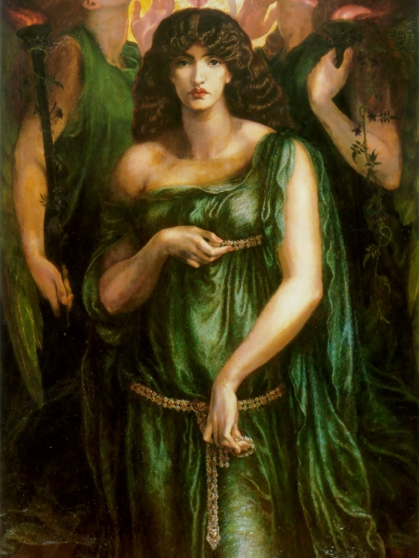
Dante Gabriel ROSSETTI (English;
12 May 1828 – 9 April 1882)
Astarte Syriaca (1877)

Slide 10
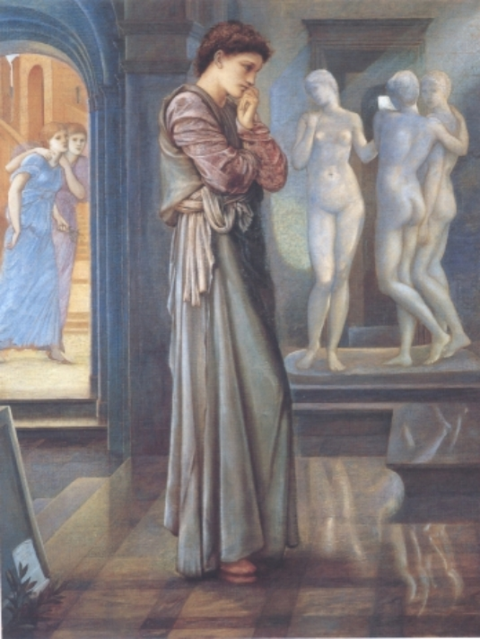
Edward Coley BURNE-JONES
(English; 28 August 1833 – 17 June 1898)
Pygmalion & the Image:
The Heart Desires (1868-78)

Slide 11
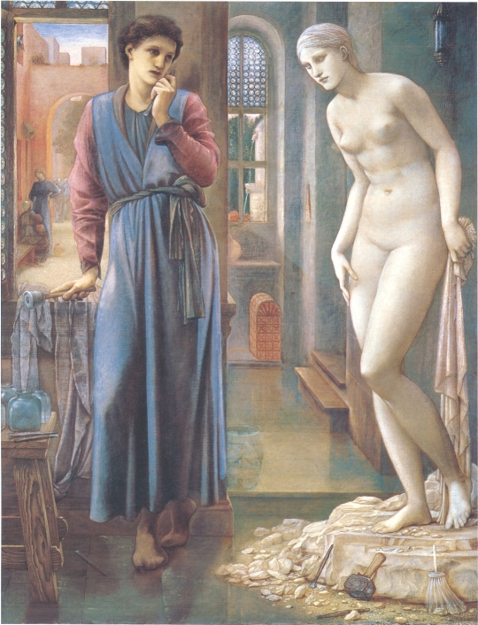
Edward Coley BURNE-JONES
(English; 28 August 1833 – 17 June 1898)
Pygmalion & the Image:
The Hand Refrains (1868–78)

Slide 12
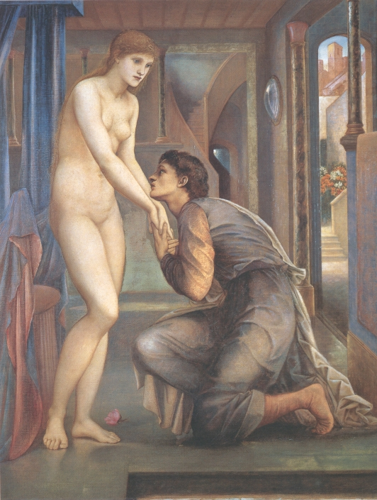
Edward Coley BURNE-JONES
(English; 28 August 1833 – 17 June 1898)
Pygmalion & the Image:
The Soul Attains (1868–78)

Slide 13
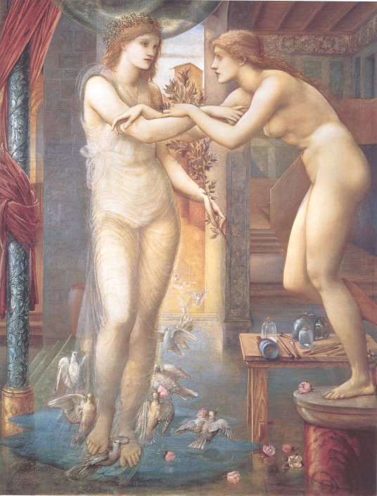
Edward Coley BURNE-JONES
(English; 28 August 1833 – 17 June 1898)
Pygmalion & the Image:
The Godhead Fires (1868–78)

Slide 14
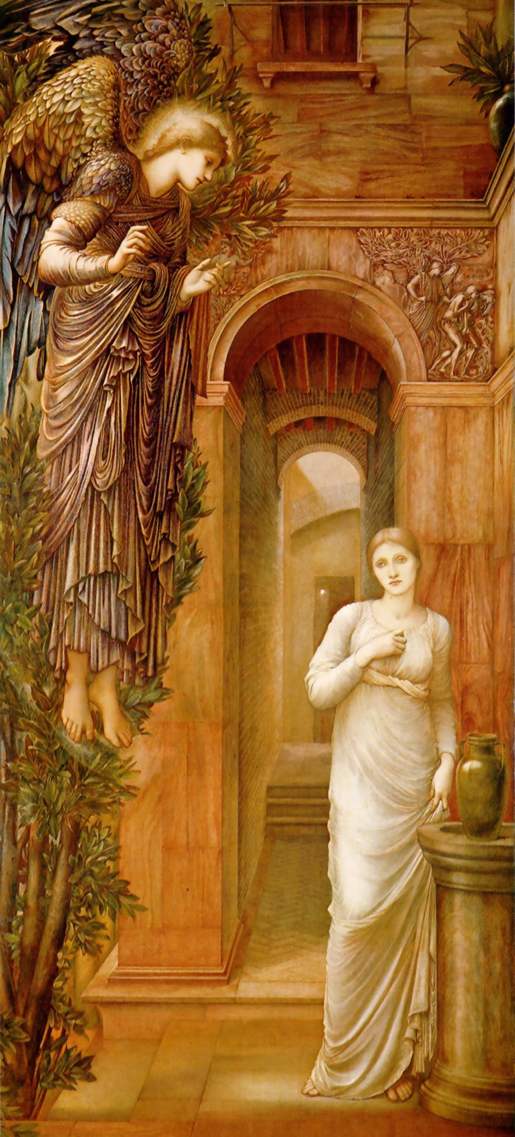
Edward Coley BURNE-JONES
(English; 28 August 1833 – 17 June 1898)
The Annunciation (1879)

Slide 15
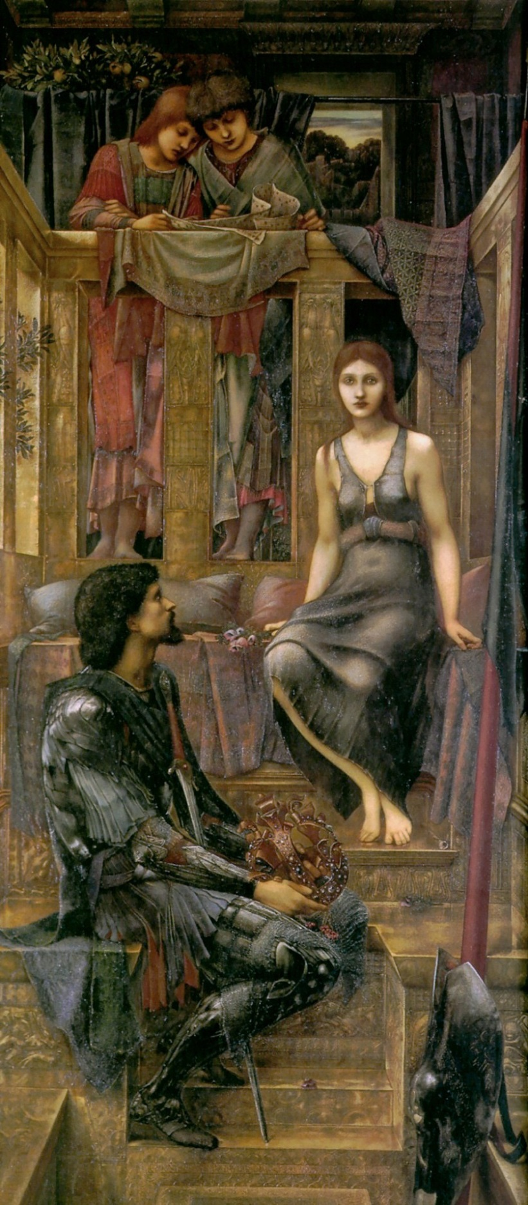
Edward Coley BURNE-JONES
(English; 28 August 1833 – 17 June 1898)
King Cophetua and the Beggar Maid (1884)

Slide 16
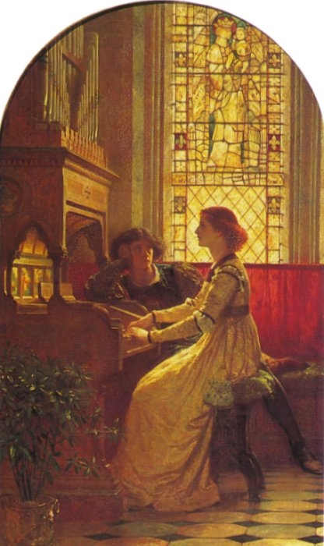
Frank [Bernard] Dicksee (English; b. London, 27 November 1853 – 17 October 1928)
Harmony (1877)

Slide 17
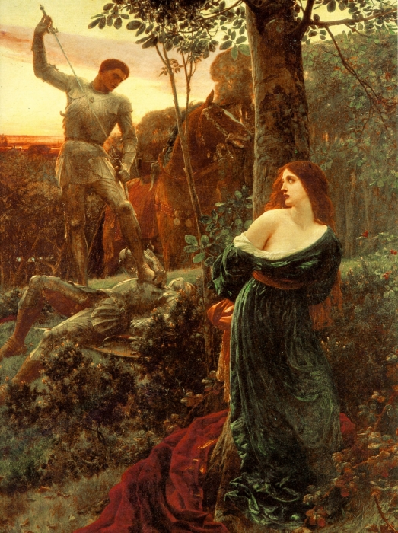
Frank [Bernard] Dicksee (English; b. London, 27 November 1853 – 17 October 1928)
Chivalry (1885)

Slide 18
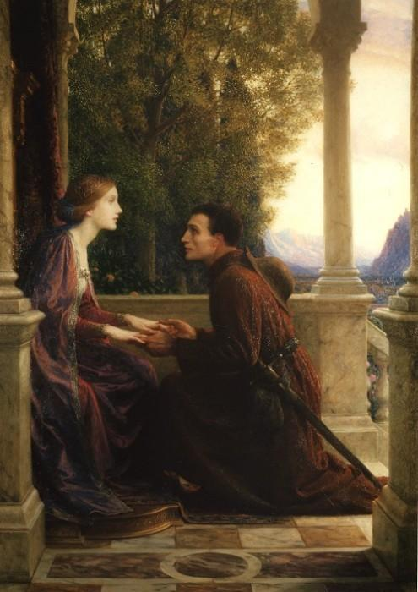
Frank [Bernard] Dicksee (English; b. London, 27 November 1853 – 17 October 1928)
The End of the Quest (1921)

Slide 19
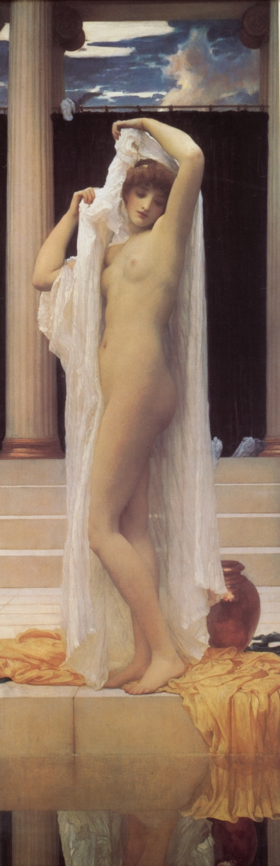
Fredric LEIGHTON (English;
3 December 1830 – 25 January 1896)
Bath of Psyche (c. 1890)

Slide 20
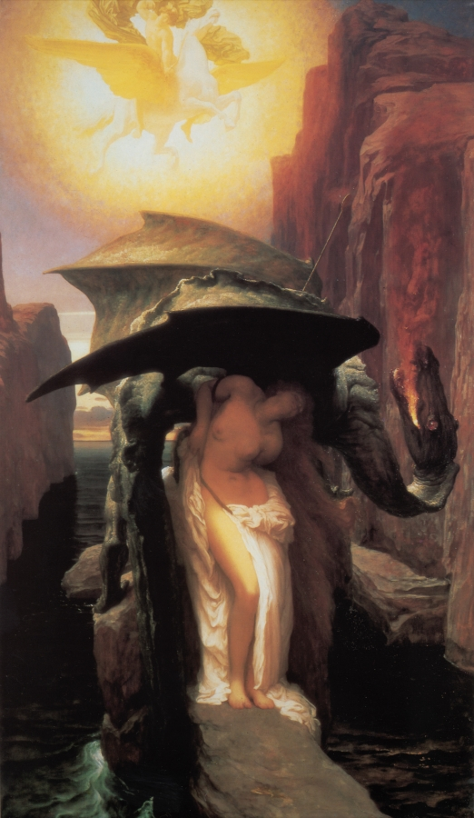
Frederic LEIGHTON (English;
3 December 1830 – 25 January 1896) Perseus and Andromeda (1891-94)

Slide 21
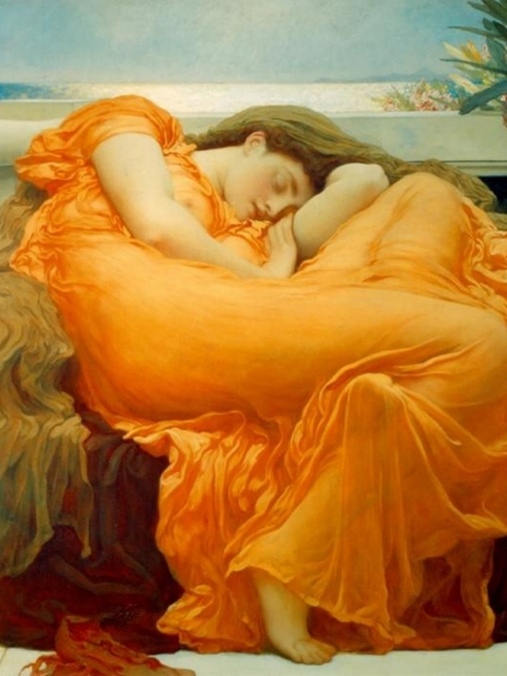
Frederic LEIGHTON (English;
3 December 1830 – 25 January 1896)
Flaming June (1895)

Slide 22
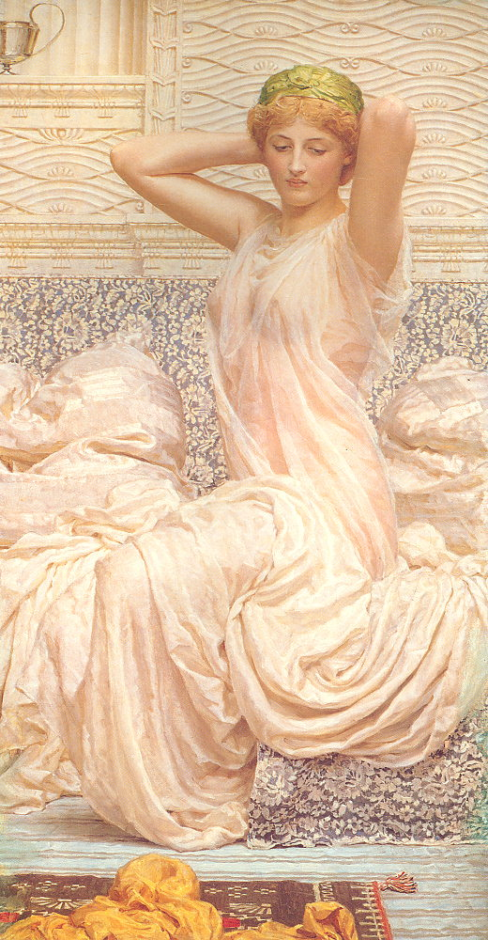
Albert Joseph MOORE (English;
4 September 1841 – 25 September 1893)
Silver (1886)

Slide 23
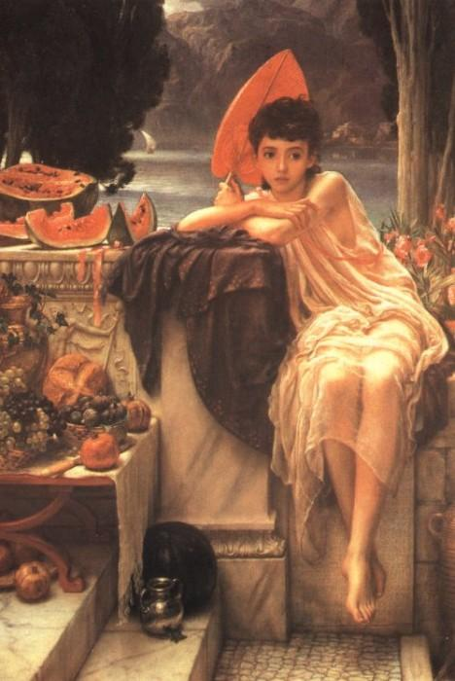
Edward John POYNTER (English;
20 March 1836 – 26 July 1919)
On the Temple Steps (1889)

Slide 24
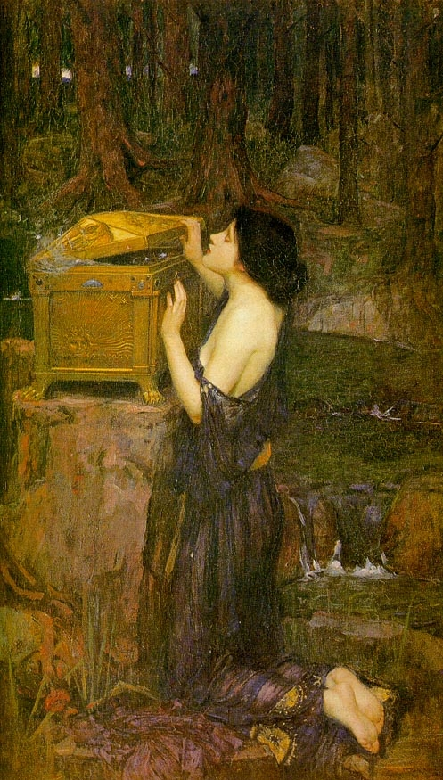
John [William] WATERHOUSE (English; baptised, 6 April 1849 — died, 10 February 1917)
Pandora (1896)

Slide 25
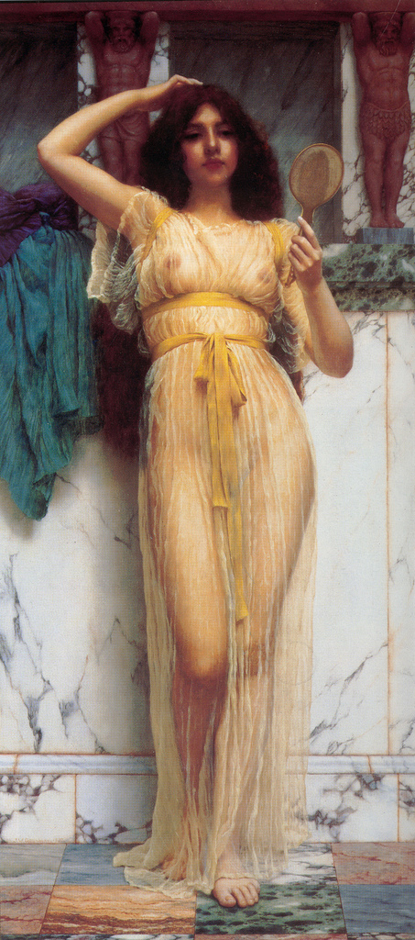
John William GODWARD (English;
9 August 1861 – 13 December 1922) The Mirror, or Contemplation (1899)

Slide 26
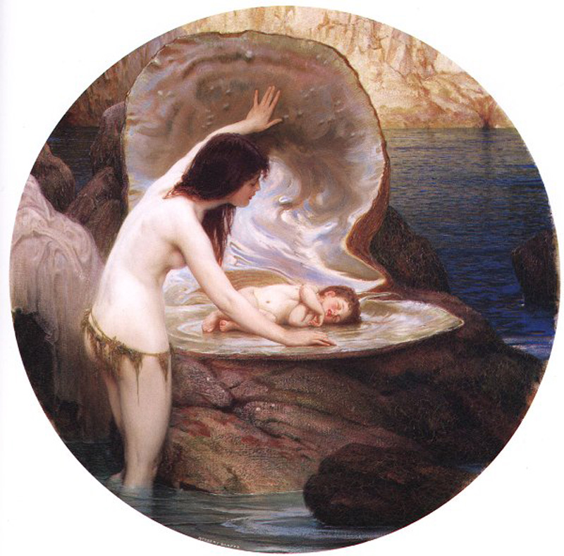
Herbert [James] DRAPER (English; 1863 – 22 September 1920)
A Water Baby (1900)

Slide 27
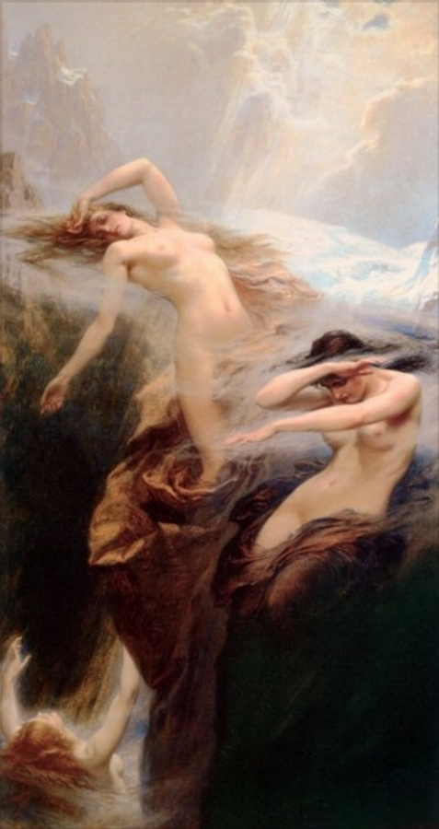
Herbert [James] DRAPER (English; 1863 – 22 September 1920)
Clyties of the Mist (1912)

Slide 28
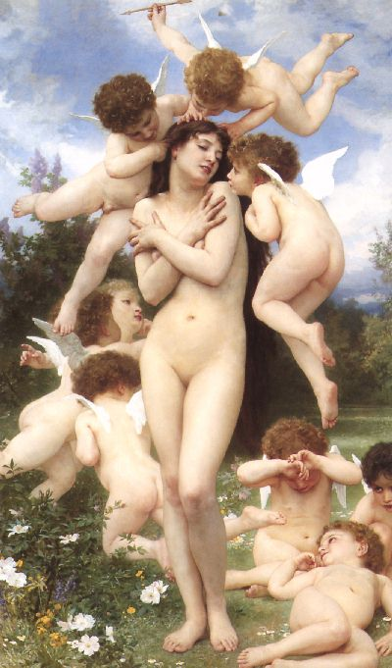
William-Adolphe BOUGUEREAU (French: November 30, 1825 – August 19, 1905)
Le Printemps [The Return of Spring] (1866)

Slide 29
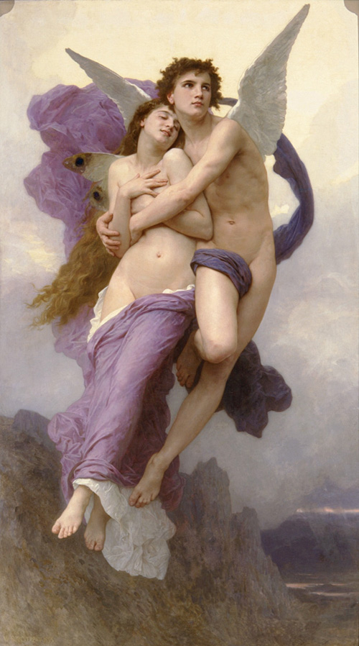
William-Adolphe BOUGUEREAU (French: November 30, 1825 – August 19, 1905)
The Abduction of Psyche (1895)

