Slide 1
The New Woman and Punch Cartoons
Chris Snodgrass @ 2014

Slide 2
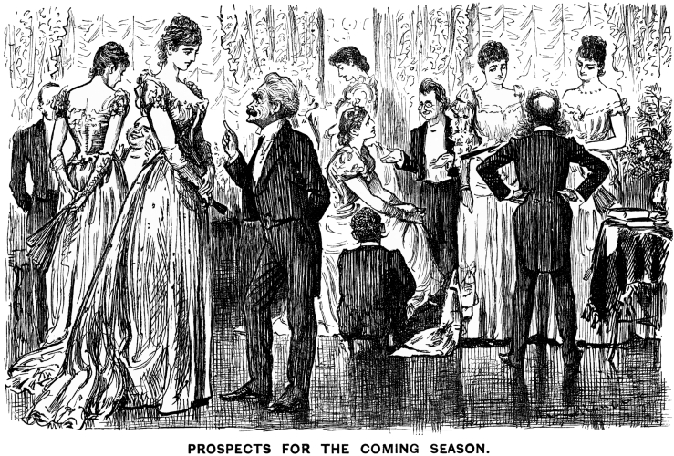
Punch cartoon, Vol. 98, p. 147
“Prospects for the Coming Season”

Slide 3
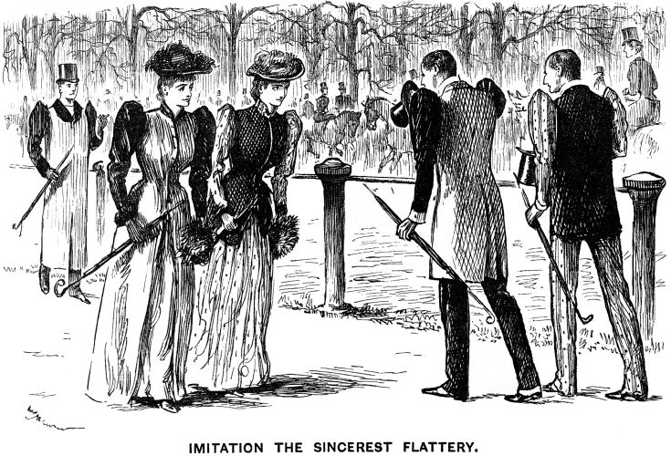
Punch cartoon, Vol. 98, p. 162
“Imitation Is the Sincerest Flattery”

Slide 4
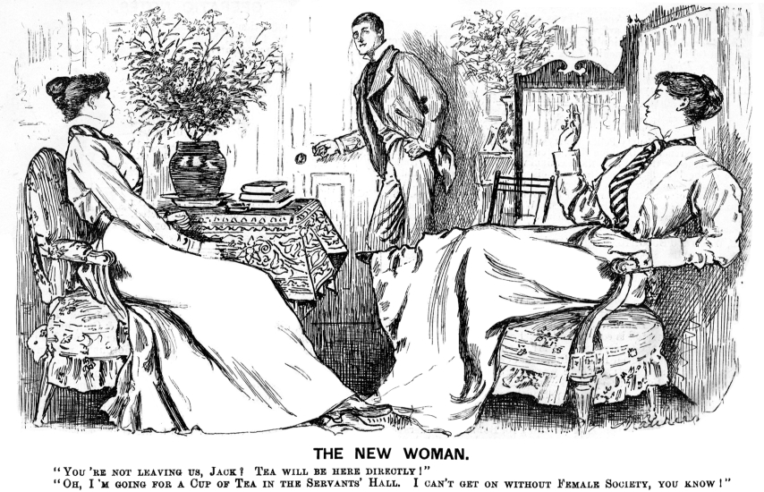
Punch cartoon, Vol. 108, p. 282
“The New Woman”

