Slide 1
The New Woman and Punch Cartoons
Chris Snodgrass @ 2014

Slide 2
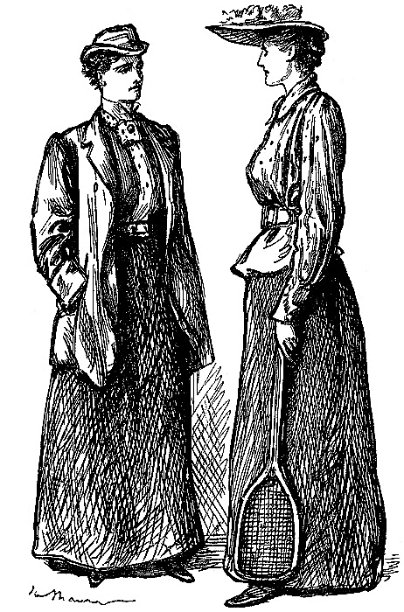
Punch cartoon, Vol. 101
“Sterner Stuff”

Slide 3
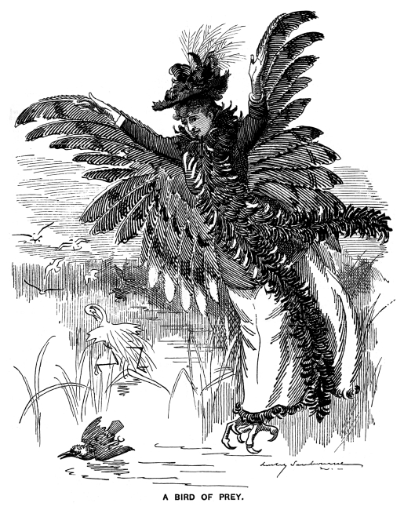
Punch cartoon, Vol. 102
“Bird of Prey”

Slide 4
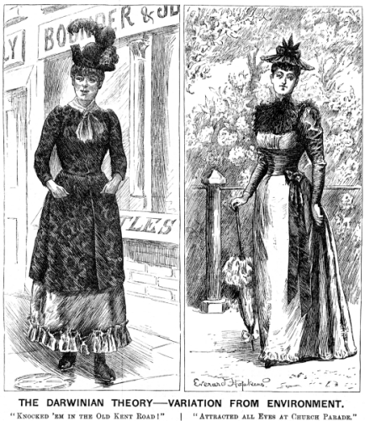
Punch cartoon, Vol. 102, p. 291
“Darwinian Theory”

Slide 5
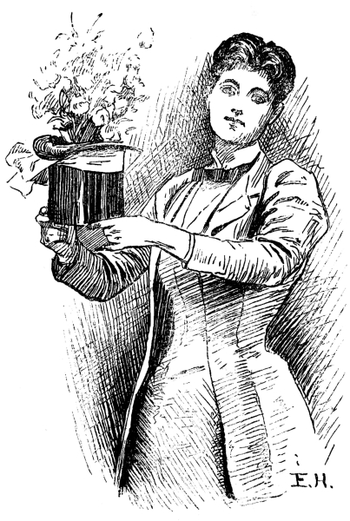
Punch cartoon, Vol. 103, p. 49
“Woman with Flowerpot Hat”

Slide 6
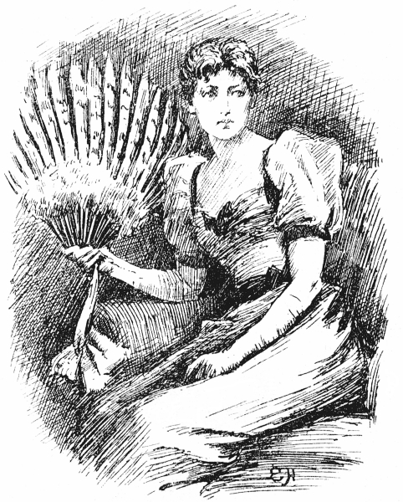
Punch cartoon, Vol. 104, p. 21
“Woman with Peacock Fan”

Slide 7
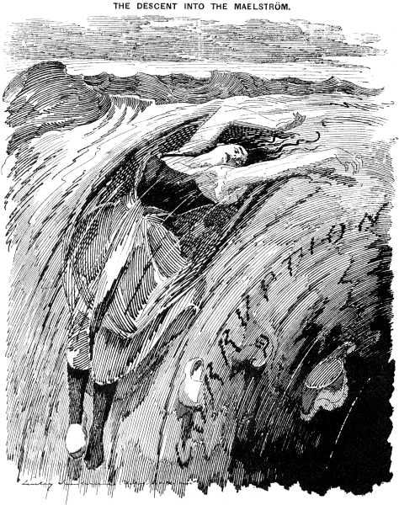
Punch cartoon, Vol. 104, p. 38
“Descent into the Maelstrom”

Slide 8
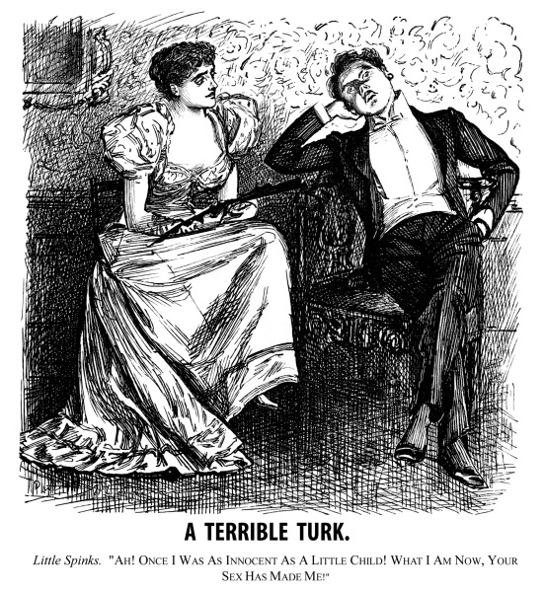
Punch cartoon, Vol. 104
“A Terrible Turk”

Slide 9
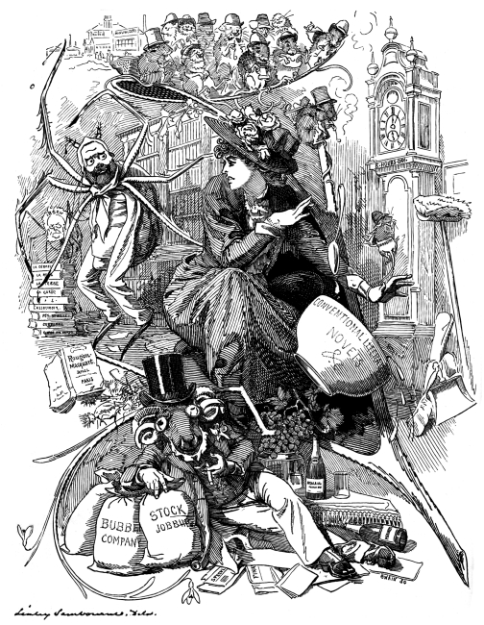
Punch cartoon, Vol. 104
“Modern Labor”

Slide 10
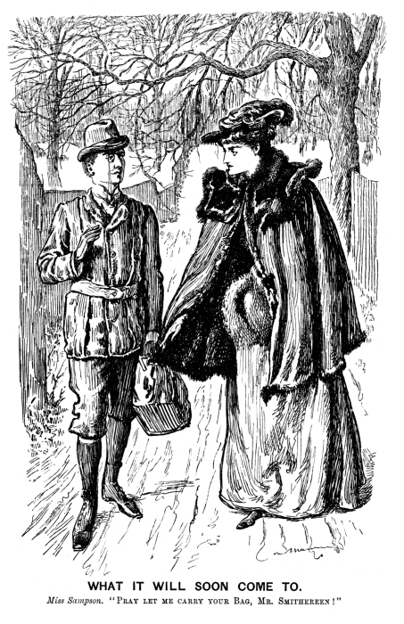
Punch cartoon, Vol. 106
“What It Will Soon Come To”

Slide 11
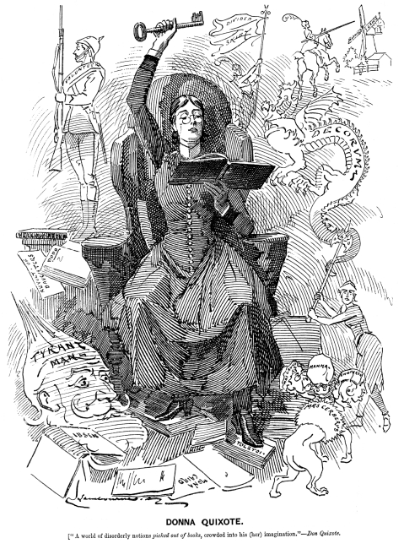
Punch cartoon, Vol. 106
“Donna Quixote”

Slide 12
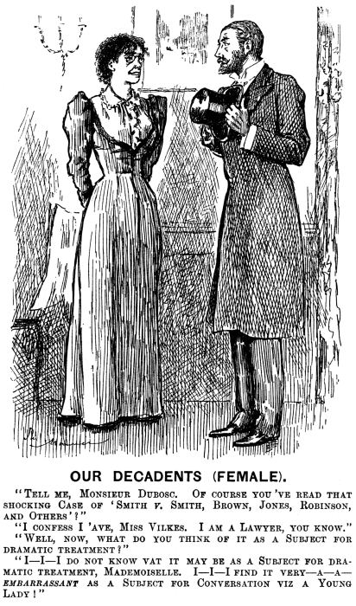
Punch cartoon, Vol. 106
“Our Decadents (Female)”

Slide 13
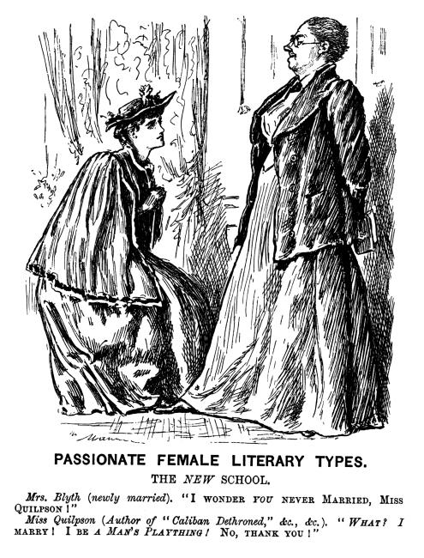
Punch cartoon, Vol. 106
“Passionate Female Literary Types”

Slide 14
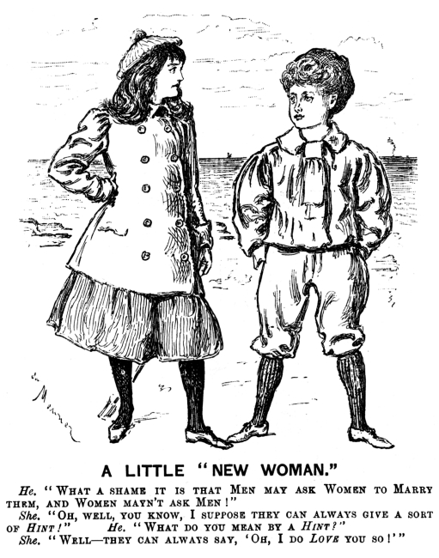
Punch cartoon, Vol. 107
“A Little ‘New Woman’”

Slide 15
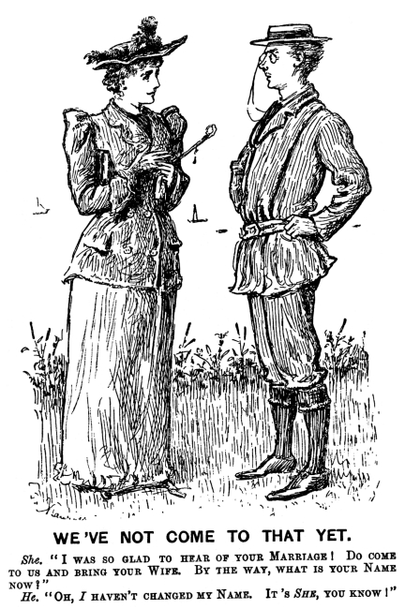
Punch cartoon, Vol. 107
“We’ve Not Come to That Yet”

Slide 16
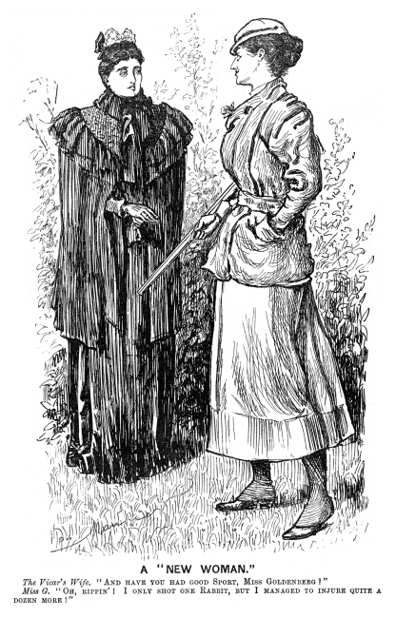
Punch cartoon, Vol. 107, p. 111
“A New Woman”

Slide 17
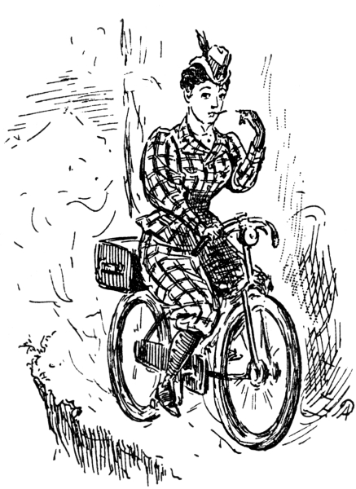
Punch cartoon, Vol. 108
New Woman Riding Bike

Slide 18
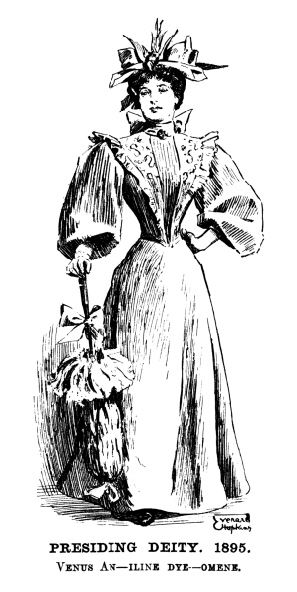
Punch cartoon, Vol. 109
“Presiding Deity, 1895”

Slide 19
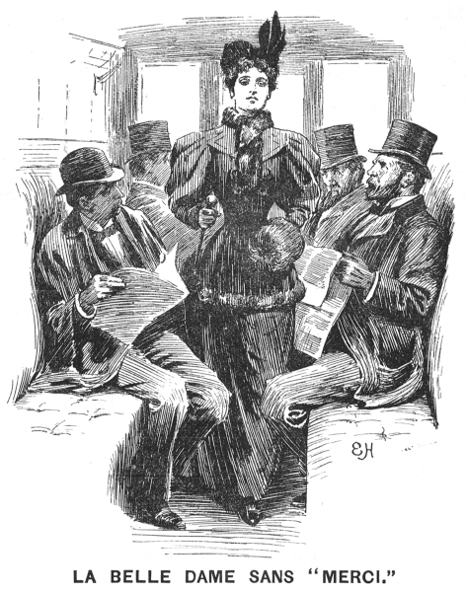
Punch cartoon, Vol. 109, p. 268
“La Belle Dame Sans Merci”

Slide 20
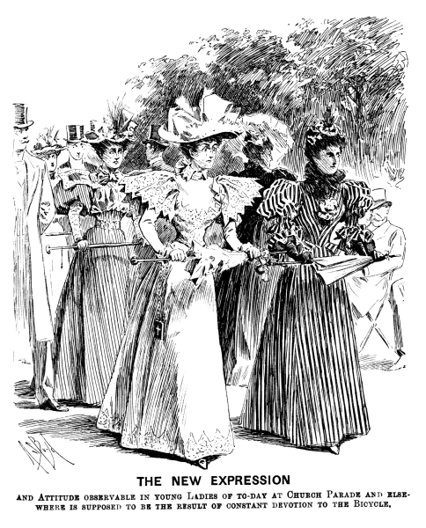
Punch cartoon, Vol. 110
“The New Expression”

Slide 21
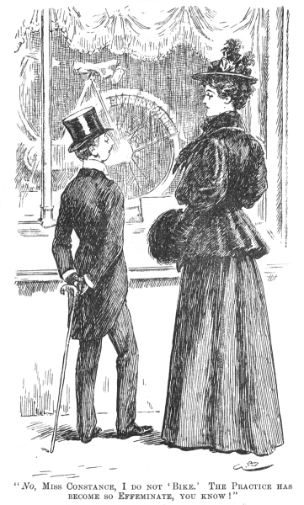
Punch cartoon, Vol. 112, p. 17
“I Do Not Bike”

