Slide 1
Paintings with
Salome-Like Themes
Chris Snodgrass @ 2014

Slide 2
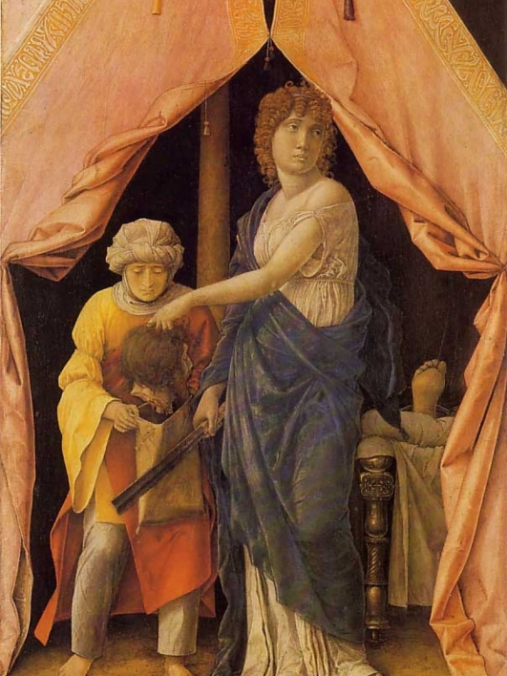
Andrea MANTEGNA (c. 1431–1506))
Judith and Holofernes (1495)

Slide 3
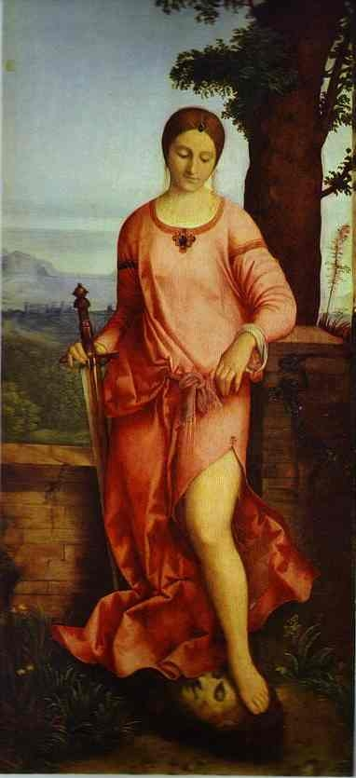
GIORGIONE [b. Giorgio Barbarelli da Castelfranco]
(c. 1477/8–1510) Judith (1504)

Slide 4
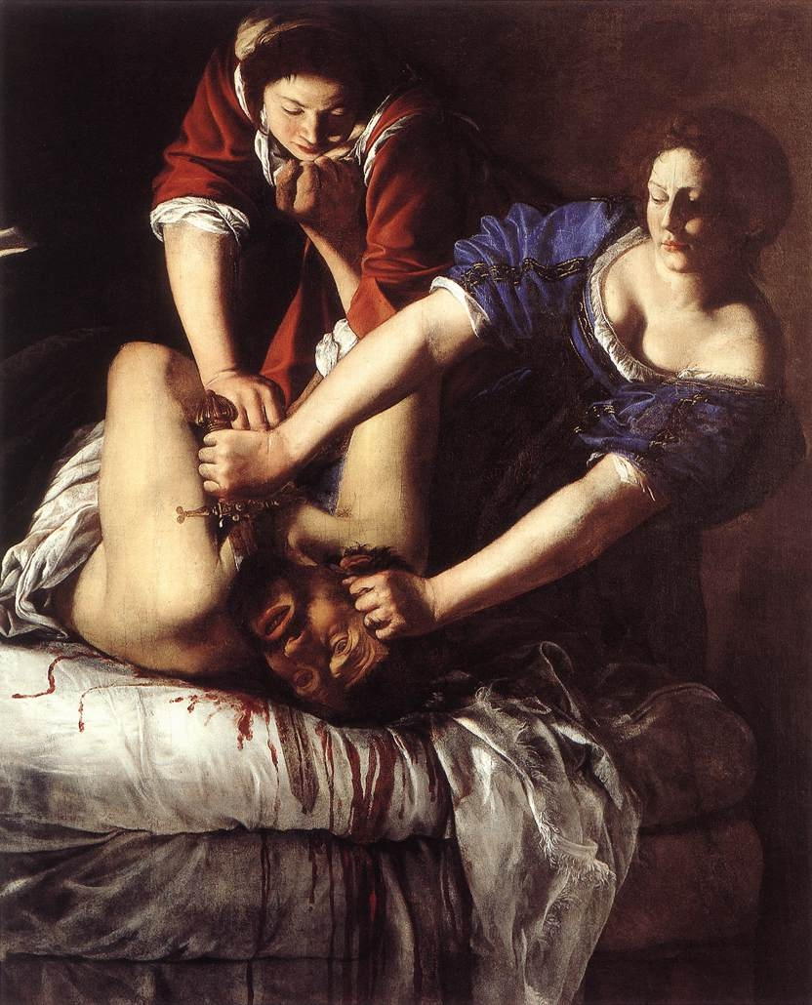
Artemisia GENTILESCHI (1593–1652)
Judith beheading Holofernes (c. 1611–12)

Slide 5
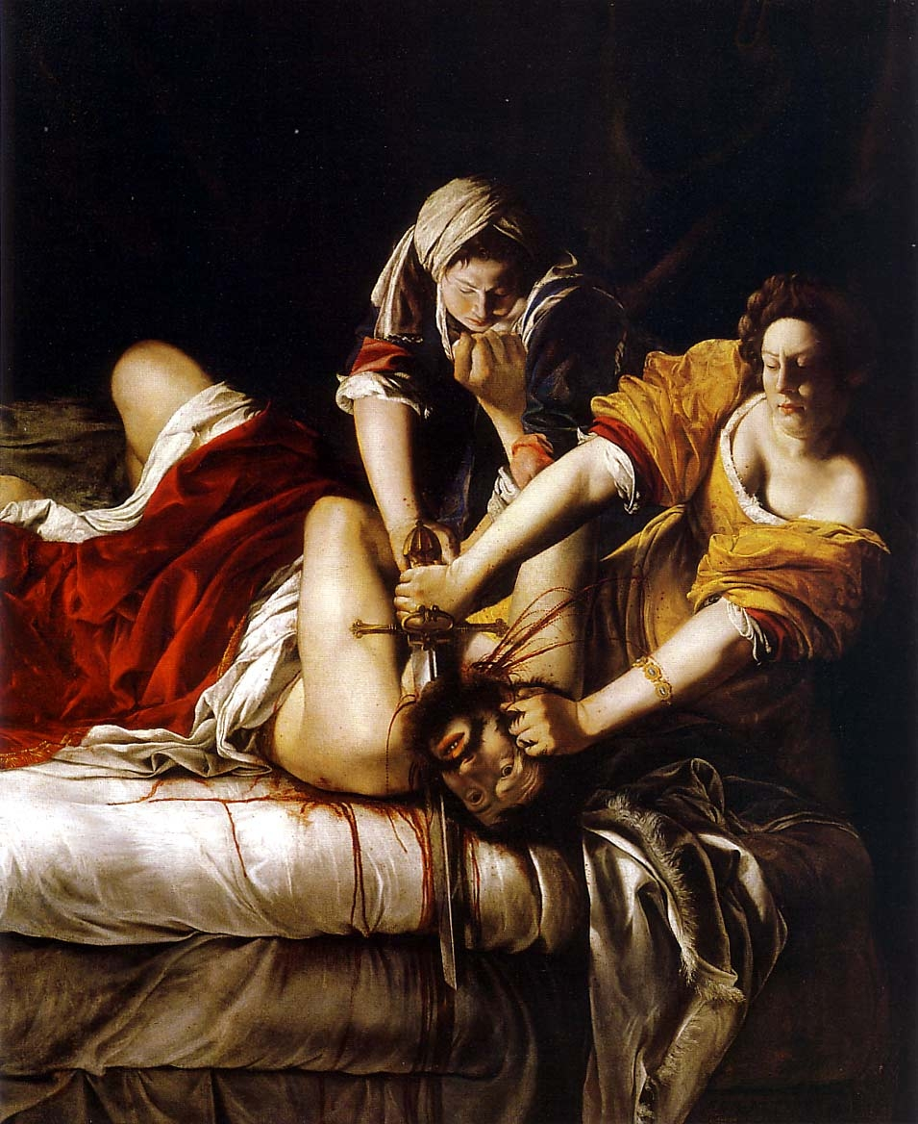
Artemisia GENTILESCHI (1593–1652)
Judith beheading Holofernes (c. 1620)

Slide 6
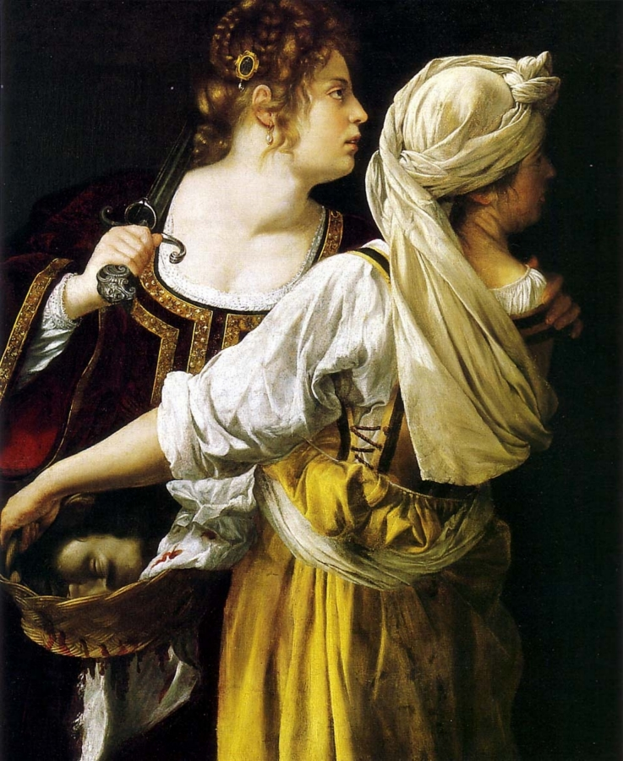
Artemisia GENTILESCHI (1593–1652)
Judith and Her Maidservant (c. 1612–13)

Slide 7
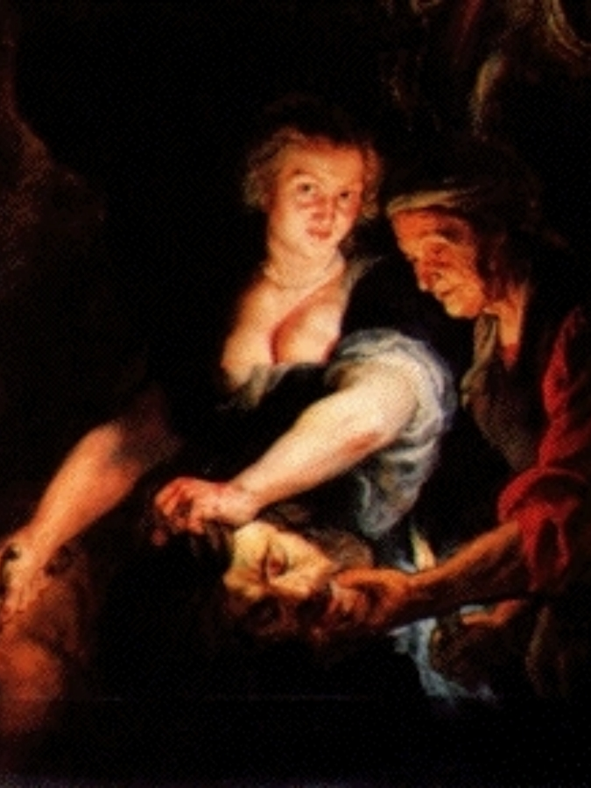
Peter Paul RUBENS (1577–1640)
Judith with the Head of Holofernes (c. 1616)

Slide 8
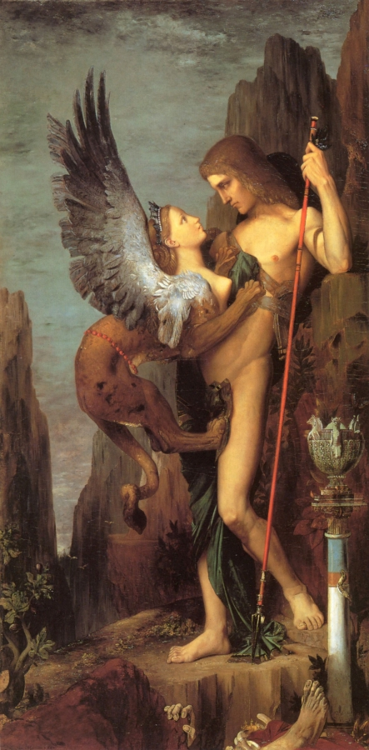
Gustav MOREAU (1826–98)
Oedipus and the Sphinx (1864)

Slide 9
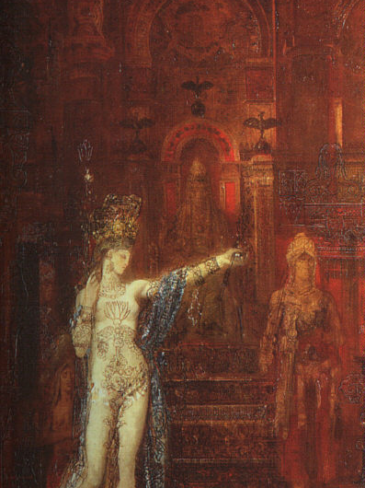
Gustav MOREAU (1826–98)
The Tattooed Salome (1875)

Slide 10
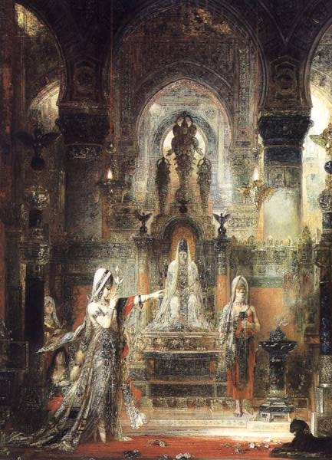
Gustav MOREAU (1826–98)
Salome Dancing before Herod (1876)

Slide 11
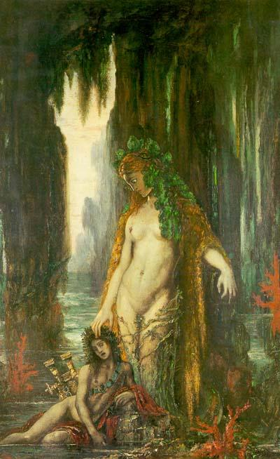
Gustave MOREAU
(French; 6 April 1826 – 18 April 1898)
The Poet and the Siren (1894)

Slide 12
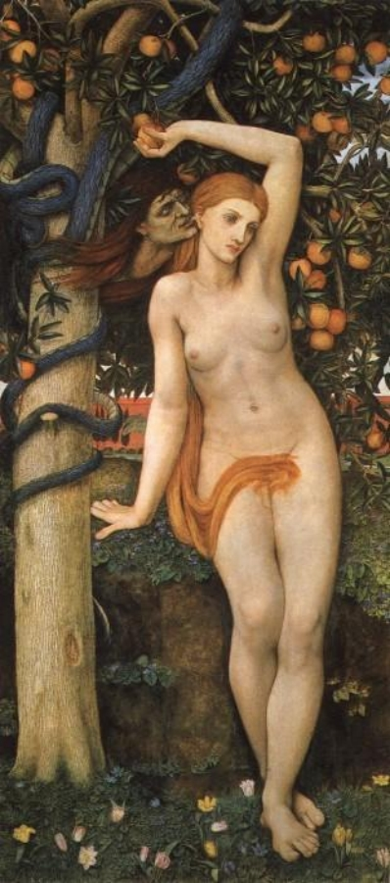
John Roddam Spencer STANHOPE (1829–1908)
Eve Tempted (1877)

Slide 13
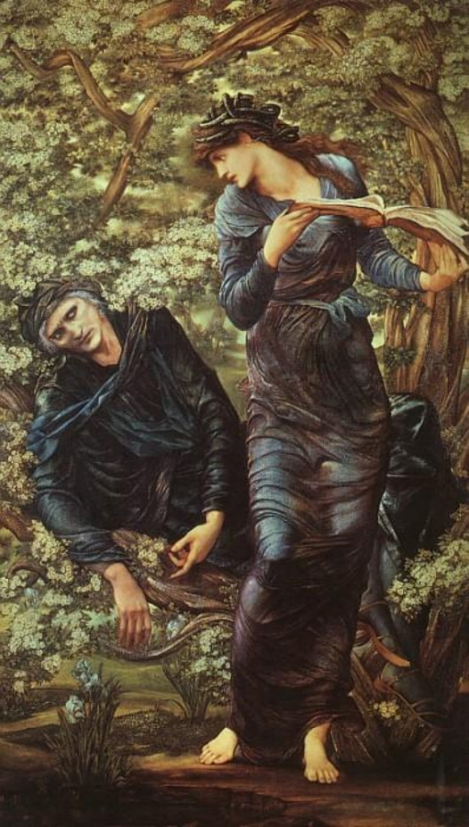
Edward Coley BURNE-JONES
(British; 28 August 1833 – 17 June 1898)
The Beguiling of Merlin (1874)

Slide 14
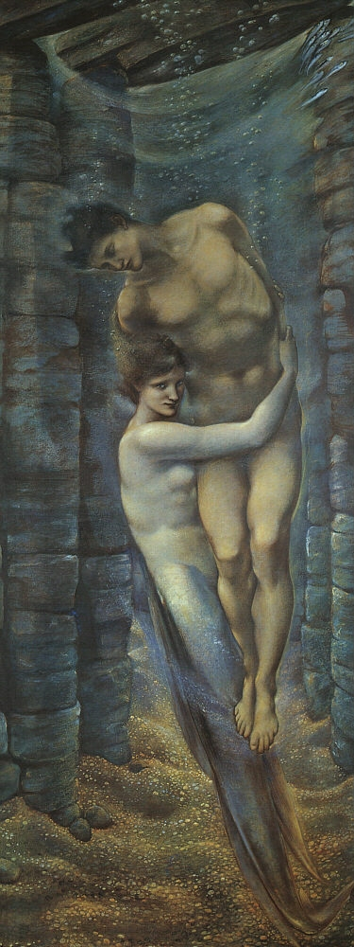
Edward Coley Burne-Jones
(British; 28 August 1833 – 17 June 1898)
The Depths of the Sea (1887)

Slide 15
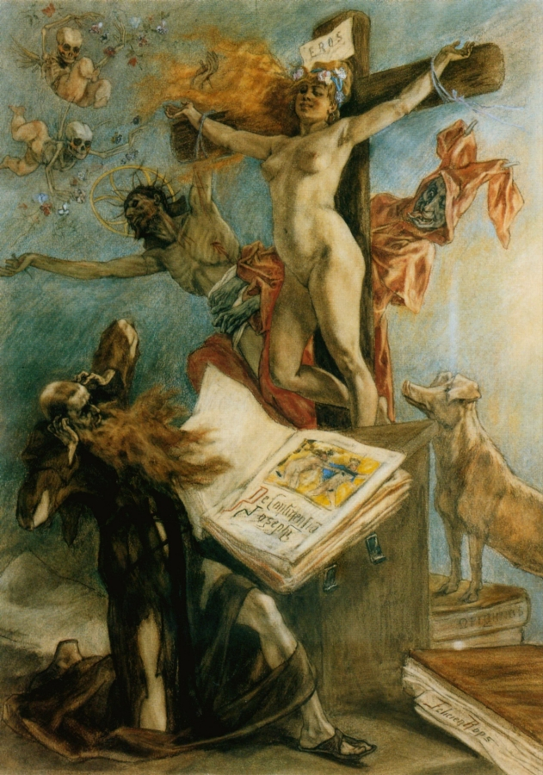
Félicien ROPS
La Tentation de St-Antoine [The Temptation of Saint Anthony] (1878)

Slide 16
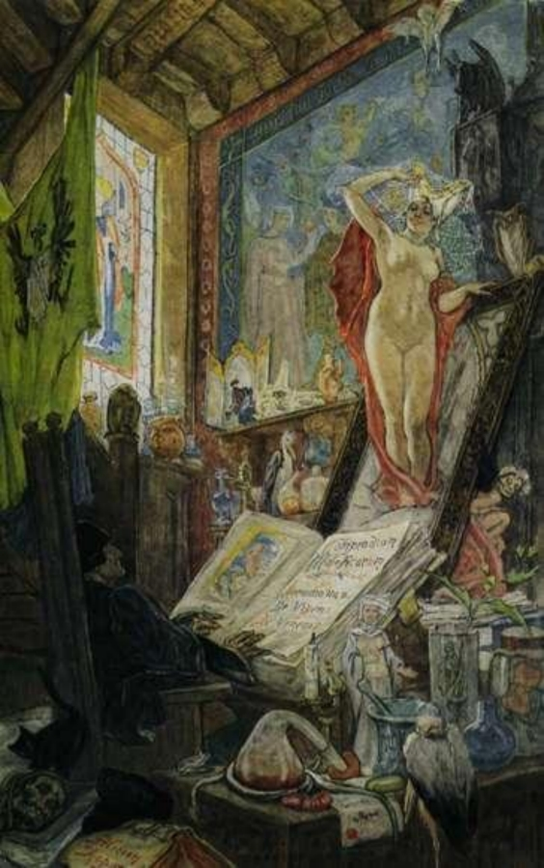
Félicien ROPS
L’Incantation [Incantation] (1896)

Slide 17
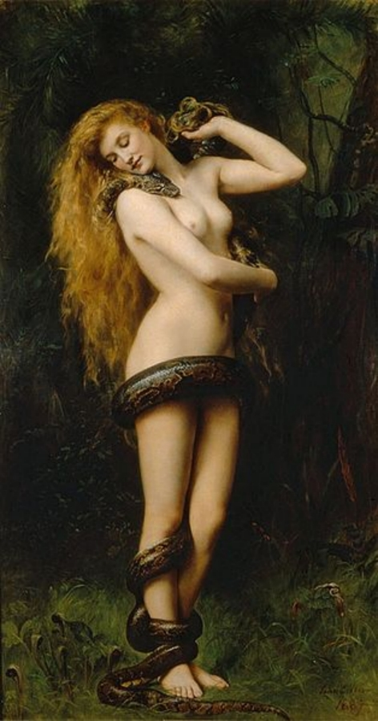
John [Maler ] COLLIER (English;
27 January 1850 – 11 April 1934)
Lilith (1887)

Slide 18
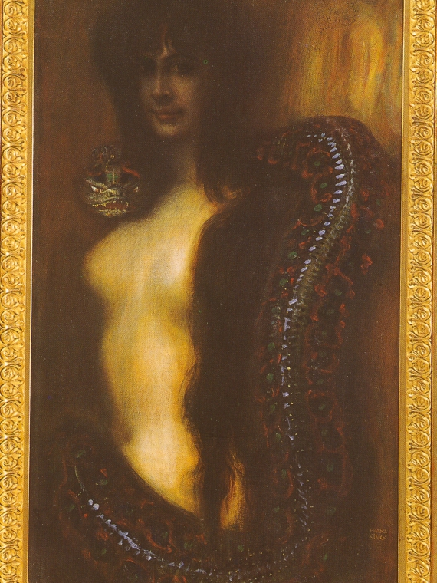
Franz von STUCK (1863–1928)
Sin (1893)

Slide 19
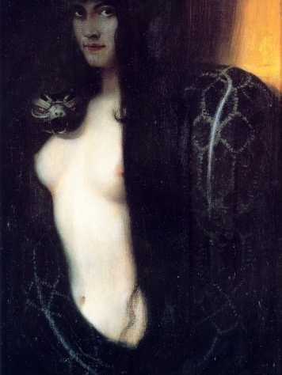
Franz von STUCK (1863–1928)
Sin (1893), 2nd version

Slide 20
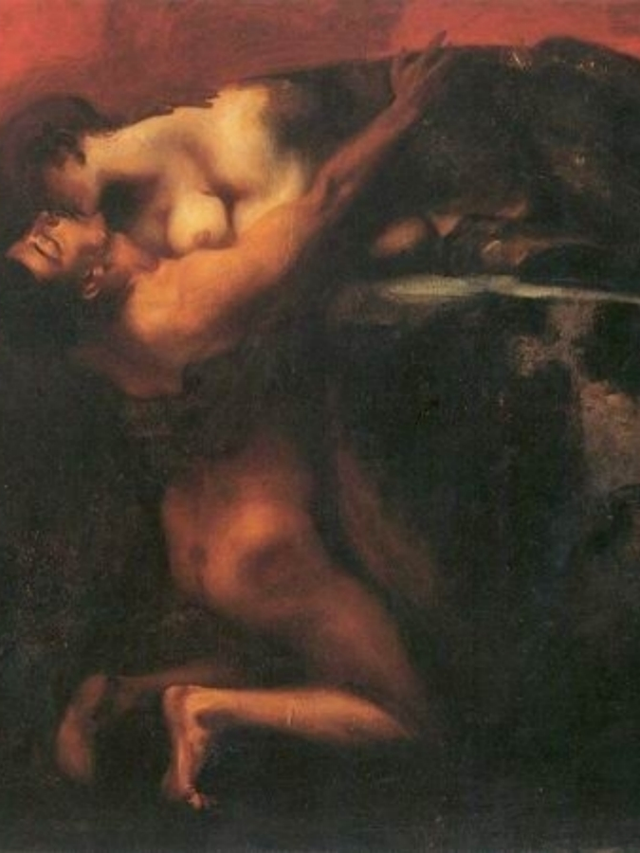
Franz von STUCK (1863–1928)
Kiss of the Sphinx (1895)

Slide 21
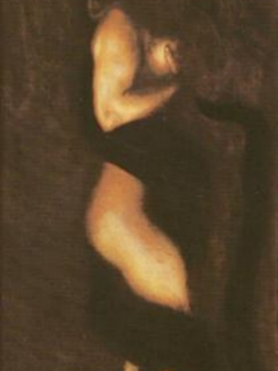
Franz von STUCK (1863–1928)
Sin (1899)

Slide 22
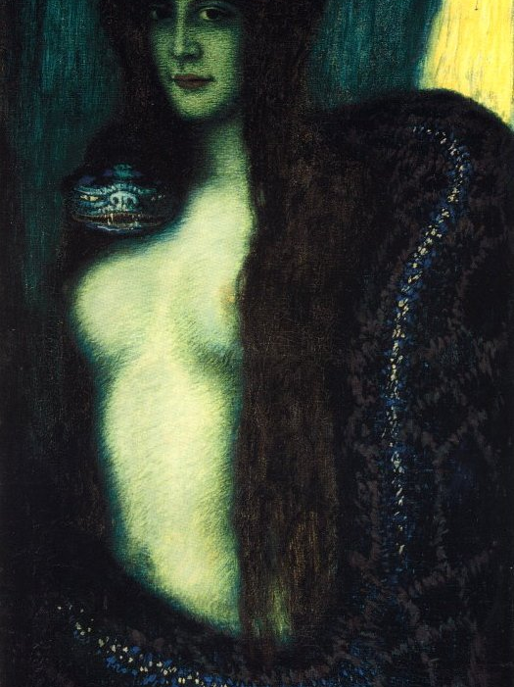
Franz von STUCK (1863–1928)
Sin (1900)

Slide 23
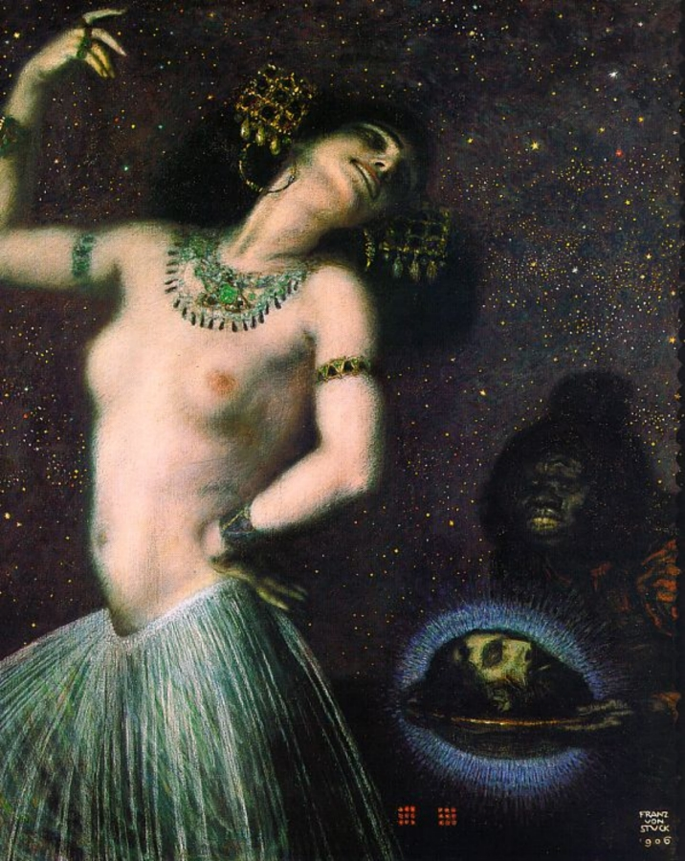
Franz von STUCK (1863–1928)
Salome (1906)

Slide 24
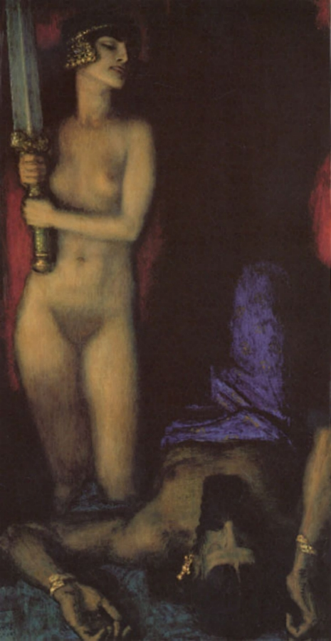
Franz von STUCK (1863–1928)
Judith and Holofernes (1926)

Slide 25
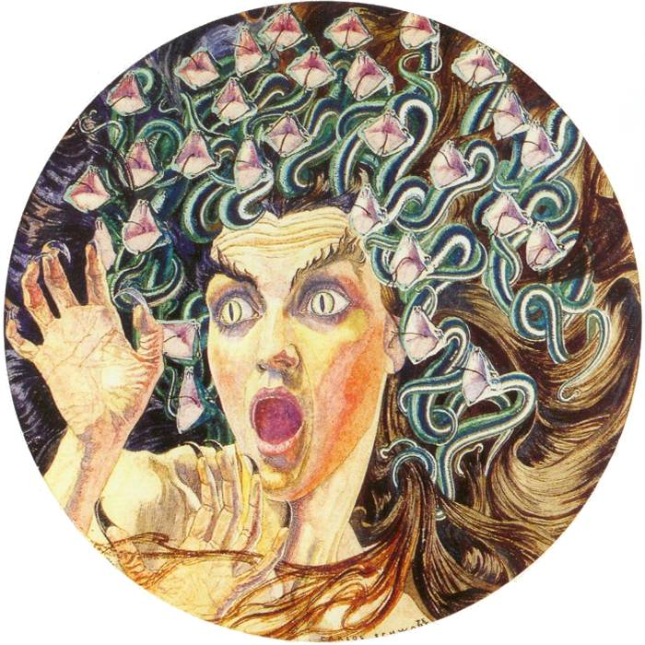
Carlos Schwabe (Swiss-German;
July 21, 1866 – 1926)
Medusa (1895)

Slide 26
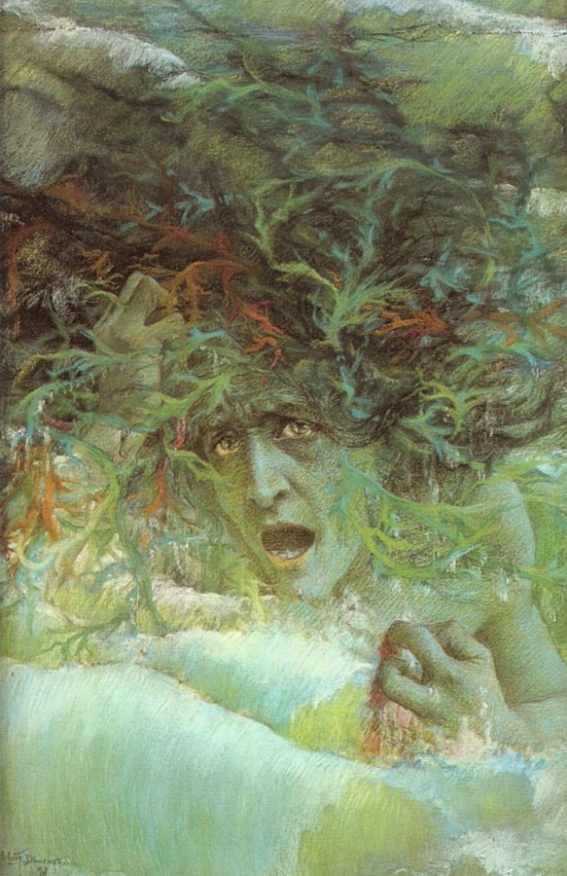
Lucien LÉVY-DHURMER (1865–1953)
Medusa (1897)

Slide 27
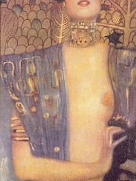
Gustav KLIMT (1862–1918)
Judith I (Czech 1901)

Slide 28
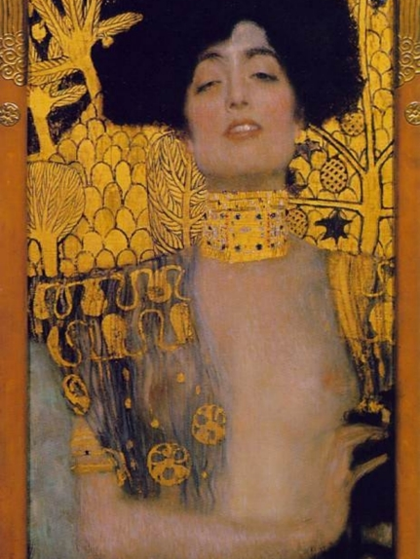
Gustav KLIMT (1862–1918)
Judith I (Vienna 1901)

Slide 29
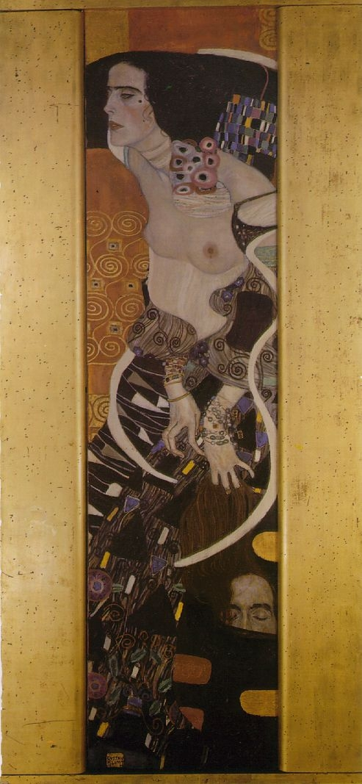
Gustav KLIMT (1862–1918)
Judith II (Vienna 1909)

Slide 30
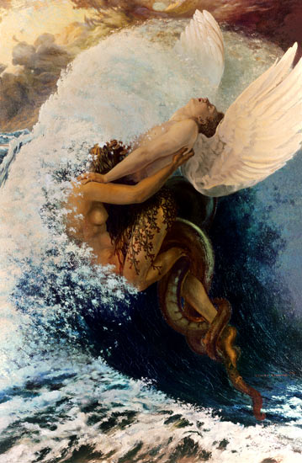
Carlos SCHWABE (1877–1926)
Spleen and Ideal (c. 1907–08)

