Slide 1
19th-Century Painting

Slide 2
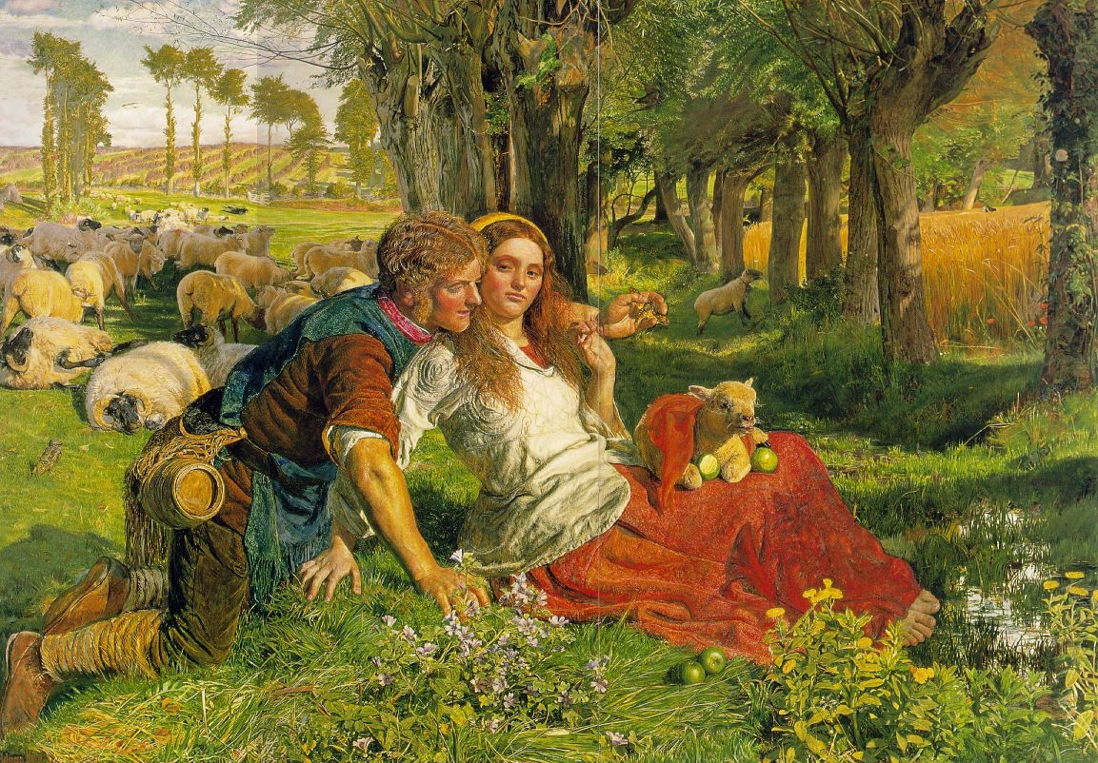
William Holman Hunt
The Hireling Shepherd (1851)
Notes:
Change

Slide 3
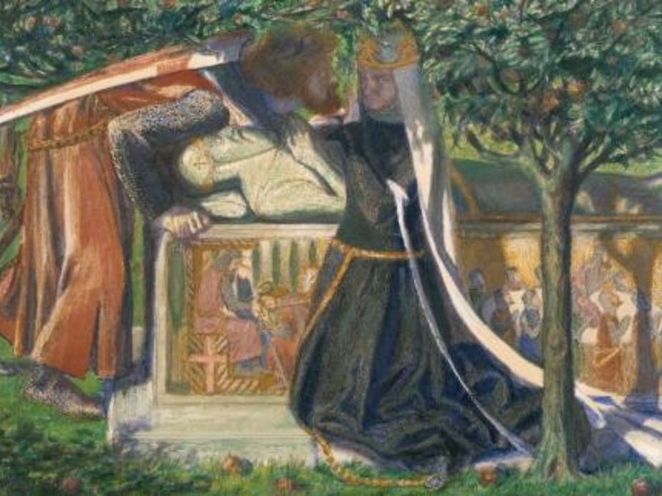
Dante Gabriel Rossetti
King Arthur’s Tomb (1854)

Slide 4
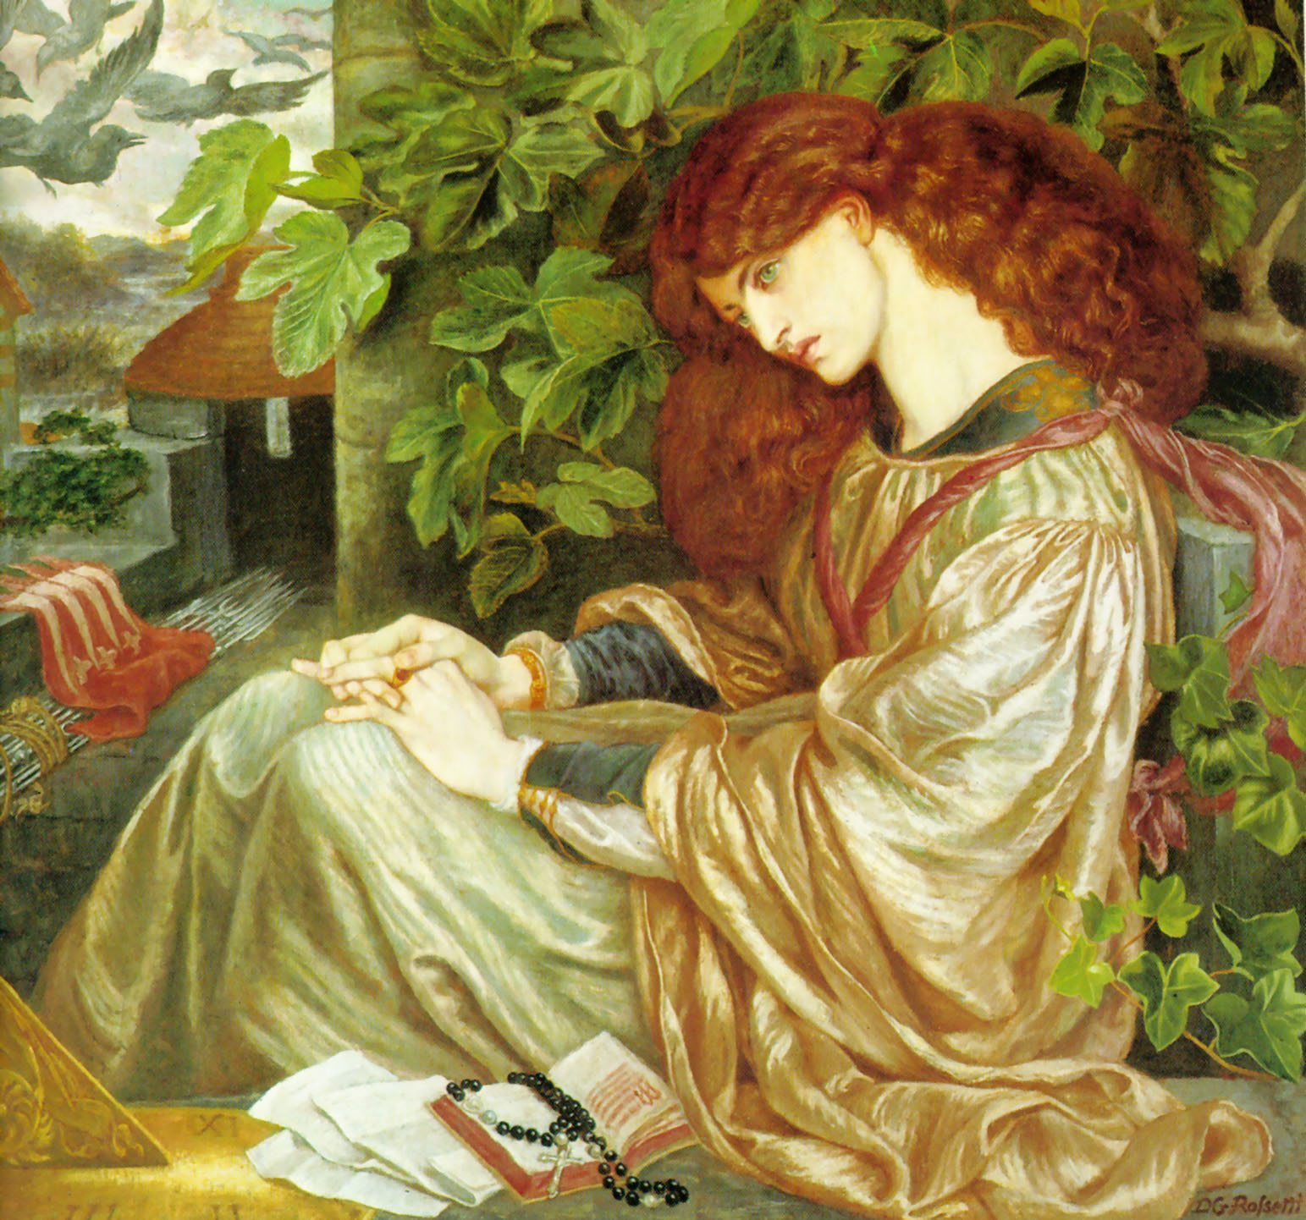
Dante Gabriel Rossetti
La Pia de’ Tolomei (1868‒80)

Slide 5
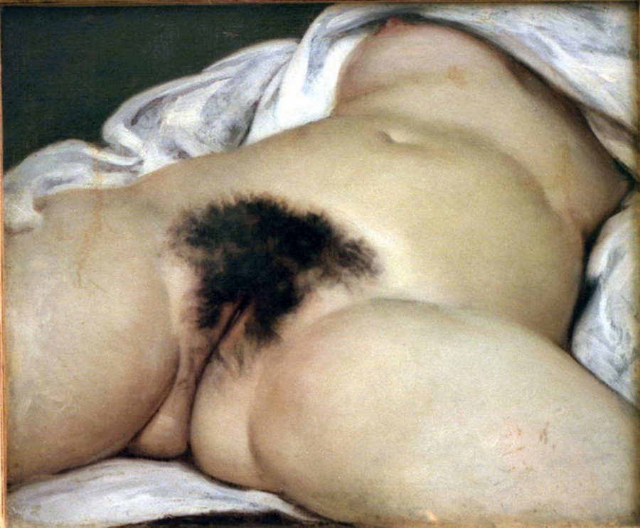
Jean Désiré Gustave COURBET (French];
10 June 1819 – 31 December 1877)
La Source du Monde [The Origin of the World] (1862)

Slide 6
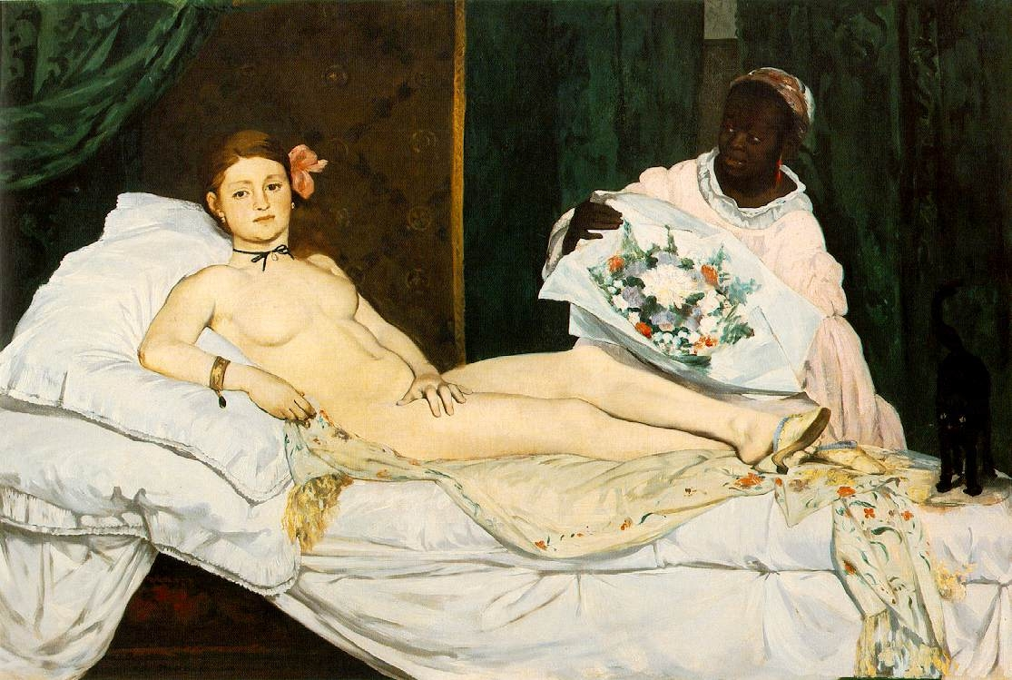
Edouard Manet
Olympia (1863)

Slide 7
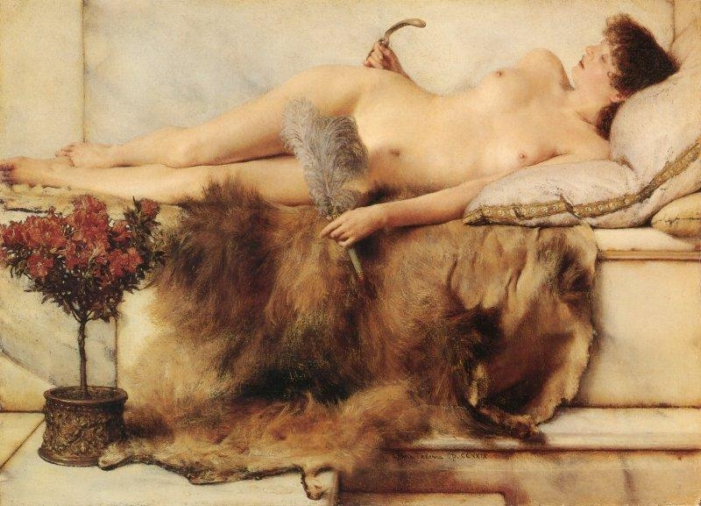
Laurence Alma-Tadema
In the Tepidarium (1881)

Slide 8
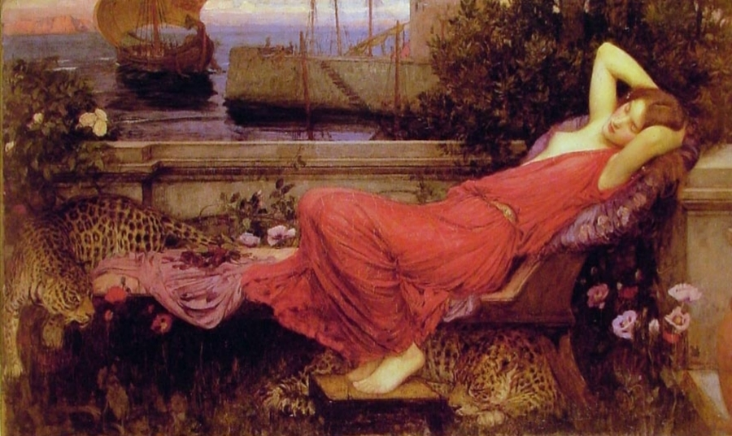
John Waterhouse
Ariadne (1898)

Slide 9
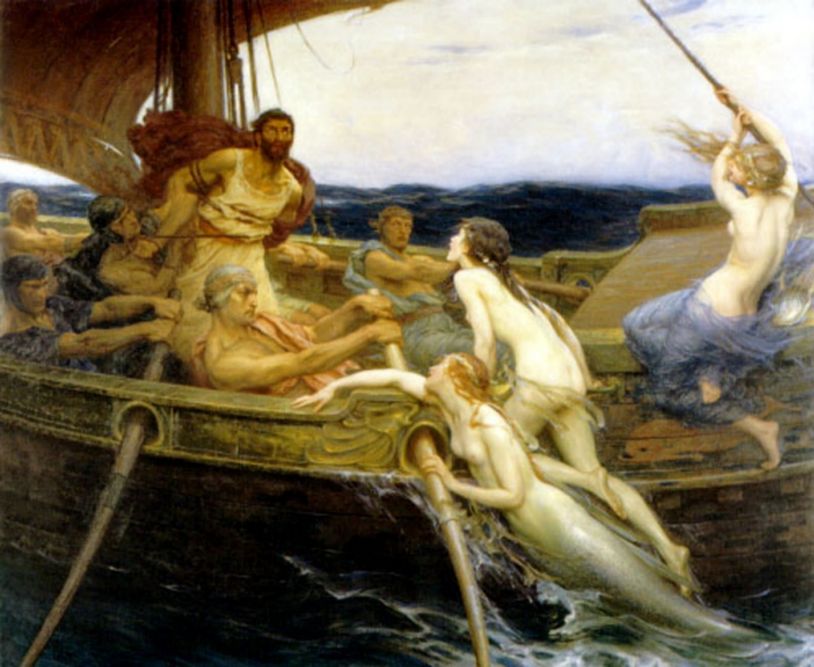
Herbert Draper
Ulysses and the Sirens (1909)

