Slide 1
Paintings with
Salome-Like Themes
Chris Snodgrass @ 2014

Slide 2
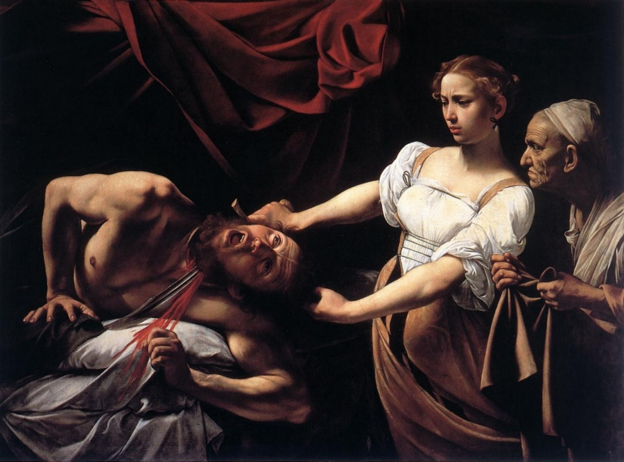
Michelangelo Merisi da CARAVAGGIO (1571–1610)
Judith Beheading Holofernes (c. 1598)

Slide 3
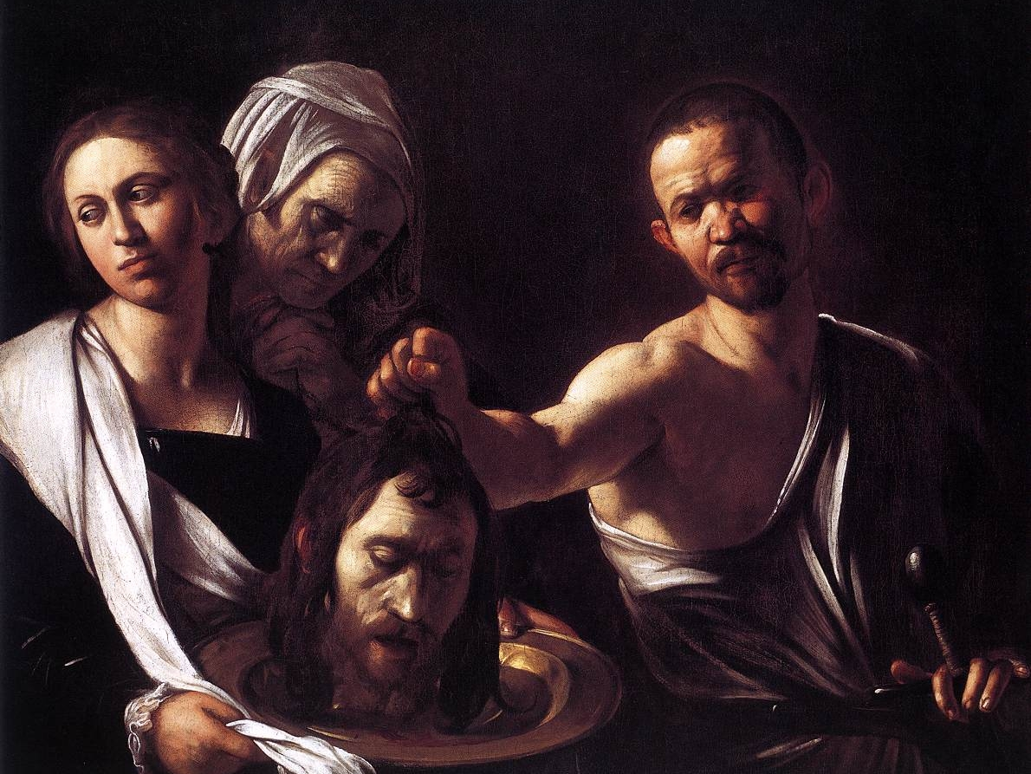
Michelangelo Merisi da CARAVAGGIO (1571–1610)
Salome with the Head of the Baptist (1607–1610)

Slide 4
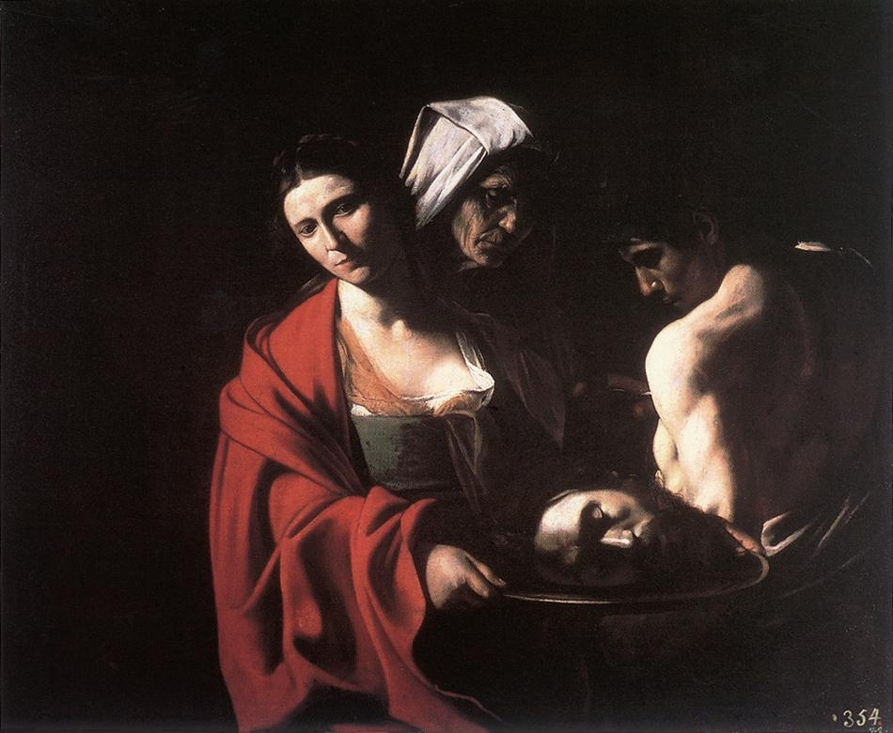
Michelangelo Merisi da CARAVAGGIO (1571–1610)
Salome with the Head of the Baptist (1609)

Slide 5
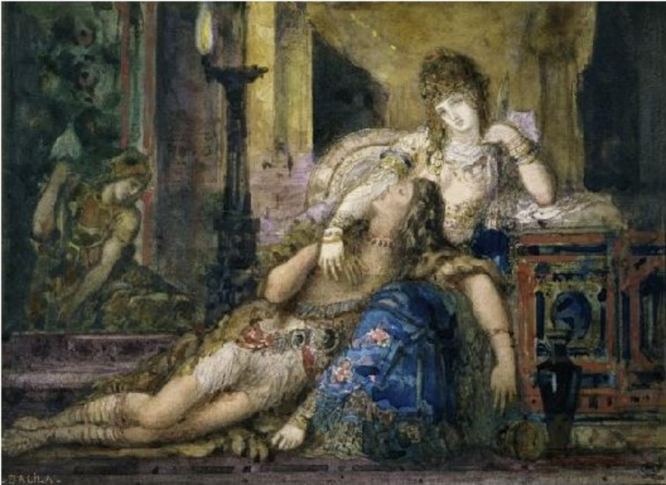
Gustav MOREAU (1826–98)
Samson and Delilah (1881–82)

Slide 6
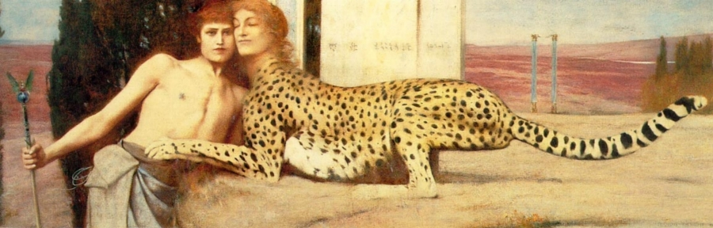
Fernand KHNOPFF (1858–1921)
The Caress (1896)

