Slide 1
Paintings with
Salome-Like Themes
Chris Snodgrass @ 2014

Slide 2
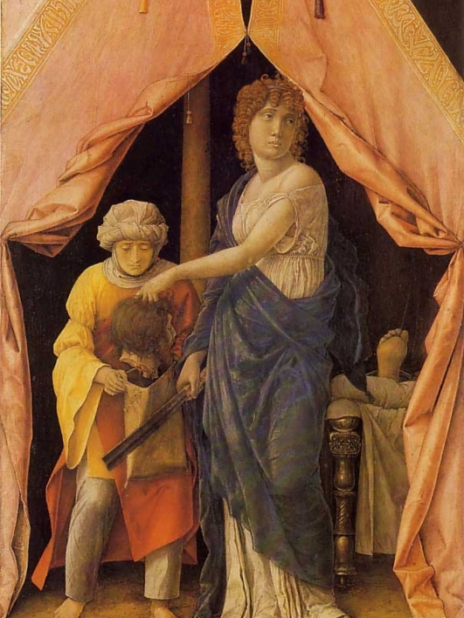
Andrea MANTEGNA (c. 1431–1506))
Judith and Holofernes (1495)

Slide 3
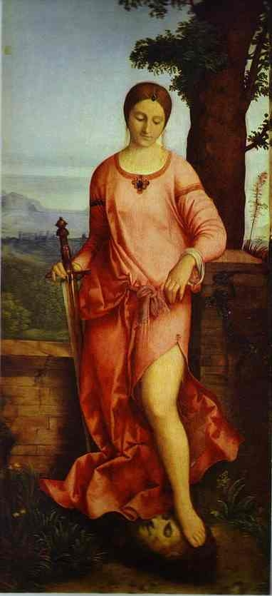
GIORGIONE [b. Giorgio Barbarelli da Castelfranco]
(c. 1477/8–1510) Judith (1504)

Slide 4
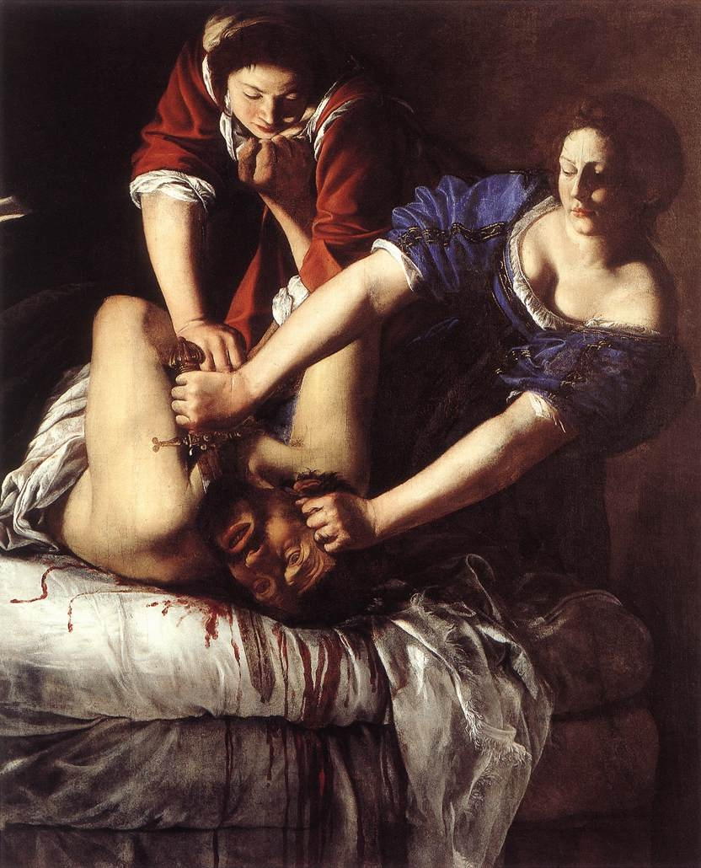
Artemisia GENTILESCHI (1593–1652)
Judith beheading Holofernes (c. 1611–12)

Slide 5
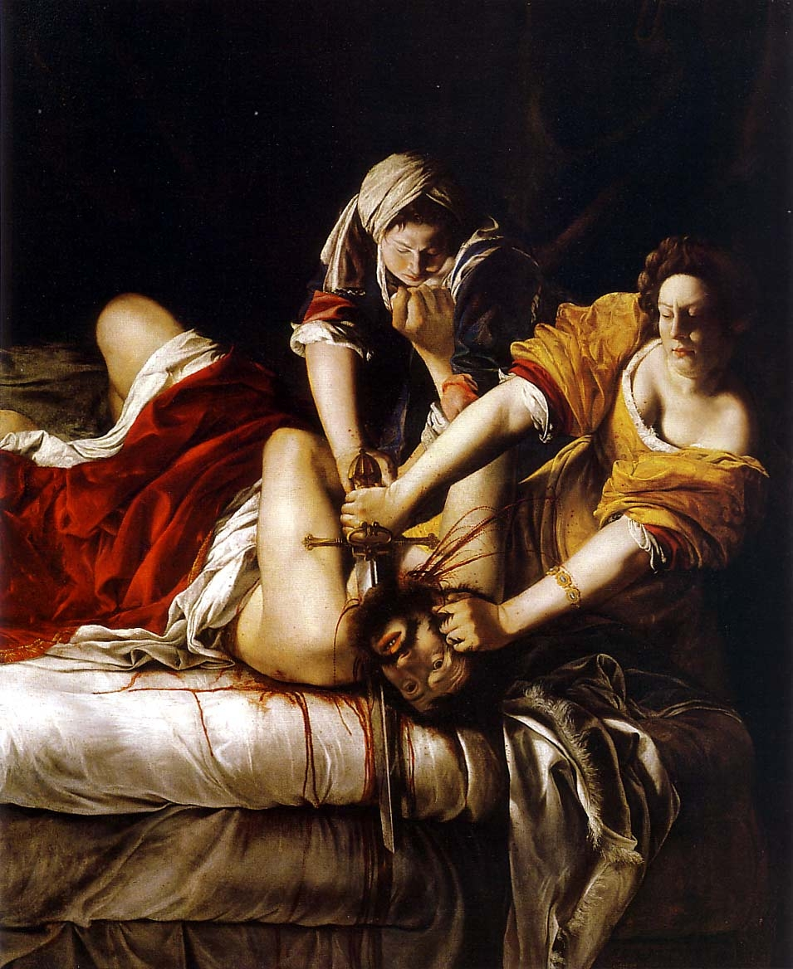
Artemisia GENTILESCHI (1593–1652)
Judith beheading Holofernes (c. 1620)

Slide 6
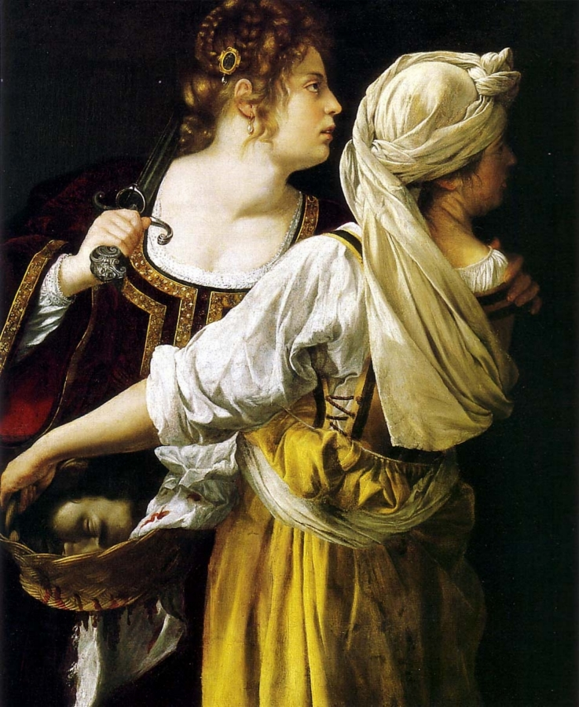
Artemisia GENTILESCHI (1593–1652)
Judith and Her Maidservant (c. 1612–13)

Slide 7
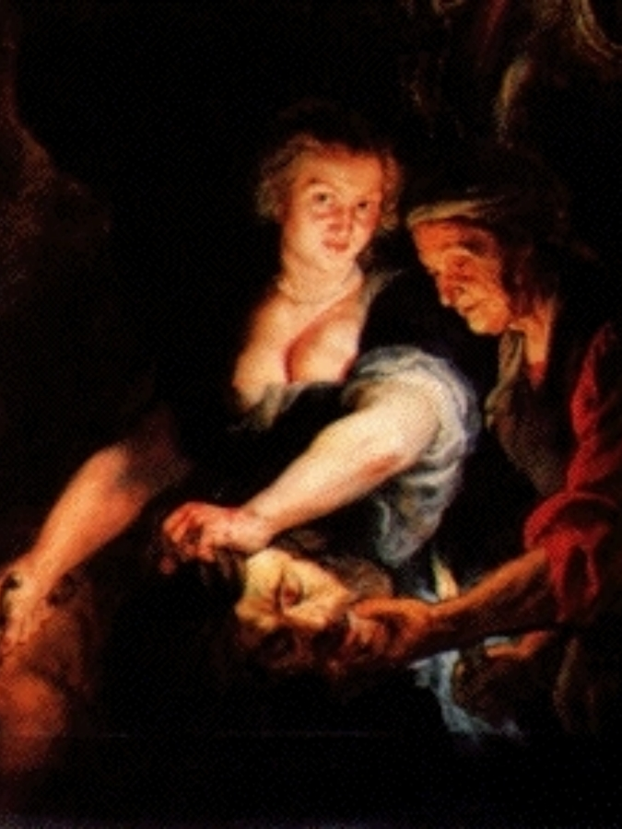
Peter Paul RUBENS (1577–1640)
Judith with the Head of Holofernes (c. 1616)

Slide 8
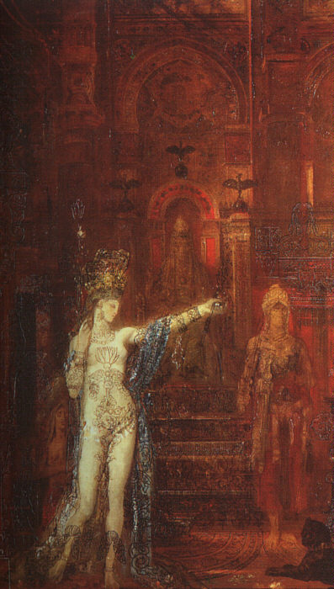
Gustav MOREAU (1826–98)
The Tattooed Salome (1875)

Slide 9
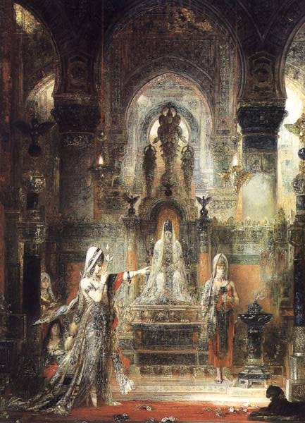
Gustav MOREAU (1826–98)
Salome Dancing before Herod (1876)

Slide 10
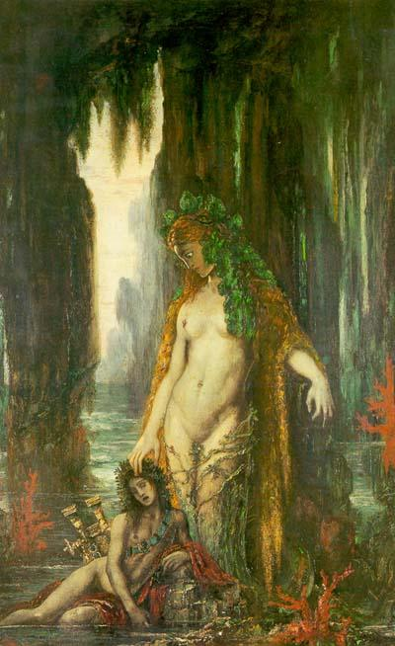
Gustave MOREAU
(French; 6 April 1826 – 18 April 1898)
The Poet and the Siren (1894)

Slide 11
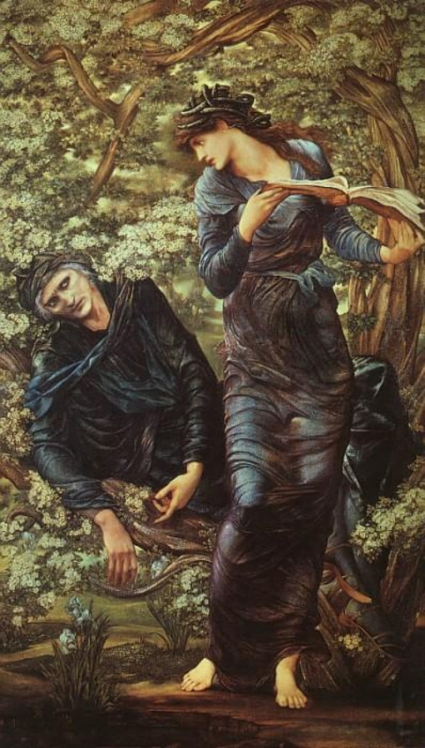
Edward Coley BURNE-JONES
(British; 28 August 1833 – 17 June 1898)
The Beguiling of Merlin (1874)

Slide 12
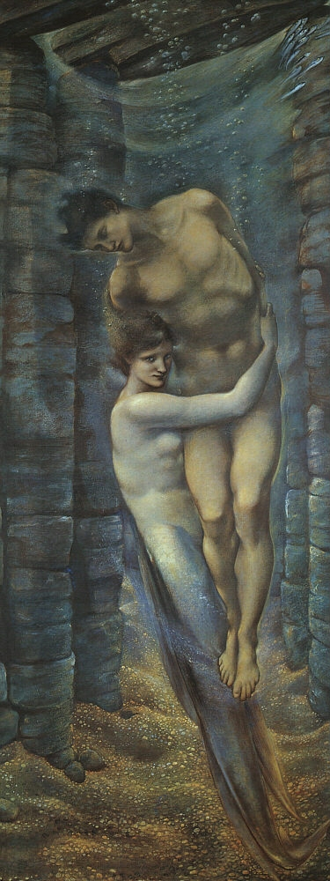
Edward Coley Burne-Jones
(British; 28 August 1833 – 17 June 1898)
The Depths of the Sea (1887)

Slide 13
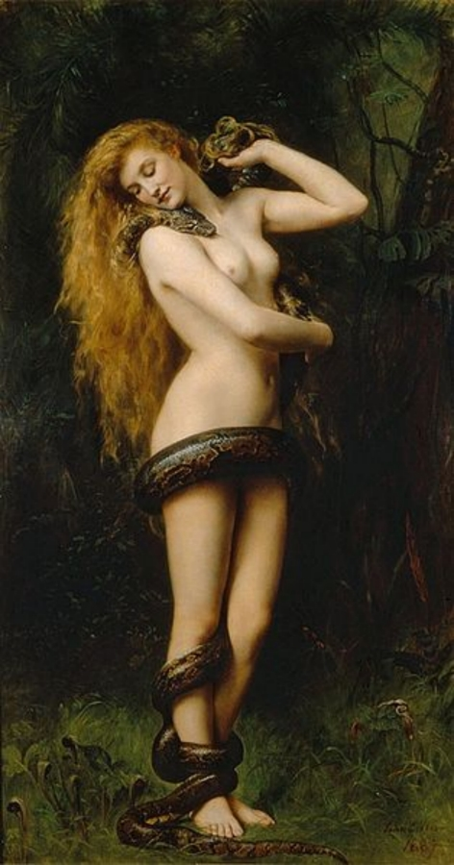
John [Maler ] COLLIER (English;
27 January 1850 – 11 April 1934)
Lilith (1887)

Slide 14
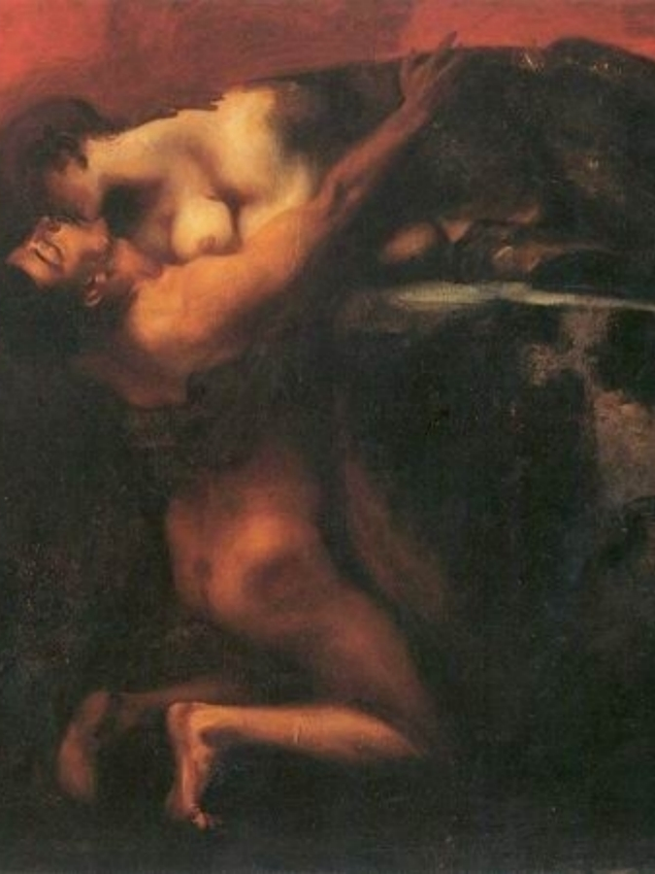
Franz von STUCK (1863–1928)
Kiss of the Sphinx (1895)

Slide 15
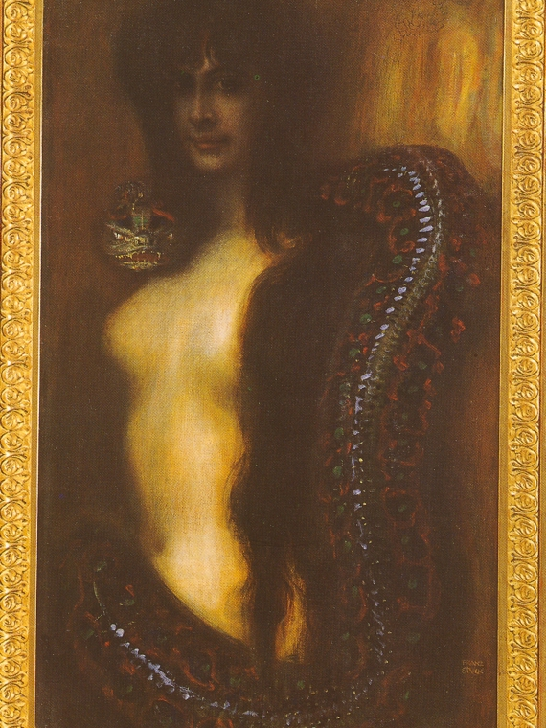
Franz von STUCK (1863–1928)
Sin (1893)

Slide 16
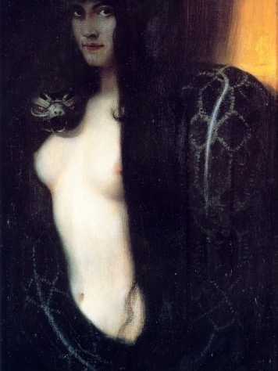
Franz von STUCK (1863–1928)
Sin (1893), 2nd version

Slide 17
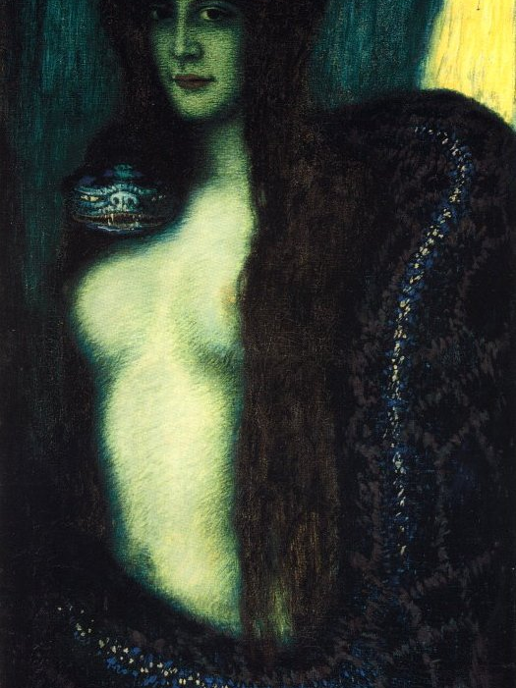
Franz von STUCK (1863–1928)
Sin (1900)

Slide 18
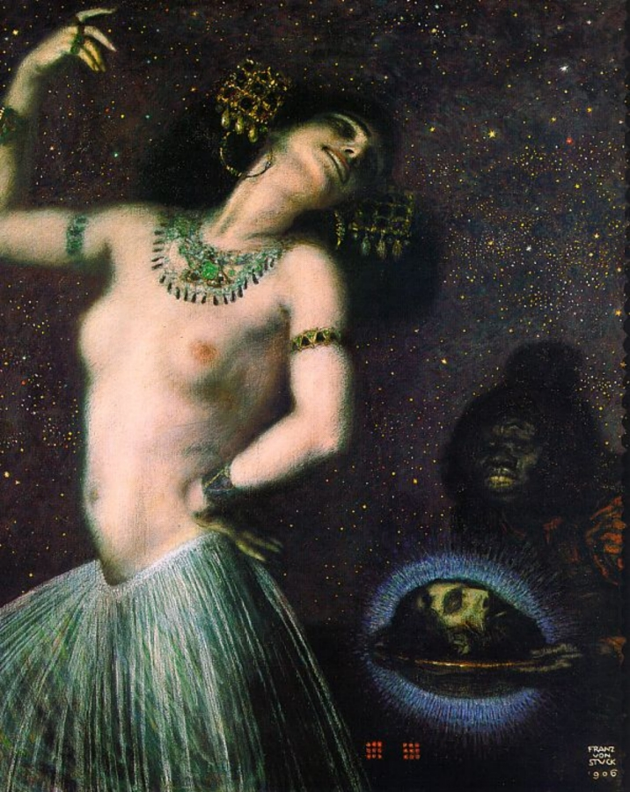
Franz von STUCK (1863–1928)
Salome (1906)

Slide 19
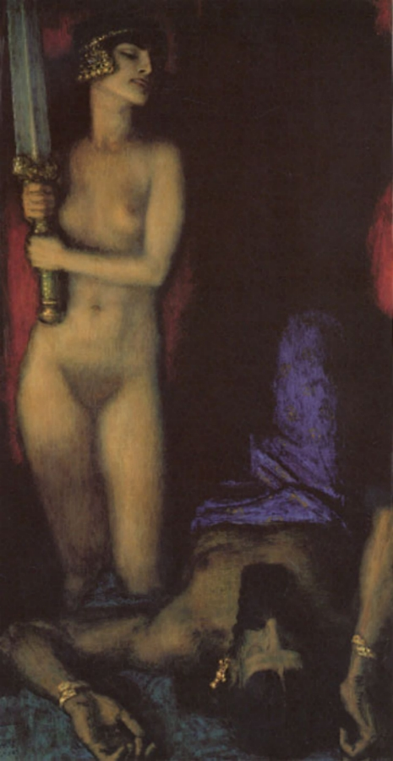
Franz von STUCK (1863–1928)
Judith and Holofernes (1926)

Slide 20
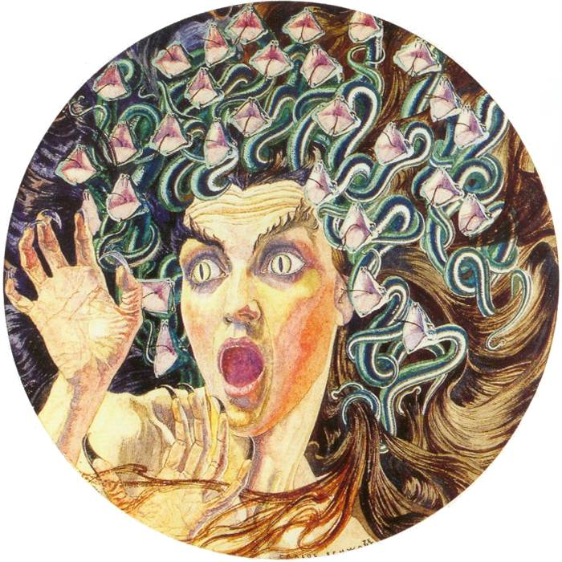
Carlos Schwabe (Swiss-German;
July 21, 1866 – 1926)
Medusa (1895)

Slide 21
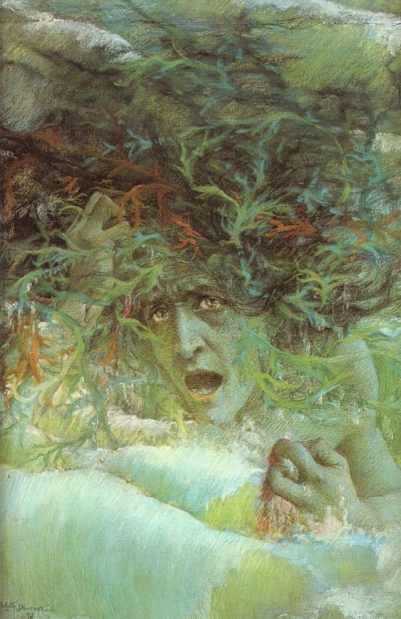
Lucien LÉVY-DHURMER (1865–1953)
Medusa (1897)

Slide 22
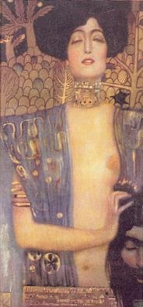
Gustav KLIMT (1862–1918)
Judith I (Czech 1901)

Slide 23
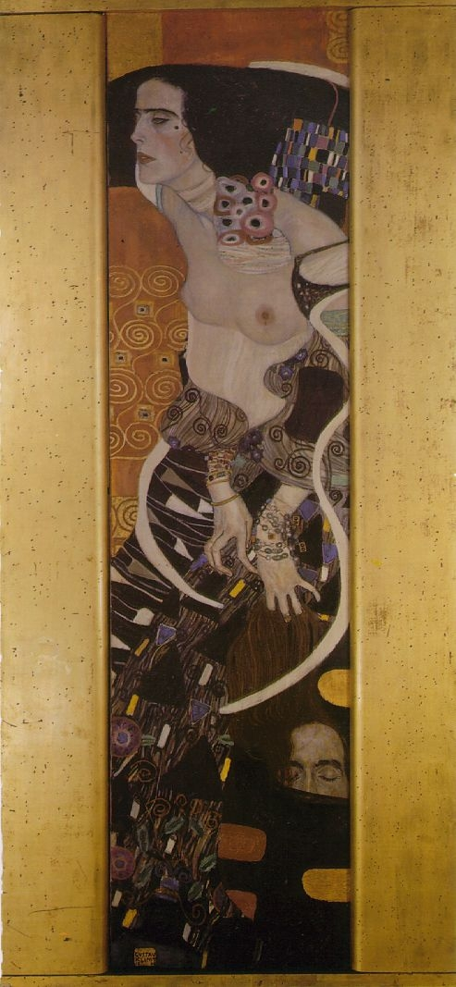
Gustav KLIMT (1862–1918)
Judith II (Vienna 1909)

Slide 24
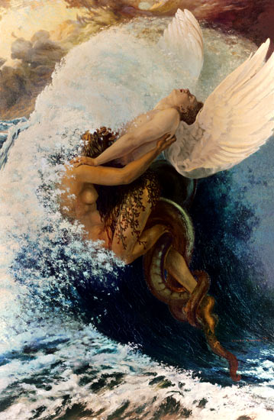
Carlos SCHWABE (1877–1926)
Spleen and Ideal (c. 1907–08)

