Slide 1
Regression Model Building
Predicting Number of Crew Members of Cruise Ships

Slide 2
Data Description
n=158 Cruise Ships
Dependent Variable – Crew Size (100s)
Potential Predictor Variables
Age (2013 – Year Built)
Tonnage (1000s of Tons)
Passengers (100s)
Length (100s of feet)
Cabins (100s)
Passenger Density (Passengers/Space)

Slide 3
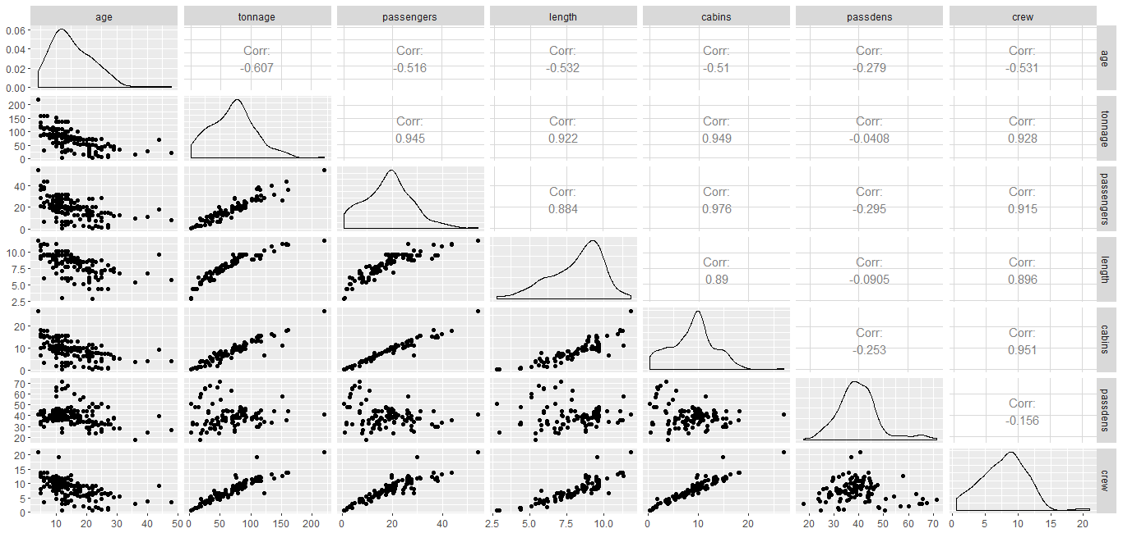
Correlation Plot / Matrix
High correlations among the predictors. (Passengers and Cabins is very problematic)
Passengers/Cabins: r=.976 Tonnage / Cabins: r=.949 Tonnage / Passengers: r=.945
Consider model with Predictors: Age, Tonnage, Passdens, Cabins, Length

Slide 4
Data – First 20 Cases

Slide 5
Full Model (5 Predictors, 6 Parameters, n=158)

Slide 6
Backward Elimination – Model Based AIC (minimize)

Slide 7
Forward Selection (AIC Based)

Slide 8
Stepwise Regression (AIC Based)

Slide 9
Summary of Automated Models
Backward Elimination
Drop Age (AIC drops from 9.09 to 7.24)
Drop Tonnage (AIC drops from 7.24 to 5.52)
Stop: Keep Passdens, Length, Cabins
Forward Selection
Add Cabins (AIC drops from 397.18 to 28.82)
Add Length (AIC drops from 28.82 to 9.87)
Add Passdens (AIC drops from 9.87 to 5.52)
Stop: Keep Passdens, Length, Cabins
Stepwise – Same as Forward Selection

Slide 10
All Possible (Subset) Regressions

Slide 11
All Possible (Subset) Regressions (Best 4 per Grp)

Slide 12
Cross-Validation
Hold-out Sample (Training Sample = 100, Validation = 58)
Fit Model on Training Sample, and obtain Regression Estimates
Apply Regression Estimates from Training Sample to Validation Sample X levels for Predicted ⇒ MSEP = sum(obs-pred)²/n
Fit Model on Validation Sample and Compare regression coefficients with model for Training Sample
PRESS Statistic (Delete observations 1-at-a-time)
Fit model with each observation deleted 1-at-a-time
Obtain Residual for each observation when it was deleted
PRESS = sum(obs-pred(deleted))²
K-fold Cross-validation
Extension of PRESS to where K groups of cases are deleted
Useful for computationally intensive models

Slide 13
Hold-Out Sample – n_{in} = 100 n_{out} = 58
Very similar coefficients for the 2 data sets

Slide 14
Testing Bias = 0 from Training data to Validation

Slide 15
PRESS Statistic
Model appears to be valid, very little difference between PRESS/n and MS(Resid)

Slide 16
K-fold Cross-Validation (k=10) – Full Model

