Slide 1
Principal Component Analysis
LPGA Golf Performance Variables – 2008 Season

Slide 2
Principal Components - Description
Data: p Variables observed on n Experimental/Sampling units
Goal: Describe the Variance-Covariance structure of the variables through uncorrelated linear combinations of the variables
Data Reduction: Fewer linear combinations (k) that “explain” large portion of total variation than the number of variables (p)
Interpretation: New variables (principal components) can simplify the summary of the original variables.
Used as input to other procedures such as Factor Analysis and Linear Regression when Predictors are Correlated

Slide 3
Population Principal Components - I

Slide 4
Population Principal Components - II

Slide 5
Principal Components - Bivariate Case (Sample)

Slide 6
LPGA 2008 Data

Slide 7
Population Principal Components - III

Slide 8
LPGA 2008 Data

Slide 9
Population Principal Components - IV

Slide 10
LPGA 2008 Data

Slide 11
Population Principal Components - V

Slide 12
LPGA 2008 Data

Slide 13
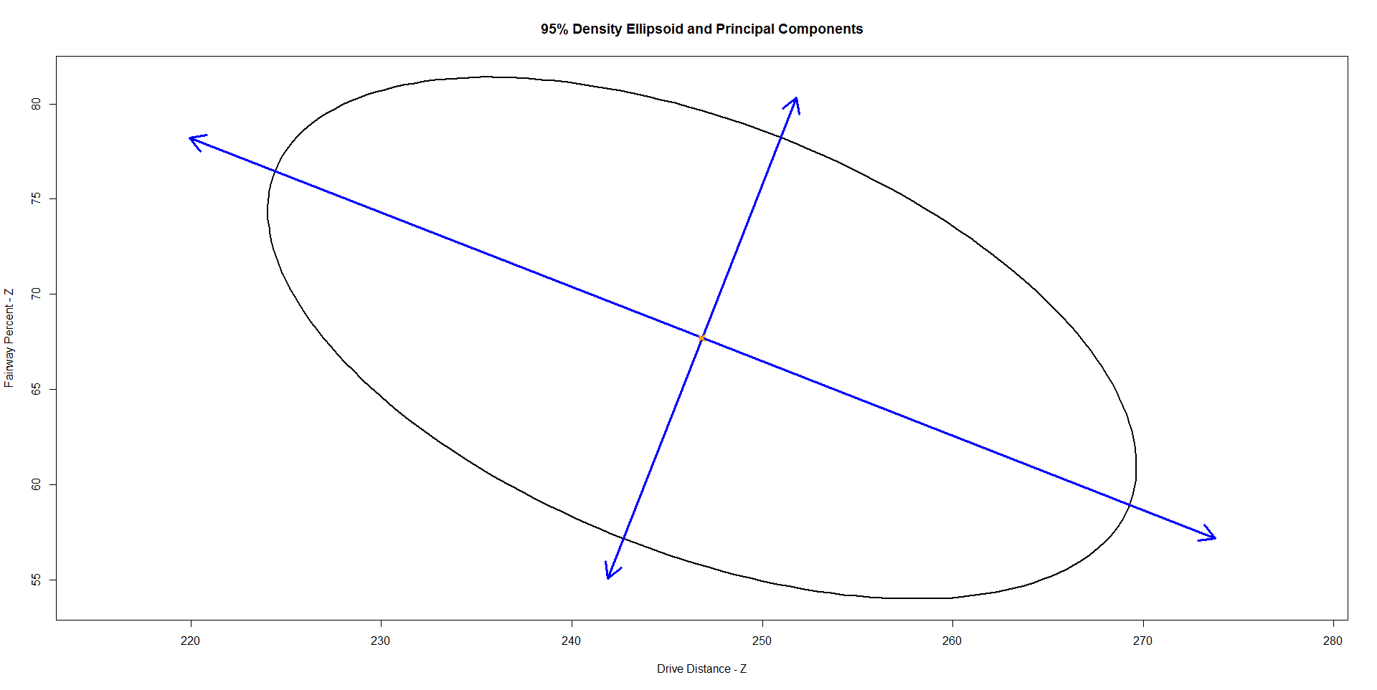
95% Density Ellipsoid and Principal Components

Slide 14
Principal Components for Standardized Variables

Slide 15
LPGA 2008 Data

Slide 16
LPGA 2008 Data

Slide 17
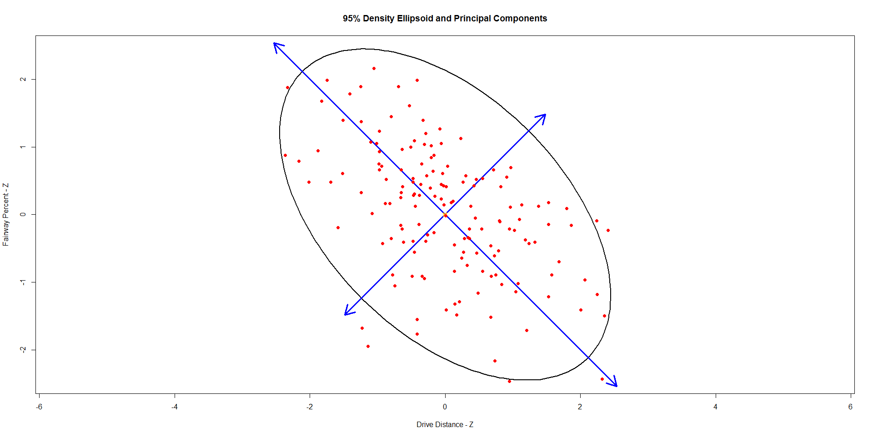
95% Density Ellipsoid and Principal Components

