Slide 1
Quantile Regression
Prize Winnings – LPGA 2009/2010 Seasons
www.lpga.com
Kahane, L.H. (2010). “Returns to Skill in Professional Golf: A Quantile Regression Approach,” International Journal of Sport Finance, Vol. 5, pp. 167-170
Cameron, A.C., and P.K. Trivedi (2010). Microeconometrics Using Stata, Revised Edition, STATA Press, College Station, TX.

Slide 2
Data Description
Ladies Professional Golf Association (LPGA) participants during 2009 and 2010 seasons
Response Variable: Earnings per Event entered ($1000s)
Predictor Variables:
Average Driving Distance
Percent of Fairways reached on Drives
Percent of Greens reached in Regulation
Putts per Hole on Greens reached in Regulation
Percent of Sand Saves (2 shots to hole)

Slide 3
Quantile Regression
Linear Regression is used to relate the Conditional Mean to predictors.
Quantile Regression relates specific quantiles to predictors. Particularly useful with non-normal data
Makes use of different loss function than Ordinary Least Squares – Uses linear programming to estimate

Slide 4
Summary Data for Earnings/Event
earnevent
-------------------------------------------------------------
Percentiles Smallest
1% .1654375 0
5% .5611538 0
10% 1.200667 .1654375 Obs 289
25% 2.991929 .2545882 Sum of Wgt. 289
50% 6.653733 Mean 13.44039
Largest Std. Dev. 17.40237
75% 15.45304 81.35504
90% 34.815 81.95658 Variance 302.8425
95% 54.85067 82.81731 Skewness 2.325991
99% 81.95658 99.06261 Kurtosis 8.461489
Note: The data are highly skewed:
Mean > 2*Median
Std. Dev. > Mean

Slide 5
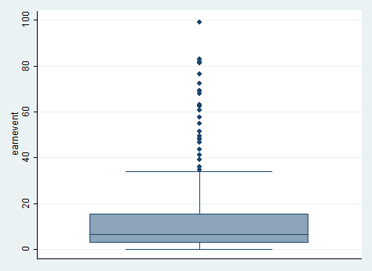
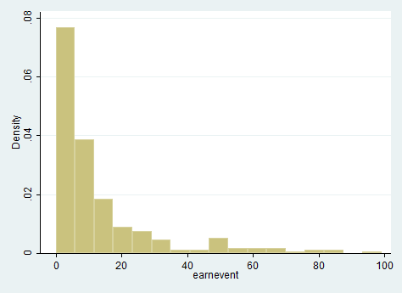
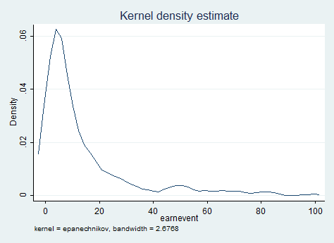
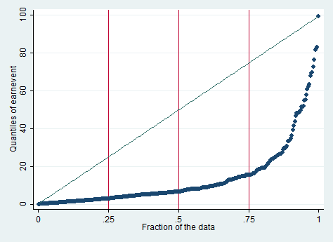
Plots of Earnings per Event – Showing Skew

Slide 6
Multiple Linear Regression
Source | SS df MS Number of obs = 289
-------------+------------------------------ F( 5, 283) = 68.95
Model | 47899.6433 5 9579.92865 Prob > F = 0.0000
Residual | 39318.9937 283 138.936374 R-squared = 0.5492
-------------+------------------------------ Adj R-squared = 0.5412
Total | 87218.637 288 302.84249 Root MSE = 11.787
------------------------------------------------------------------------------
earnevent | Coef. Std. Err. t P>|t| [95% Conf. Interval]
-------------+----------------------------------------------------------------
drive | .0749854 .112027 0.67 0.504 -.1455266 .2954974
fairway | .0765432 .1433219 0.53 0.594 -.2055689 .3586554
green | 1.515417 .2260856 6.70 0.000 1.070394 1.96044
girputtshole | -155.7758 19.96318 -7.80 0.000 -195.0709 -116.4806
sandsvpct | .4146478 .0919212 4.51 0.000 .2337117 .5955839
_cons | 160.2711 49.32258 3.25 0.001 63.1854 257.3567
------------------------------------------------------------------------------
The model explains approximately 55% of the variation in earnings per event
Important Factors: Greens in Regulation (+), Putts per hole (-), Sand Save Percent (+)

Slide 7
Influential Observations wrt β^{s}
These cases are extremely influential (higher than twice the “rule of thumb”).
Golfers: 30 (Michelle Ellis, 2009), 104 (Liselotte Neuman, 2009), 125 (Jiyai Shin, 2009), 166 (Paula Creamer, 2010), 211 (Cristie Kerr, 2010), 249 (Angela Park, 2010), and 268 (Jiyai Shin, 2010) appear to have high influence on several regression coefficients

Slide 8
Quantile Regression
Models the regression relation for various quantiles between the predictors and the response variable: Earnings per Event
Standard errors of regression coefficients are estimated by bootstrapping 400 samples

Slide 9
Quantile Regression Output (STATA)
Note:
Driving distance is only significant among golfers at the 75th percentile
Putting ability effect increases among skill levels
Greens in regulation effect is fairly equal among skill levels
Fairway accuracy is not significant for any skill level
Sand saves are more important for golfers at the 75th percentile

Slide 10
Tests of Equality of Coefficients Across Quantiles
. test[q25=q50=q75]: drive
( 1) [q25]drive - [q50]drive = 0 ( 2) [q25]drive - [q75]drive = 0
F( 2, 283) = 3.25 Prob > F = 0.0403
. test[q25=q50=q75]: fairway
( 1) [q25]fairway - [q50]fairway = 0 ( 2) [q25]fairway - [q75]fairway = 0
F( 2, 283) = 0.27 Prob > F = 0.7603
. test[q25=q50=q75]: green
( 1) [q25]green - [q50]green = 0 ( 2) [q25]green - [q75]green = 0
F( 2, 283) = 0.58 Prob > F = 0.5600
. test[q25=q50=q75]: girputtshole
( 1) [q25]putts - [q50]putts = 0 ( 2) [q25] putts - [q75] putts = 0
F( 2, 283) = 1.62 Prob > F = 0.1989
. test[q25=q50=q75]: sandsvpct
( 1) [q25]sandsvpct - [q50]sandsvpct = 0 ( 2) [q25]sandsvpct - [q75]sandsvpct = 0
F( 2, 283) = 5.35 Prob > F = 0.0053

Slide 11
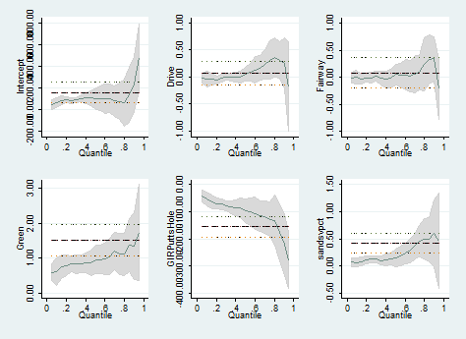
Plots of Regression Coefficients by Quantile

