Slide 1
1-Way Random Effects Model
NBA Player Efficiencies by Game
2016-2017 Regular Season

Slide 2
Setting
Population of Units
Each Unit has a True Mean Level of Response
Individual Measurements Within Units Vary Around the Unit’s Mean Response
Overall Population Mean Response is Mean of Individual Units’ Mean Responses
A Sample of g Units are Taken, and Measurements are Made Among a Sample of n_{i} “Subunits” Within the i^{th} Sampled Unit.
Goals: Estimate Population Mean Response, Among and Within Unit Variances, Intraclass Correlation

Slide 3
Statistical Model – Normal Effects and Errors - I

Slide 4
Means and Variances of Sample Means

Slide 5
Sums of Squares and Their Expectations

Slide 6
ANOVA F-test – Balanced Case

Slide 7
Estimating Overall Mean μ - Balanced Data

Slide 8
Estimating Intra-Class Correlation ρ_{I} = σ_{α}² /( σ_{α}² + σ²)

Slide 9
Estimating Within Group Variance: σ²

Slide 10
Estimating Between Group Variance: σ_{α}²

Slide 11
Satterthwaite’s Approximation

Slide 12
Example – NBA Player Efficiencies – 2016/7
Population: 409 Players (At least 10 games with more than 6 minutes of playing time in a game)
Total of 23655 player games (Average of 57.8 games per player)
Response Variable: Efficiency scaled to 36 Minutes:
36[(Points+Rebounds+Assists+Steals+Blocks)-(MissedFG+MissedFT+Turnovers)]/Minutes
Obtain Average for each player
Obtain (Unweighted) Average across players
Obtain player effect (Player Average – Overall Average)
Obtain within player “Errors” (Game – Player Average)

Slide 13
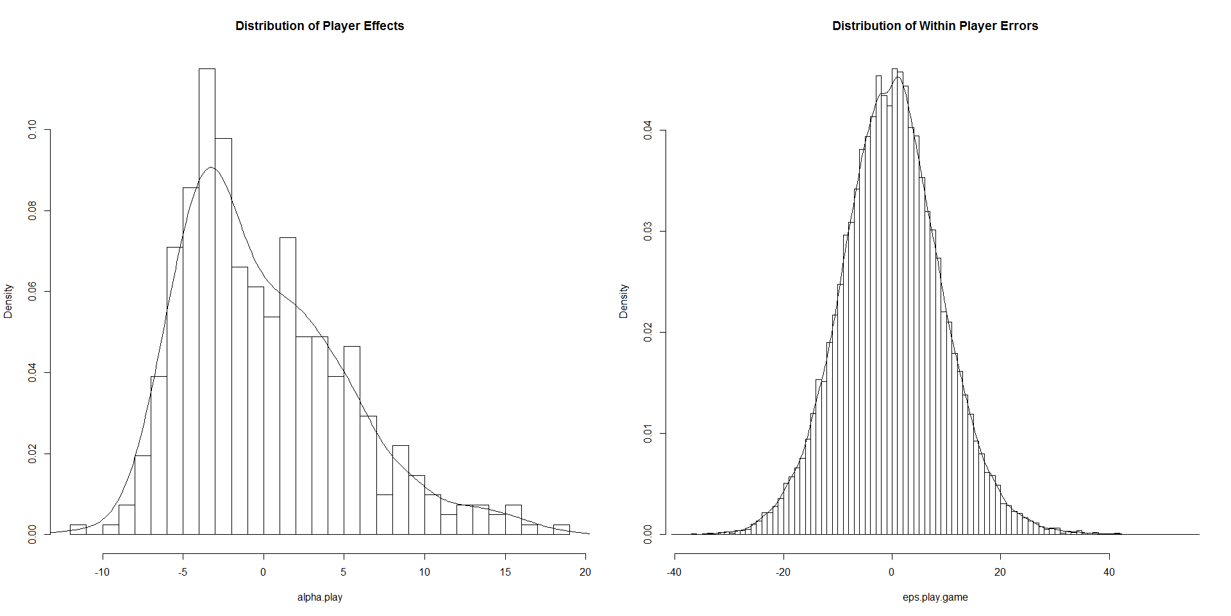
Population Results

Slide 14
Sampling/Analysis Procedure
Take many random samples (10000)
Within Samples:
Take a Random Sample of Players (g=15)
For each Sampled Player, Take a Random Sample of Games (n=6)
Compute and Save:
F-Statistic
Estimates and Confidence Intervals for: Mean, Variance Components, and Intraclass Correlation
Compare with True Values of Parameters

Slide 15
Numeric Results
Notes:
Between variance estimates are biased low (below the true value) partly caused by negative estimates
Coverage rates are below the nominal .95 due to the fact that the random player effects are skewed

Slide 16
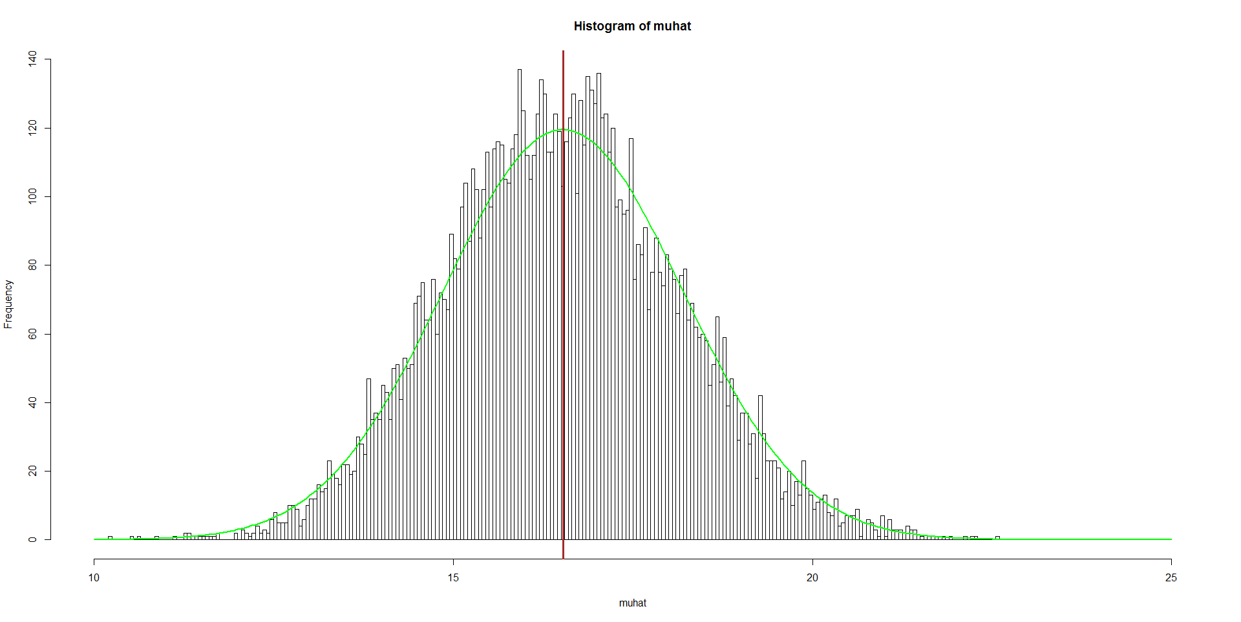
Histogram of the Estimates of μ

Slide 17
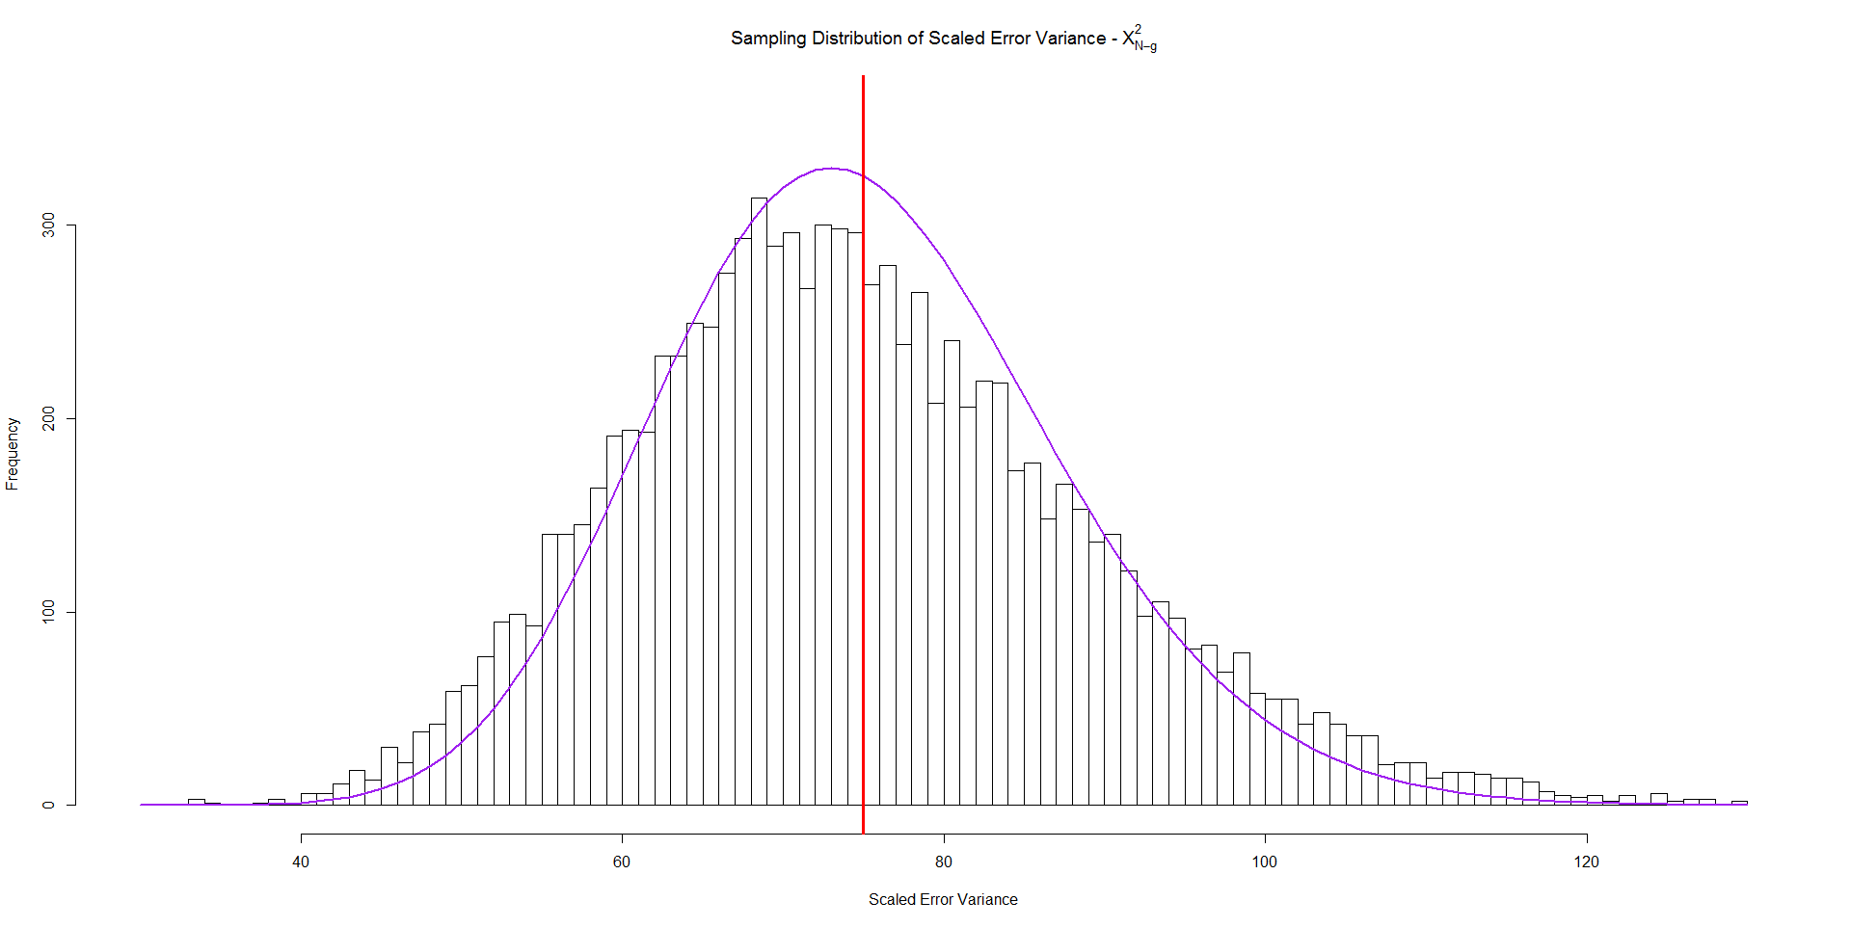
Histogram of the (Scaled) Estimates of σ²

Slide 18
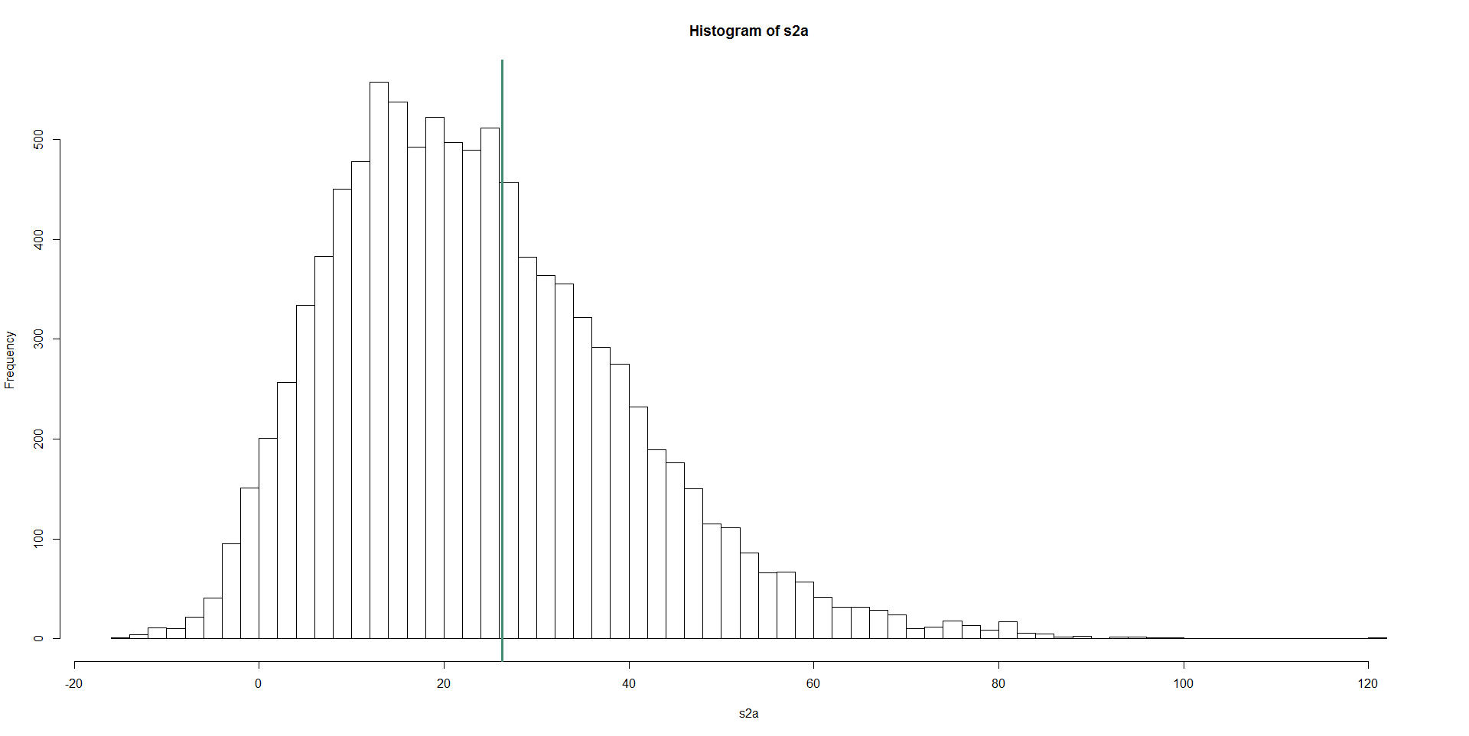
Histogram of the Estimates of σ_{α}²

Slide 19
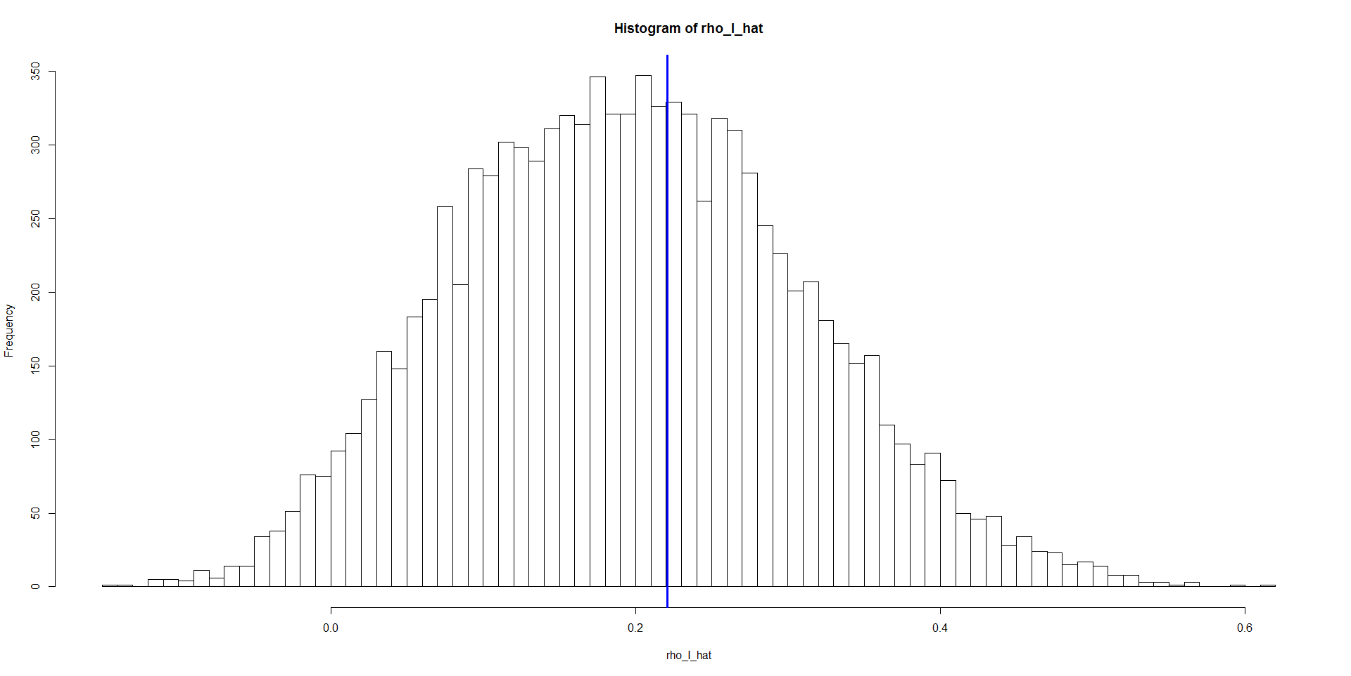
Histogram of Estimates of ρ_{I}

Slide 20
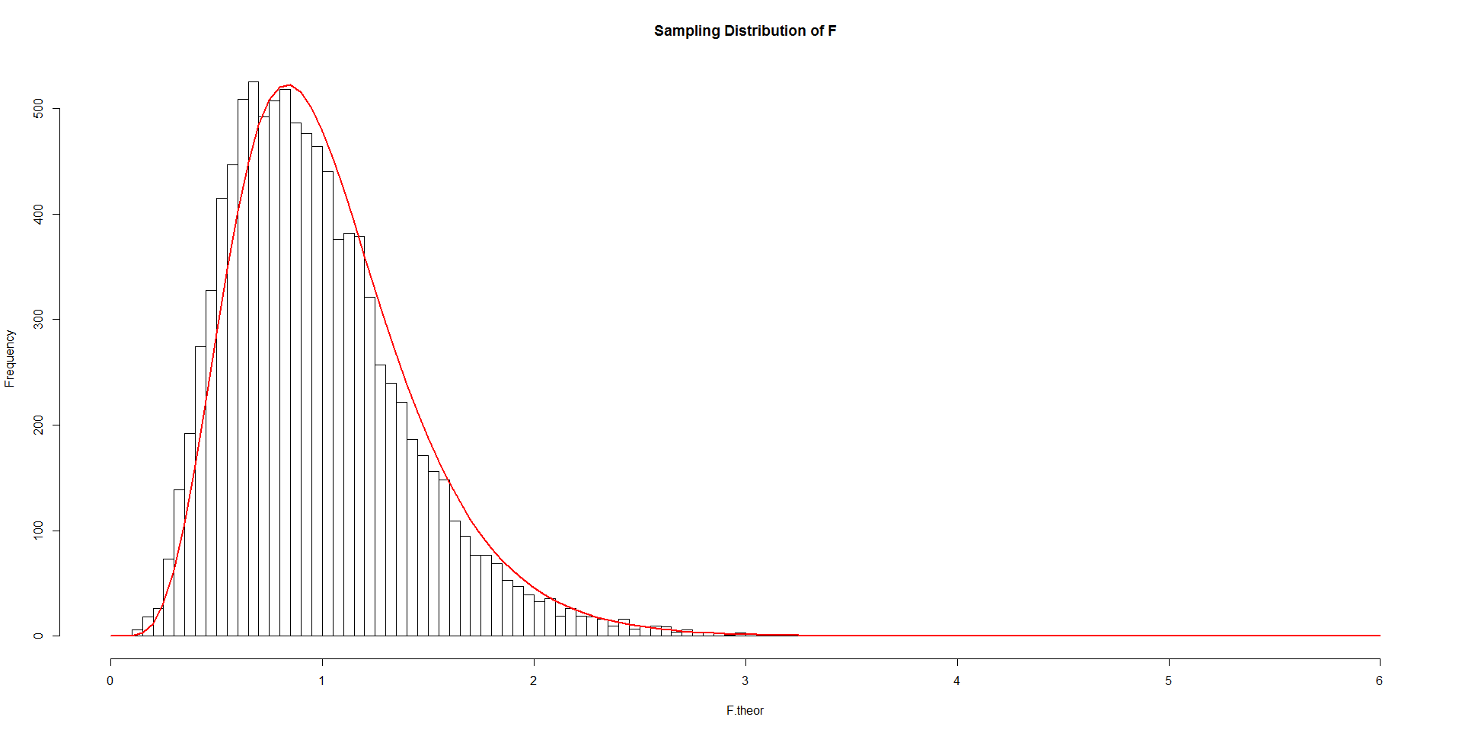
Histogram of F

