Slide 1
Matrix form of 1-Way ANOVA Cell Means Model Weighted Least Squares
Body Mass Index for NHL, EPL, and NBA Athletes

Slide 2
Populations / Model
All National Hockey League, English Premier League, and National Basketball Association Players
Y ≡ Body Mass Index = 703(weight²/height)
Weight (pounds), Height (inches)
NHL (2014): μ₁ = 26.50 σ₁ = 1.455 N₁ = 717
NBA (2013-14): μ₂ = 24.74 σ₂ = 1.720 N₂ = 505
EPL (2015): μ₃ = 23.02 σ₃ = 1.713 N₃ = 526

Slide 4
Matrix Form of the Model and OLS Estimation

Slide 5
OLS with all Means Being Equal

Slide 6
Weighted Least Squares with Different Means

Slide 7
WLS with all Means Being Equal

Slide 8
I - Weighted Least Squares Testing H₀: μ₁ = μ₂ = μ₃

Slide 9
II - Weighted Least Squares Testing H₀: μ₁ = μ₂ = μ₃

Slide 10
III - Weighted Least Squares Testing H₀: μ₁ = μ₂ = μ₃

Slide 11
IV - Weighted Least Squares Testing H₀: μ₁ = μ₂ = μ₃

Slide 12
V - Weighted Least Squares Testing H₀: μ₁ = μ₂ = μ₃

Slide 13
VI - Weighted Least Squares Testing H₀: μ₁ = μ₂ = μ₃

Slide 14
Testing for League Differences in Mean BMI Levels
For each Sample Size arrangement:
Obtain the degrees of freedom for the F-Statistic: (df₁ 3-1=2, df₂ = N-3)
Obtain Critical Value for α = 0.05 level test based on the central F-distribution: F_{.05;df1,df2}
For the corresponding non-central F, with non-centrality parameter 2Ω_{Trts}, find the area above the Critical Value from the central F. This is the power of the test to detect these particular differences
In R, use: 1-pf(qf(1-α,df1,df2),df1,df2,2Ω_{Trts})

Slide 15
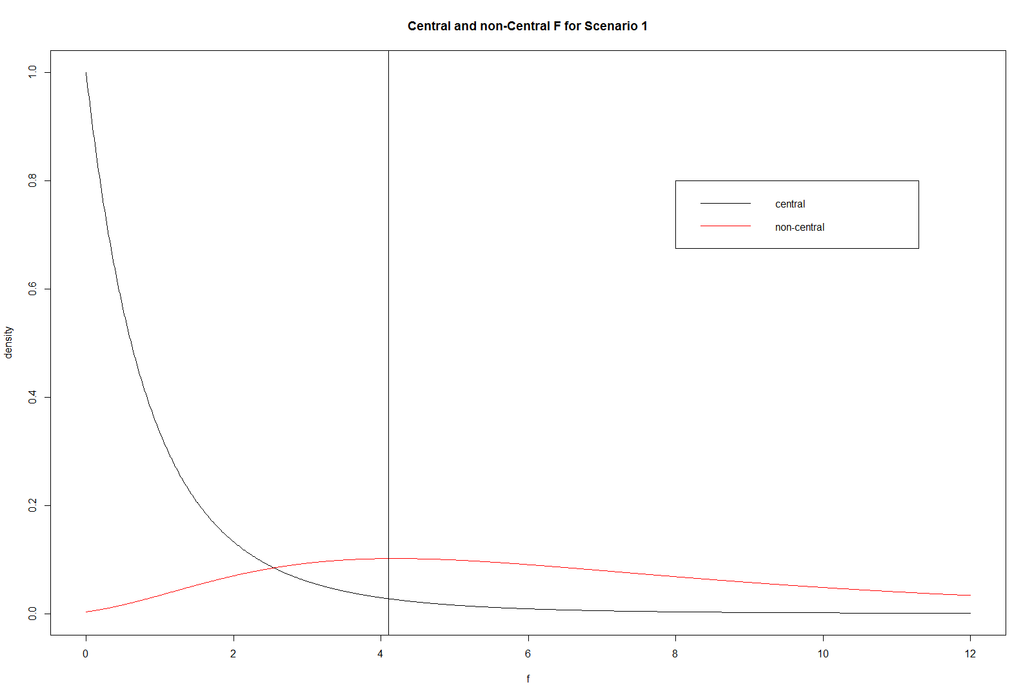

Slide 16
Simulating the F-test from Actual Distributions
For each Sample Size Scenario, sample without replacement, n_{i} individuals from league i
Compute the F-Statistic and save it.
Obtain summary statistics of the computed F-Statistics and observe how many exceed F_{.05,df1,df2}
Plot a Histogram of the computed statistics
If possible, super-impose the theoretical non-central F-distribution over Histogram

Slide 17
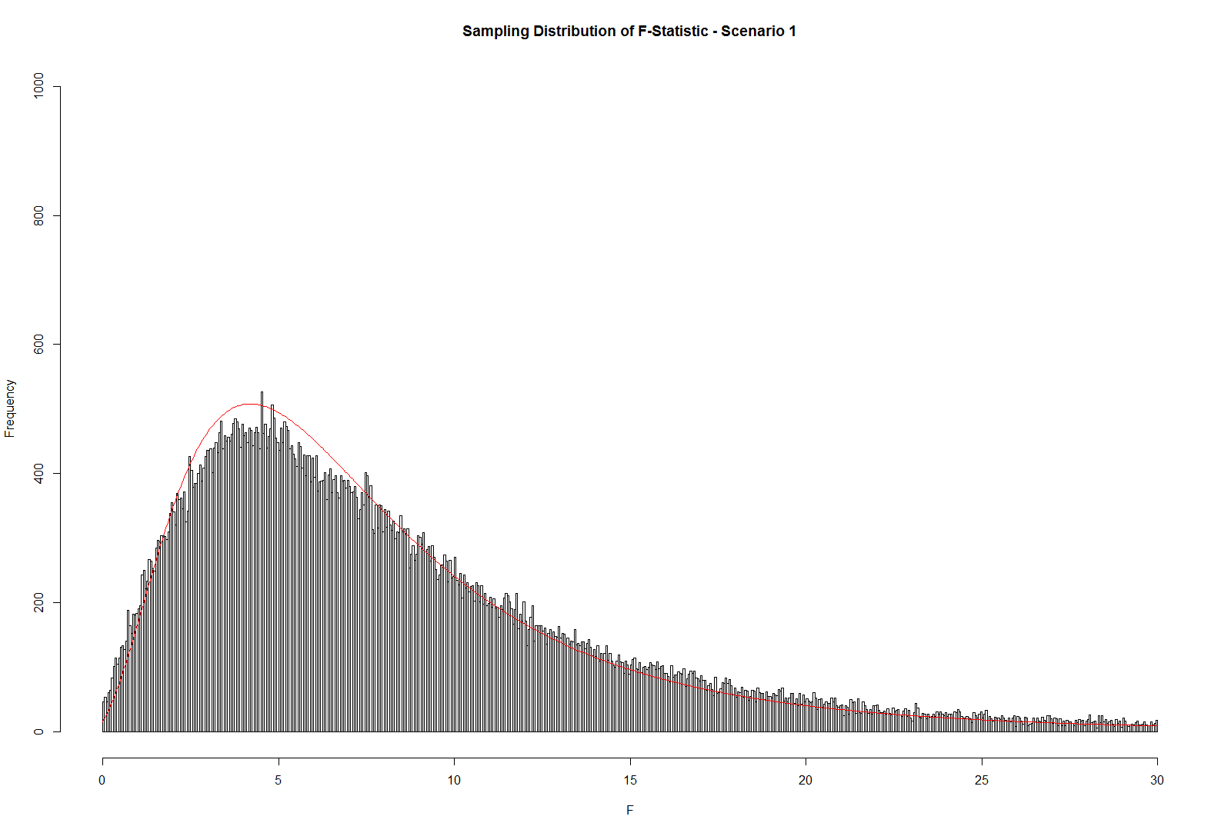

Slide 18
