Slide 1
Violations of Assumptions In Least Squares Regression

Slide 2
Standard Assumptions in Regression
Errors are Normally Distributed with mean 0
Errors have constant variance
Errors are independent
X is Measured without error

Slide 3
Example X^{s} and OLS Estimators
“t” is used to imply time ordering

Slide 4
Non-Normality Errors (t₃ errors)

Slide 5
Errors = 3*t₃
E(ε_{t}) = E(3*t₃)=3E(t₃)=3*0=0
V(ε_{t}) = V(3*t₃)=9V(t₃)=9*(3/(3-2))=27
Based on 100,000 simulations, the 95% CI for β₁ contained 10 in 95.31% of the samples.
Average=9.999271, SD=0.3478
Average s²(b1) = 0.1216903

Slide 6
Non-Constant Error Variance (Heteroscedasticity)
Mean: E(Y) = β₀ + β₁ X = 50 + 10X
Standard Deviation: σ_{X} = 0.1(X+5)
Distribution: Normal

Slide 7
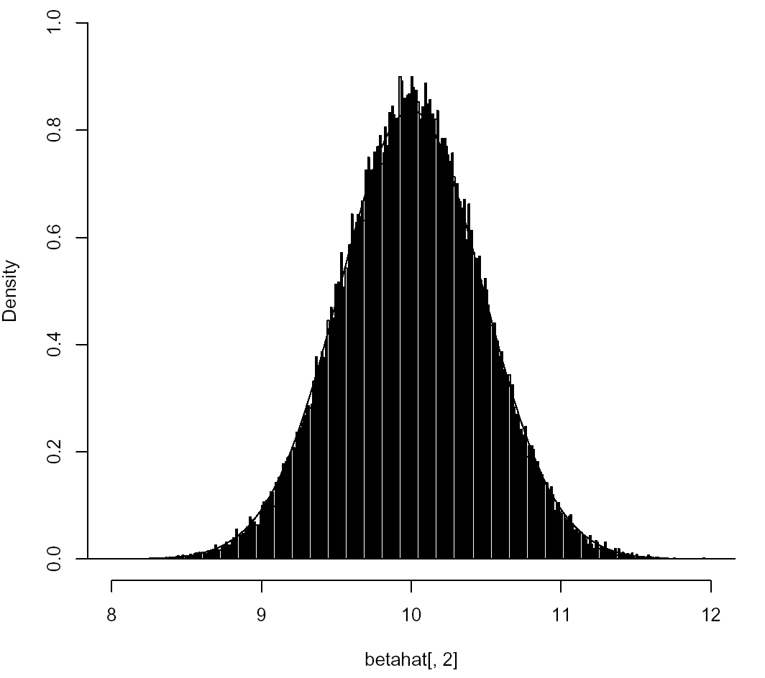
Non-Constant Error Variance (Heteroscedasticity)
Based on 100,000 simulations, the 95% CI for β₁ contained 10 in 92.62% of the samples.
Average=9.999724, SD=0.4667337
Average s²(b1) = 0.1813961 < 0.2184

Slide 8
Correlated Errors
Example: σ²= 9, ρ=0.5, n=22

Slide 9
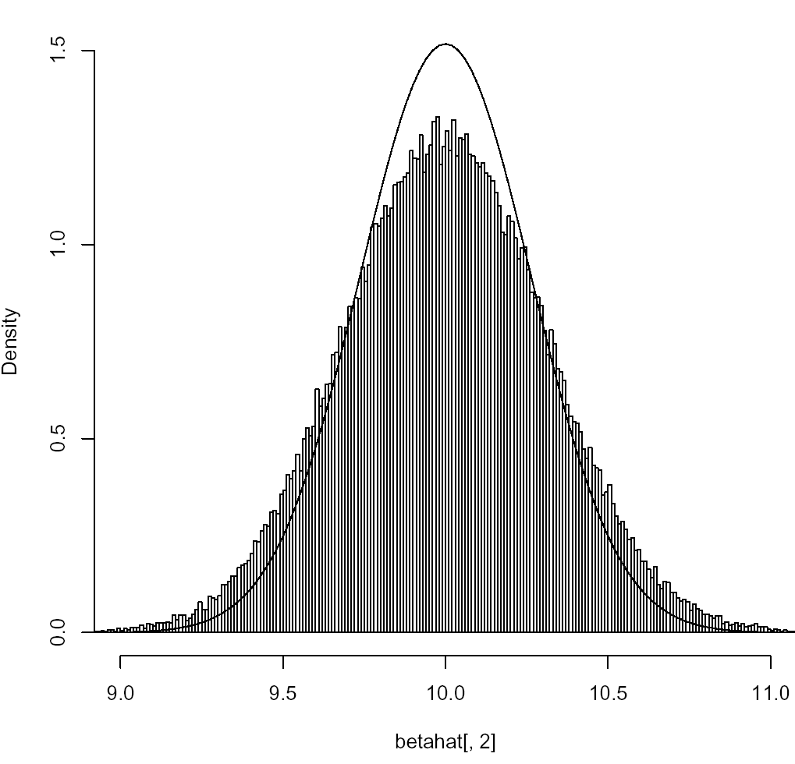
Correlated Errors
Based on 100,000 simulations, the 95% CI for β₁ contained 10 in 84.46% of the samples.
Average=9.99853, SD=0.3037228
Average s²(b1) = 0.0474835 < 0.092157

Slide 10
Measurement Error in X
Z=True Value of Independent Variable (Unobserved)
X=Observed Value of Independent Variable
X=Z+U (Z can be fixed or random)
Z, U independent (assumed) when Z is random
V(U) is independent of Z when Z is fixed

Slide 11
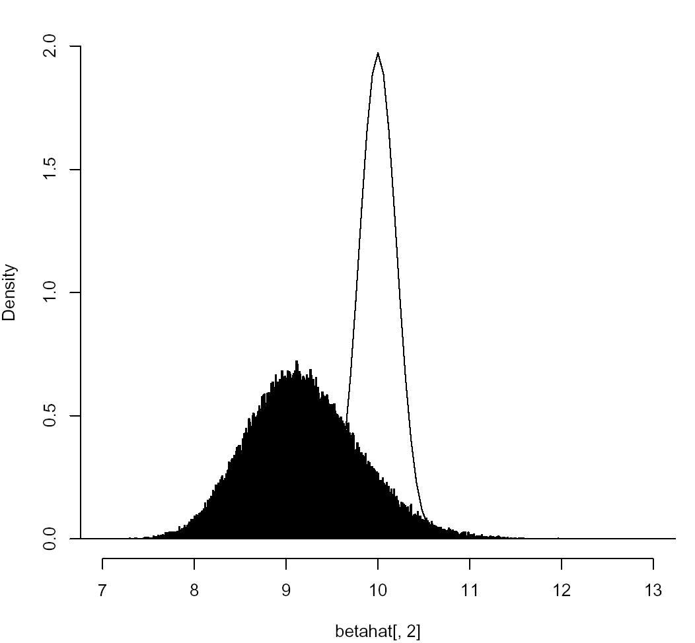
Measurement Error in X
Based on 100,000 simulations, the 95% CI for β₁ contained 10 in 76.56% of the samples.
Average=9.197172, SD=0.6112944
Average s²(b1) = 0.4290028 >> (0.20226)²

