Slide 1
Randomization/Permutation Tests
Body Mass Indices Among NBA & WNBA Players
Home Field Advantage in England Premier League

Slide 2
Background
Goal: Compare 2 (or More) Treatment Effects or Means based on sample measurements
Independent Samples: Units in different treatment conditions are independent of one another. In controlled experiments they have been randomized to treatments. Observed data are: Y₁₁,…Y_{1n1} and Y₂₁,…,Y_{2n2}
Paired Samples: Units are observed under each condition (treatment), and the subsequent difference has been obtained: d_{j} = Y_{1j} – Y_{2j} j=1,…,n
Procedure: Working under null hypothesis of no differences in treatment effects, how extreme is observed treatment difference relative to many (in theory all) possible randomizations/permutations of the observed data to the treatment labels.

Slide 3
Independent Samples – 2 Treatments
Algorithm:
Compute Test Statistic for Observed Data and save
Obtain large number of permutations (N) of observed values to treatment labels
For each permutation, compute the Test Statistic and save
P-value = (# Permuted TS ≥ Observed TS)/(N+1)

Slide 4
Example – NBA and WNBA Players’ BMI
Groups: Male: NBA(i=1) and Female: WNBA(i=2)
Samples: Random Samples of n₁ = n₂ = 20 from 2013 seasons (2013/2014 for NBA)

Slide 5
Permutation Samples
Generate Permutations of the 40 integers using a random number generator (like pulling 1:40 from hat, one-at-a-time without replacement)
Assign the first 20 players (based on id) selected to Treatment 1, last 20 to Treatment 2
Compute and save Test Statistic:
Continue for many (N total) samples
Count number as large or larger than observed Test Statistic (in absolute value, if 2-sided test)
P-value obtained as (Count+1)/(N+1)

Slide 6
Permutation Samples (EXCEL)
Comments:
Column 4: (Ran1) has smallest number (.01077) corresponding to id=11. Thus player 11 is first player in group 1 in Permutation sample. Next smallest is .06690 (id=34)
The “sort” columns (5-8) give the first permutation samples for the 2 groups.
The difference in BMI for groups 1 and 2 in the original sample is 1.5957
The difference in BMI for groups 1 and 2 in the permutation sample is 0.8568

Slide 7
R Program
### Download dataset
nba.bmi <- read.csv("http://www.stat.ufl.edu/~winner/data/wnba_nba_bmi.csv",
header=T)
attach(nba.bmi); names(nba.bmi)
### Obtain sample sizes, sample means, and observed Test Statistic
(n1 <- length(BMI[Gender==1])); (n2 <- length(BMI[Gender==2]))
(ybar1.obs <- mean(BMI[Gender==1])); (ybar2.obs <- mean(BMI[Gender==2]))
(TS.obs <- ybar1.obs-ybar2.obs); (n.tot <- n1+n2)
### Choose number of permutations and initialize TS vector to save Test Statistics
### set seed to be able to reproduce permutation samples
N <- 9999; TS <- rep(0,N); set.seed(97531)
### Loop through N samples, generating Test Stat each time
for (i in 1:N) {
perm <- sample(1:n.tot,size=n.tot,replace=F)
if (i == 1) print(perm)
ybar1 <- mean(BMI[perm[1:n1]]) ### mean BMI of first n1 elements of perm
ybar2 <- mean(BMI[perm[(n1+1):(n1+n2)]]) ### mean BMI of next n2 elements of perm
TS[i] <- ybar1-ybar2
}
### Count # of cases where abs(TS) >= abs(TS.obs) for 2-sided test and obtain p-value
(num.exceed <- sum(abs(TS)>=abs(TS.obs)))
(p.val.2sided <- (num.exceed+1)/(N+1))
### Draw histogram of distribution of TS, with vertical line at TS.obs
hist(TS,xlab="Mean1 - Mean2",breaks=seq(-2.5,2.5,0.25),
main="Randomization Distribution for BMI")
abline(v=TS.obs)

Slide 8
R Output
> ### Obtain sample sizes, sample means, and observed Test Statistic
> (n1 <- length(BMI[Gender==1]))
[1] 20
> (n2 <- length(BMI[Gender==2]))
[1] 20
> (ybar1.obs <- mean(BMI[Gender==1]))
[1] 24.94665
> (ybar2.obs <- mean(BMI[Gender==2]))
[1] 23.35099
> (TS.obs <- ybar1.obs-ybar2.obs)
[1] 1.595653
> (n.tot <- n1+n2)
[1] 40
### First permutation of 1:40
[1] 26 31 12 20 4 28 23 13 2 19 9 35 34 5 16 14 29 11 32 24 39 10 7 3 36
[26] 30 21 27 1 38 17 22 15 25 8 18 6 40 33 37
> ### Count # of cases where abs(TS) >= abs(TS.obs) for 2-sided test and obtain p-value
> (num.exceed <- sum(abs(TS)>=abs(TS.obs)))
[1] 121
> (p.val.2sided <- (num.exceed+1)/(N+1))
[1] 0.0122

Slide 9
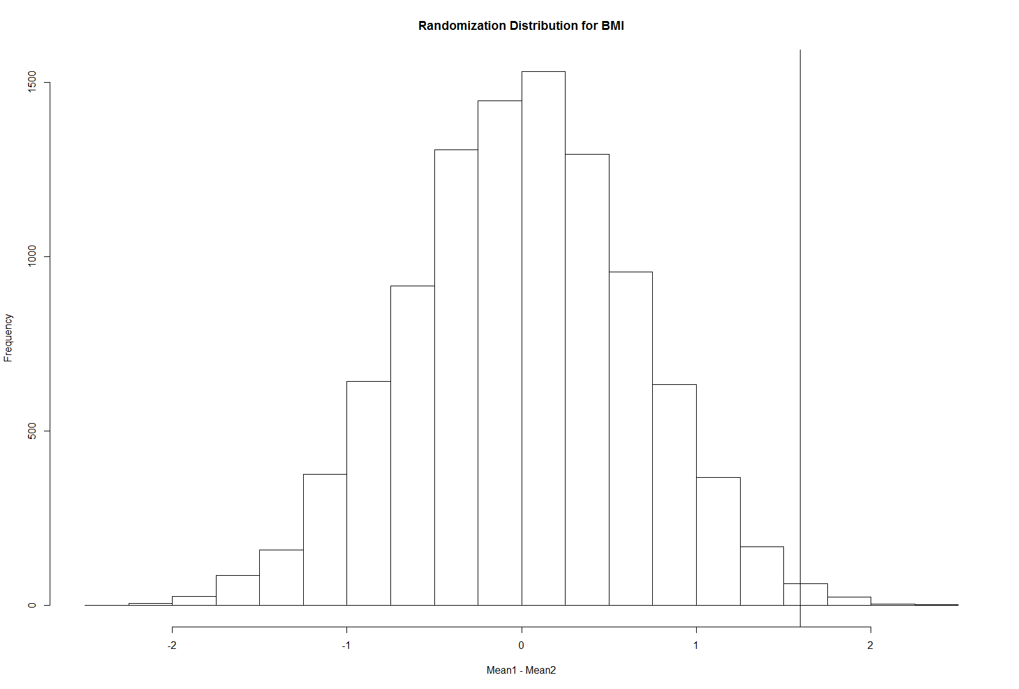

Slide 10
Normal t-test (Equal Variances Assumed)

Slide 11
t-test for NBA vs WNBA BMI
Note: the Permutation and t-tests give the same P-value to 4 decimal places – ≈Normal Data

Slide 12
Paired Samples
Data Consists of n Pairs of Observations (Y_{1j},Y_{2j}) j=1,…,n
Data are on same subject (individuals matched on external criteria) under 2 conditions (often Before/After)
Construct the differences: d_{j} = Y_{1j} - Y_{2j}
The true population mean difference is: μ_{d} = μ₁ – μ₂
Wish to test H₀: μ_{d} = 0 with a 1-sided or 2-sided alternative

Slide 13
Procedure
Compute an observed Test Statistic that measures the treatment effect in some manner (such as the sample mean of the differences)
For many randomization samples:
Generate a series of n U(0,1) random variables: U₁,…,U_{n}
If (say) U_{j}< 0.5 set d_{j*} = -d_{j} where d_{j*} is difference for case j in this sample, otherwise, set d_{j*} = d_{j}
Compute the Test Statistic for this sample and save
Compare the observed Test Statistic with the sample Test Statistics in a manner similar to Independent Sample Case: Computing the proportion of sample Test Statistics as extreme or more than the observed Test Statistics

Slide 14
Example: English Premier League Football - 2012
Interested in Determining if there is a home field effect
League has 20 teams, all play all 19 opponents Home and Away (190 pairs of teams, each playing once on each team’s home field). No overtime.
Label teams in alphabetical order: 1=Arsenal, 20=Wigan
Let Y_{1jk} = (H_{j}-A_{k}) j < k Differential when j at Home, k is Away
Let Y_{2jk} = (A_{j}-H_{k}) j < k Differential when j is Away, k is at Home
d_{jk} = Y_{1jk} – Y_{2jk} = (H_{j}+H_{k}) - (A_{j}+A_{k}) j < k
Note: d represents combined Home Goals – Combined Away Goals for the Pair of teams
No home effect should mean μ_{d} = 0

Slide 15
Representative Games from the Sample
Comments (regarding these 9 pairs, and these 2 samples - Full Analysis next slide):
For the original sample, the Test Statistic is the Average Difference: 0.556
For the first random sample, games 1,4,8 had Ran1 < 0.5, and their d_{jk} switched sign. The new sampled test statistic was 1.000
For the second random sample, games 1,2,3,5,6,8 had Ran2 < 0.5, and their d_{jk} switched sign. The new sampled test statistic was -0.333
The p-value for a 1-tailed (H_{A}: μ_{d} > 0) would be p = (1+1)/(2+1) = 2/3 as both the original sample and Ran1 have Test Statistics ≥ 0.556. The 2-sided is also p = 2/3

Slide 16
R Program
epl2012 <- read.csv("http://www.stat.ufl.edu/~winner/data/epl_2012_home_perm.csv",
header=T)
attach(epl2012); names(epl2012)
### Obtain Sample Size and Test Statistic (Average of d.jk)
(n <- length(d.jk))
(TS.obs <- mean(d.jk))
### Choose the number of samples and initialize TS, and set seed
N <- 9999; TS <- rep(0,N); set.seed(86420)
### Loop through samples and compute each TS
for (i in 1:N) {
ds.jk <- d.jk # Initialize d*.jk = d.jk
u <- runif(n)-0.5 # Generate n U(-0.5,0.5)'s
u.s <- sign(u) # -1 if u.s < 0, +1 if u.s > 0
ds.jk <- u.s * ds.jk
TS[i] <- mean(ds.jk) # Compute Test Statistic for this sample
}
summary(TS)
(num.exceed1 <- sum(TS >= TS.obs)) # Count for 1-sided (Upper Tail) P-value
(num.exceed2 <- sum(abs(TS) >= abs(TS.obs))) # Count for 2-sided P-value
(p.val.1sided <- (num.exceed1 + 1)/(N+1)) # 1-sided p-value
(p.val.2sided <- (num.exceed2 + 1)/(N+1)) # 2-sided p-value
### Draw histogram of distribution of TS, with vertical line at TS.obs
hist(TS,xlab="Mean Home-Away",main="Randomization Distribution for EPL
2012 Home Field Advantage")
abline(v=TS.obs)

Slide 17
R Output
>
> ### Obtain Sample Size and Test Statistic (Average of d.jk)
> (n <- length(d.jk))
[1] 190
> (TS.obs <- mean(d.jk))
[1] 0.6368421
>
> summary(TS)
Min. 1st Qu. Median Mean 3rd Qu. Max.
-0.573700 -0.110500 -0.005263 -0.002513 0.100000 0.542100
> (num.exceed1 <- sum(TS >= TS.obs)) # Count for 1-sided (Upper Tail) P-value
[1] 0
> (num.exceed2 <- sum(abs(TS) >= abs(TS.obs))) # Count for 2-sided P-value
[1] 0
> (p.val.1sided <- (num.exceed1 + 1)/(N+1)) # 1-sided p-value
[1] 1e-04
> (p.val.2sided <- (num.exceed2 + 1)/(N+1)) # 2-sided p-value
[1] 1e-04
The observed Mean difference (0.6368) exceeded all 9999 sampled values:
(min = -0.5737, max = 0.5421) Thus, both P-values = (0+1)/(9999+1) = .0001

Slide 18
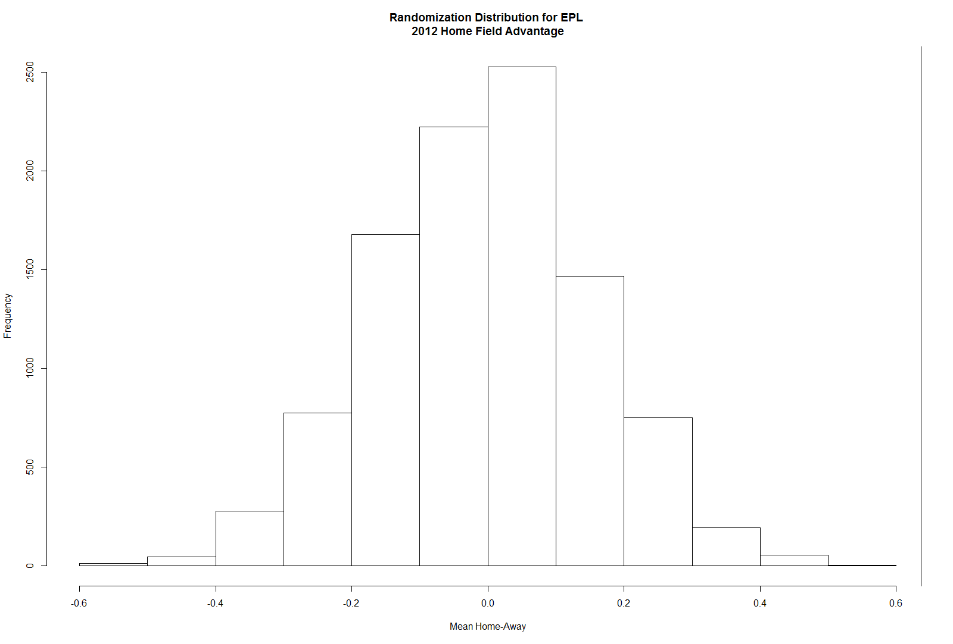

Slide 19
Normal Paired t-test

Slide 20
Paired t-test for EPL 2012 Home vs Away Goals
Note: the t-test gives smaller P-value, but Permutation test was limited to number of samples

