Slide 1
Inference Concerning a Proportion
Results from an Extrasensory Perception (ESP) Experiment

Slide 2
Experimental Data
53 students participated in an ESP experiment
Experiment consisted of 25 categories with 3 choices per category
Randomization used to choose “Target” option within each category
Each student selected one of the 3 options for each category
Total of 53(25) = 1325 Selections
Total of 484 Correct Choice
Sample Proportion Correct: 484/1325 = .3653 (36.53%)

Slide 3
Data

Slide 4
Inference Regarding π – No Subject Effects

Slide 5
Testing for Heterogeneity Among Subjects
Test often used in meta-analyses to test whether the true effects among individual studies differ
No evidence of Heterogeneity Among Subjects

Slide 6
Bayesian Analysis for a Proportion
Makes use of a PRIOR distribution for the unknown parameter π: f(π)
Updates information regarding π once data has been obtained in form of the LIKELIHOOD: p(y|π)
Combines the prior and the likelihood into a POSTERIOR distribution for π: f(π|y)
The posterior is proportional to the product of the prior and the likelihood

Slide 7
3 Prior Distributions
“Flat Prior” – Uniform distribution over [0,1] ≡ Beta(1,1)
“Concentrated Prior” – Beta distribution with mean equal to guessing value (1/3) and a standard deviation of .015. Beta(329,658)
Exponentially decreasing distribution over the range [1/3,1]

Slide 8
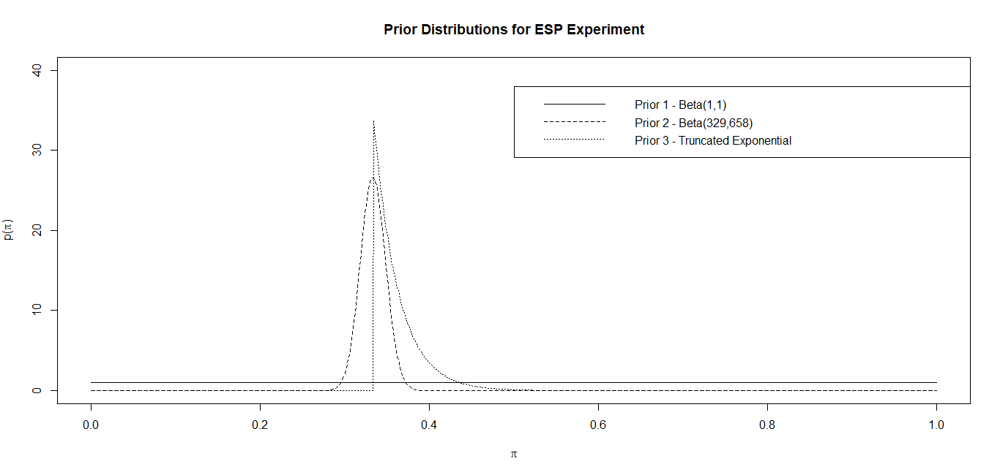
Plots of Prior Distributions

Slide 9
Posterior Distributions

Slide 10
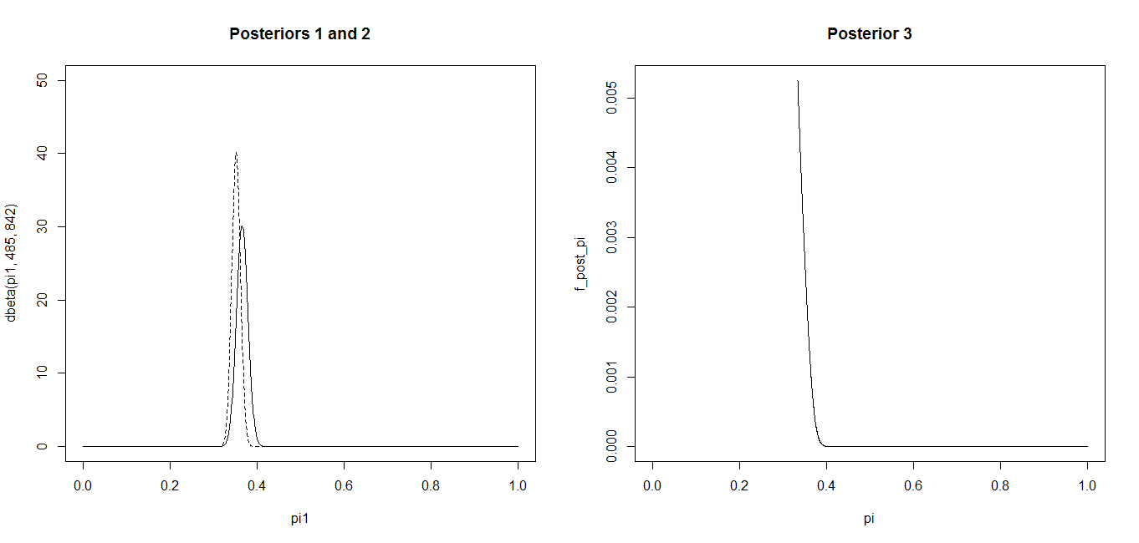
Plots of Posterior Distributions

