Slide 1
Model Estimation and Comparison Gamma and Lognormal Distributions
2015 Washington, D.C. Rock ‘n’ Roll Marathon Velocities

Slide 2
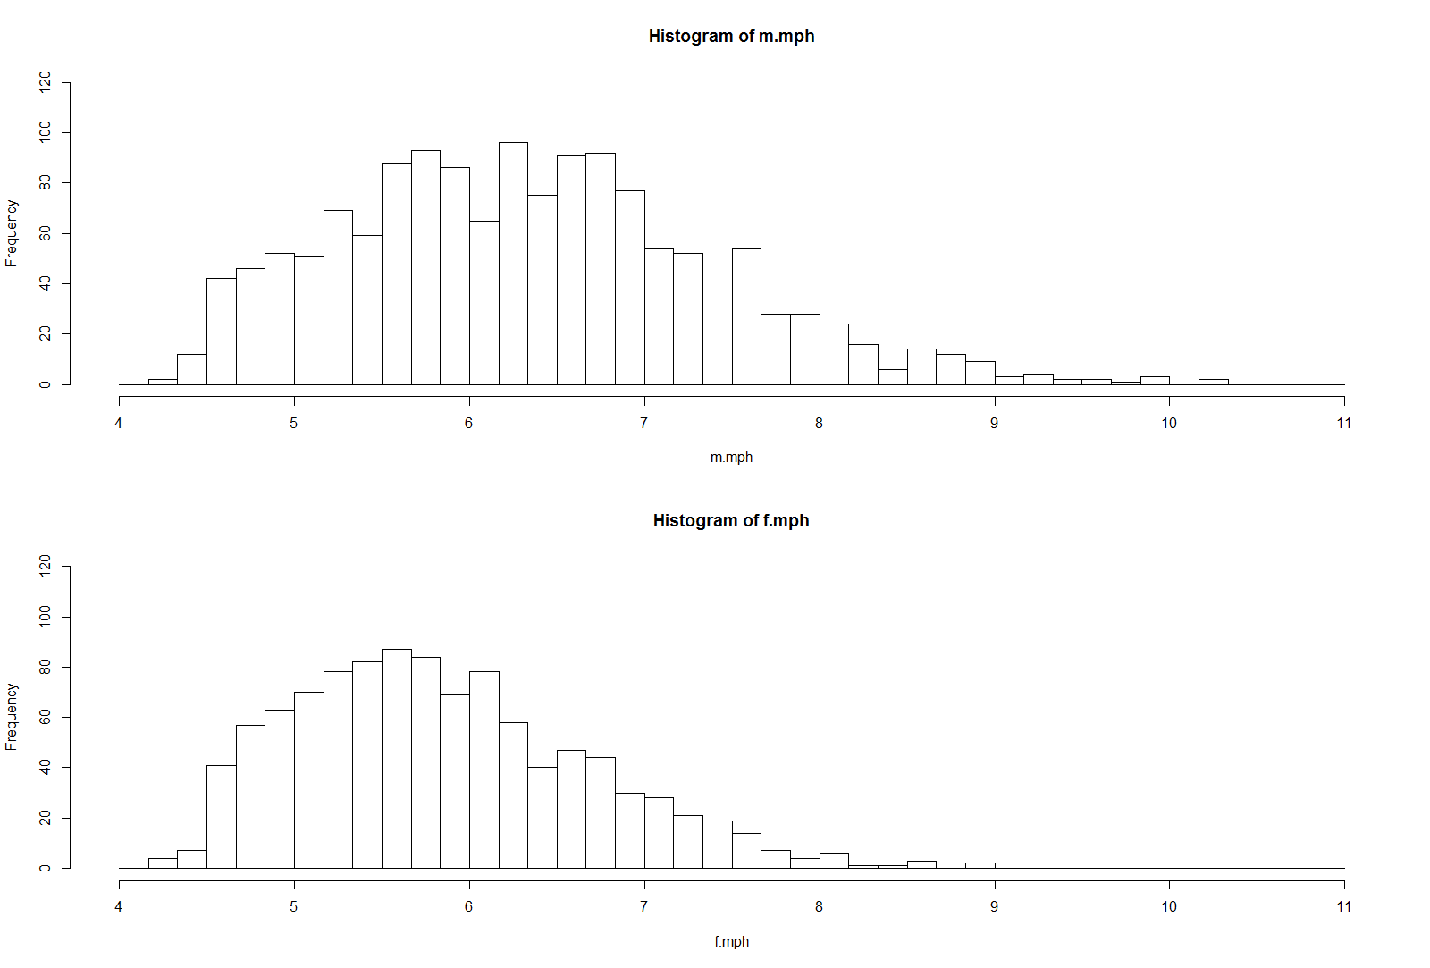
Data Description / Distributions
Miles per Hour for 2499 people completing the marathon (1454 Males, 1045 Females)
Males: Mean=6.337, SD=1.058, Min=4.288, Max=10.289
Females: Mean=5.840, SD=0.831, Min=4.278, Max=8.963

Slide 3
Gamma and Lognormal Distributions

Slide 4
Method of Moments Estimators - Gamma
Obtain the Sample Mean and Variance and Use them to obtain estimates of parameters

Slide 5
Method of Moments Estimators - Lognormal

Slide 6
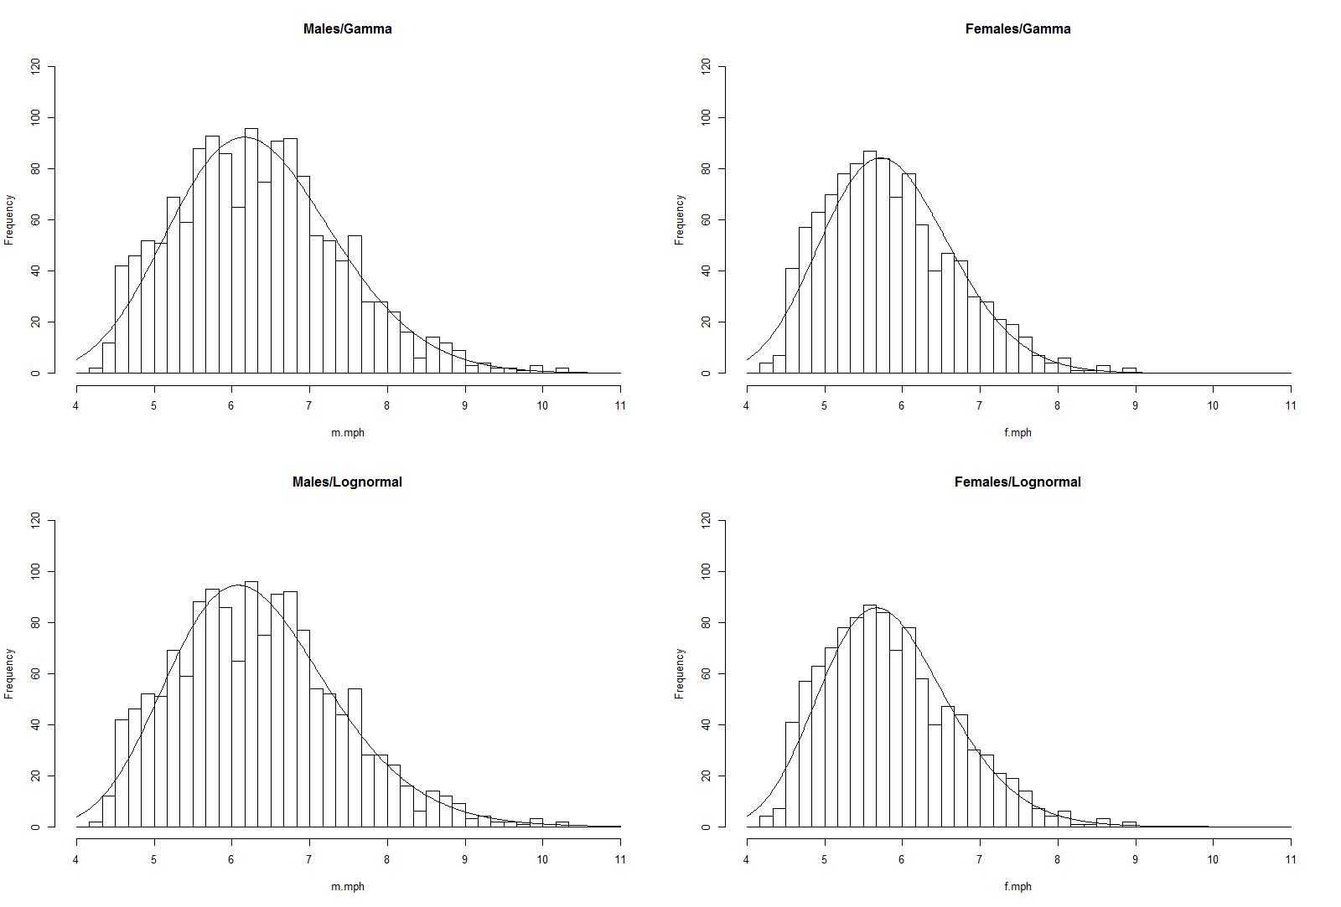
Method of Moments Estimates / Graphs

Slide 7
Maximum Likelihood Estimators - Gamma

Slide 8
Maximum Likelihood Estimators - Lognormal

Slide 9
Maximum Likelihood Estimates

Slide 10
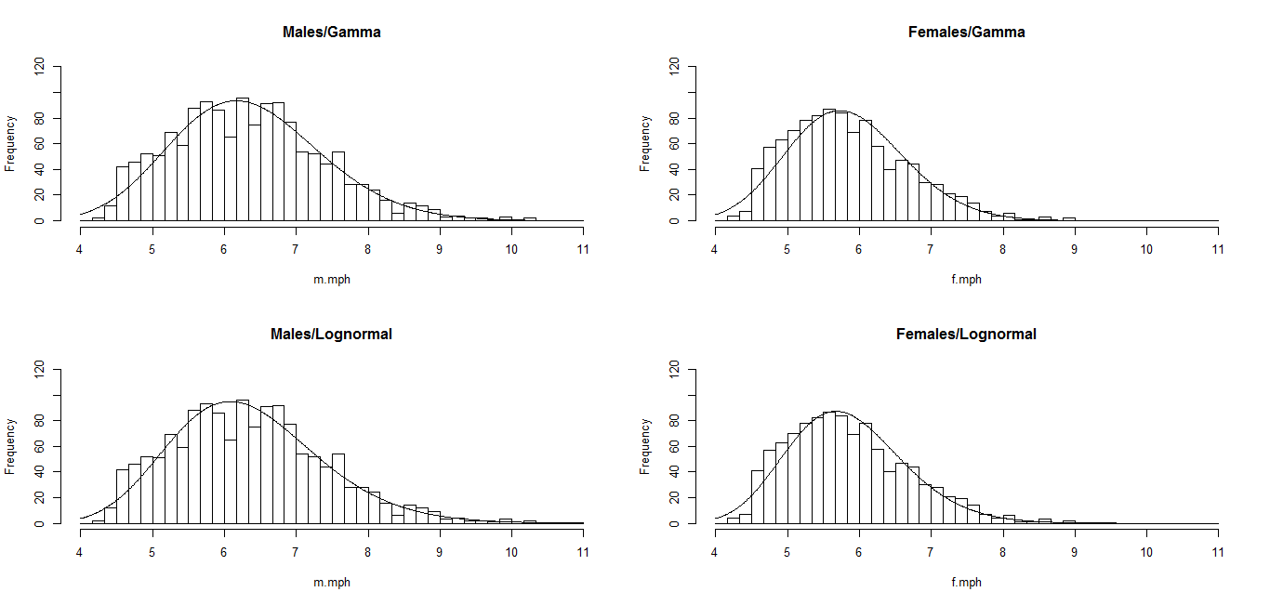
Maximum Likelihood Estimates / Graphs

Slide 11
Minimum Chi-Square Estimator
Slice Range of Y (mile per hour) values into a set of non-overlapping sub-ranges
Create a grid of parameter values for each distribution (Gamma and Lognormal)
Obtain the Pearson Chi-Square statistic for each set of parameter values and choose the values that minimize the Chi-Square statistic
Ranges for this example:
Males: (0,4.75],(4.75,5.25],…,(8.75,9.25] ,(9.25,∞)
Females: (0,4.75],(4.75,5.25],…,(7.25,7.75] ,(7.75,∞)

Slide 12
Minimum Chi-Square Results
For both Males and Females, the Lognormal appears to fit better than the Gamma (smaller minimum chi-square statistic). However, for Females, the chi-square statistic exceeds the critical value, rejecting the null hypothesis that the distribution is appropriate.

