Slide 1
(Approximately) Bivariate Normal Data and Inference Based on Hotelling’s T²
WNBA Regular Season Home Point Spread and Over/Under Differentials 2010-2018

Slide 2
Description of Population
Units: N=1833 WNBA Regular Season Games with Home Team Point Spread and Over/Under Total Lines During 2010-2018 Regular Seasons
Home Point Spread Line (X₁) : The Number of Points the Home Teams “Starts Up” by at Game Begin (Negative Spread Implies Home Team is Favored – Starts Behind)
Over/Under Total Line (X₂) : Expected Total Points by Both Teams in a Game
Home Team Score (X₃) Away Team Score (X₄)

Slide 3
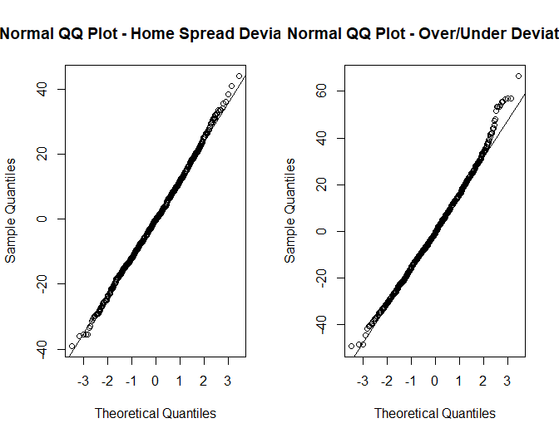
Population Data

Slide 4
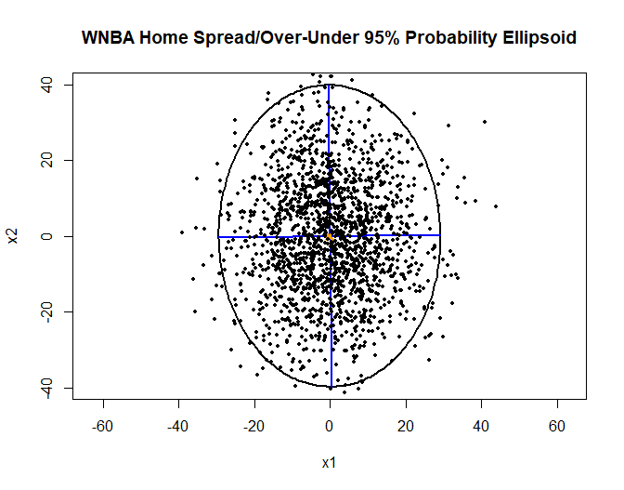

Slide 5
Sampling Distributions of Mean Vector and Variance-Covariance Matrix

Slide 6
Hotelling’s T²

Slide 7
Sampling from the Population
Number of Random Samples: 100000
Sample Size: n = 50
For each Sample:
Save: Mean Vector and Variance-Covariance Matrix
Test H₀: δ = 0 Obtain 95% CIs for δ₁, δ₂
Compare Univariate Distributions of Mean Differences with Theoretical Distributions
Plot Mean Differences with Superimposed Bivariate Normal Ellipsoid
Graph Histogram of Scaled T² Statistics with Superimposed F-distribution
Compare Mean and Variance of Sample Variances and Covariance with Theoretical Values
Graph Histogram of Scaled Correlation Coefficients with t-density (ρ ≈ 0)

Slide 8
Empirical Results

Slide 9
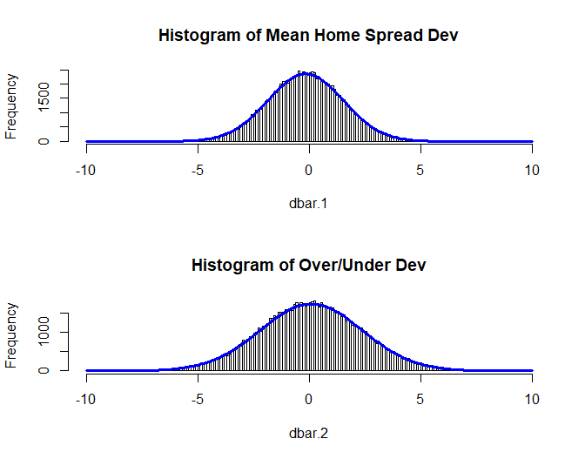
Empirical Distributions of Means and Normal Densities

Slide 10
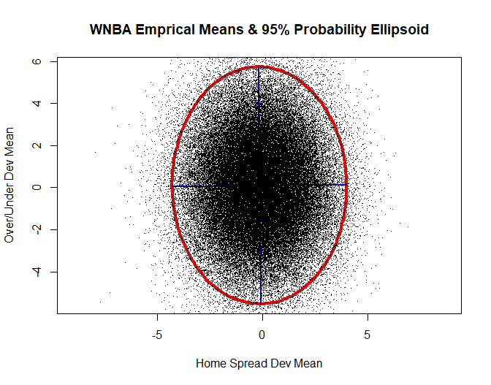
Bivariate Empirical Distributions and Normal Ellipsoid

Slide 11
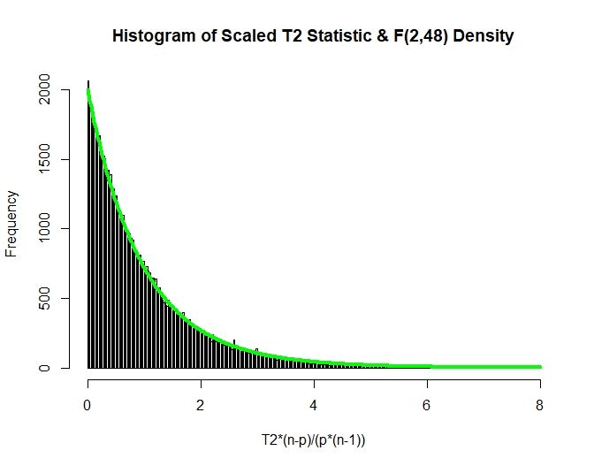

Slide 12
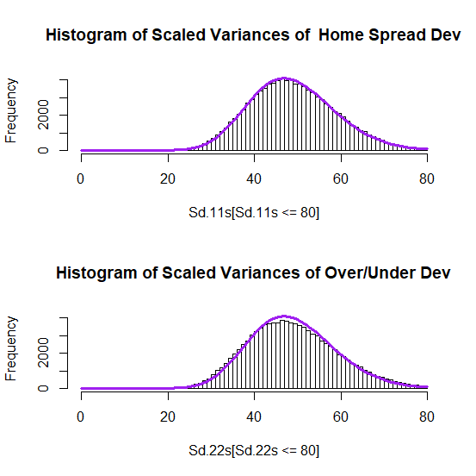

Slide 13
