Slide 1
Quantum Mechanics:
How Einstein and Bohr led everybody astray
Erik Deumens
UFIT Research Computing & Quantum Theory Project
Dept. of Physics and Dept. of Chemistry
University of Florida
Notes:
This talk will rattle your concepts of physics and quantum mechanics
Unless you sleep through the talk.
I will do my very best to not let you go to sleep

Slide 2
One slide summary of the talk
Classical mechanics
Quantum mechanics
ANALOGY
1 photograph
1 frame
static
MATHEMATICS
Newton equation
ANALOGY
2 hour movie
24 frames per second
172,800 = 24 x 7,200 frames
smoothly aligned sequence
MATHEMATICS
Schrödinger equation
Notes:
If there is one thing to remember, it is this.
I will come back to this throughout the talk

Slide 3
Some history
1926 – Birth of quantum mechanics
The correct mathematical formulation
Never contradicted by any finding since
Heisenberg, Jordan, Born, Schrödinger, Dirac,…
1900 – 1926 – today
Arguments about quantum phenomena
Contradicting interpretations
Planck, Einstein, Bohr,…
Notes:
Not a single one has held up to all findings
Some are just an excuse to not make a precise verifiable statement

Slide 4
Scientific method
Phenomenology - Description
Theory - Explanation
1619 – Kepler – laws of planetary motion
1869 – Mendeleev – Periodic table of elements
1926 – Born – Probability rule
1687 – Newton – Law of force and law of gravity
1913 – Bohr – Atomic theory of elements and chemical bonding
2013 – Allaverdyan, Balian, Nieuwenhuizen – derivation of Born’s rule from Liouville-von Neumann equation
Notes:
John Newlands (1864) and Julius Meyer (1864) gave preliminary versions of the periodic table

Slide 5
Some philosophy
Notes:
Two views in philosophy of science
Start from data and experiment
Build theory to derive what is observed
We need both to get useful scientific theories that can feed engineering applications

Slide 6
The mystery of quantum mechanics
Notes:
The famous double slit experiment shows the essential paradox
There are many other ways to show it

Slide 7
The math of quantum mechanics
Notes:
Compare the math of classical and quantum
There are very similar in some ways, and very different in other ways.

Slide 8
Tomomura, Endo, Matsuda, Kawasaki, Exawa Amer. J. Phys, 57, p. 117 (1989)
Notes:
The result on the computer display screen of a real double slit experiment

Slide 9
State of the theory
The disagreement
  Math is about wave functions
  Experiment is about particles popping up randomly
Bohr – some questions cannot be asked – black box
  Sounds like an excuse to not look for an answer
Bohm – precise trajectories guided by pilot wave
  The mysteries of the wave function are now on the pilot wave
Everett – wave function splits in multiple universes
  How do we experimentally verify that?
Notes:
Sketch the positions of a few “interpretations”
There are many variations and some other approaches, too.

Slide 10
A circular argument
Notes:
The arguments are circular because of a fundamental assumption made by Einstein and Bohr and almost everybody else.

Slide 11
John Bell (1928-1990) & Alain Aspect (1947-)
Bell’s theorem
Aspect’s experiment
Develop theory
Analyze statistics of values
Analogy: Photographs
Correlation is smaller than a limit
Bell’s inequality
Measure the correlation
Quantum mechanics has functions
Analogy: videos
Correlation is found larger
Bell’s inequality is violated
Heisenberg is right
Bohr and Einstein are wrong
Notes:
John Stewart Bell 1964 published a theorem with a clear statistical test about what should be measured if the dynamics is controlled by variables (photographs!) as a classical theory.
Quantum mechanics uses functions (movies!) and gets different result.
Alan Aspect and his team did an experiment and showed that the quantum result is correct.
Statistics of pictures of cats: 292,000,000 in 0.52 s
Statistics of frames from videos of cats: 799,000,000 in 0.75 s -> higher correlation

Slide 12
How does this work?

Slide 13
Classical atom is not stable
Notes:
Explain the nature of old quantum theory

Slide 14
Bohr atom has a “quantum condition”
Notes:
Bohr’s atom was a great advance, he got the Nobel Prize in 1922 for this work
He built the theory of the periodic table with it, which is still valid
Only we use different math to get the correct numbers, but the concepts are Bohr’s

Slide 15
Old QM view – Einstein 1948
Either there is a definite q and p; ψ is incomplete
Or ψ is complete, there is not q and p; precise values are created by unavoidable measurement process
Notes:
Einstein got the Nobel prize in 1921 for the photoelectric effect (awarded in 1922)

Slide 16
Young Heisenberg view
Bohr expected the answer would follow from a direct analysis of the definition of the idealized concepts,
Heisenberg argued that the answer was hidden in the formal structure of the theory and that a closer scrutiny of this structure would bring it to light.
  Commentary of Rosenfeld in 1971
The bubbles revealing particle tracks form as a result of a complex process initiated by the charged particle

Slide 17
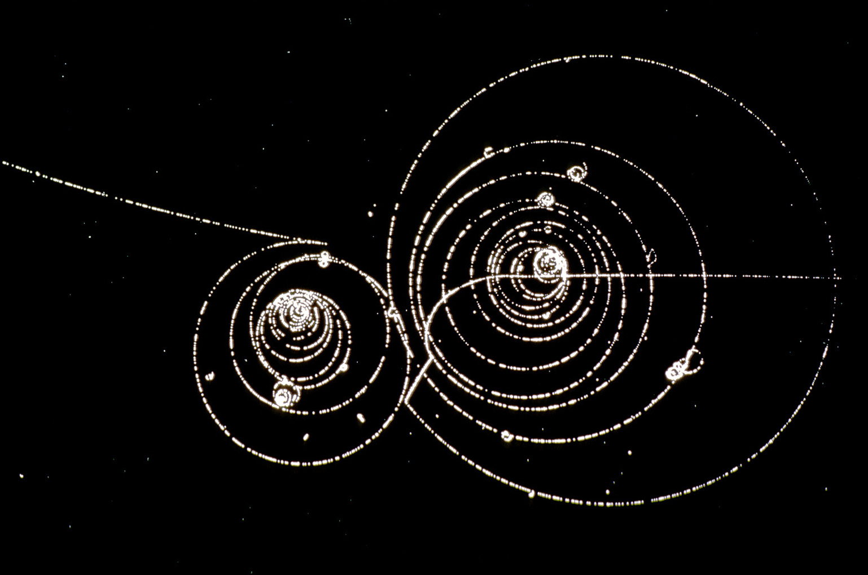
Tracks of particles in a Wilson cloud chamber
Notes:
What happens in the cloud chamber is complex physics, involving a macroscopically large number of degrees of freedom and a phase transition
Supersaturated water or alcohol
Cloud chamber invented in 1911 by Charles Thomson Rees Wilson
Bubble chamber invented later in 1952 by Donald A. Glaser

Slide 18
Physics in the detector
In classical theories – measurement is direct observation
Bohr and Einstein assumed that remains valid for quantum phenomena
Heisenberg suspected it is not valid
It is not valid!

Slide 19
Notes:
Take a closer look at the detector.
How does it work?
What is going on in there?
Is it so simple we can just describe it as “it records”?

Slide 20
The Tomomura et al. detector
Electrons 50 kV – half speed of light – traverse 1.5 m in 0.1 μs – one electron injected every 1000 μs – no interaction between any two
Detector 12 mm diameter
Fluorescent film – molecules – about 30 atoms – 10 nm diameter – 80 nm² cross section – 10¹² molecules in the detector
One electron impact generates 500 photons – one photon emitted from one molecule – one mini detector has 500 molecules
The detector has 2 x 10⁹ = 10¹² / 500 = 2,000,000,000 mini detectors
Photons from 2,000 mini detectors caught in one 5 μm optical fiber
Notes:
Do some numbers…

Slide 21
Every experiment in QM is complicated
It has more moving parts than the CMS and ATLAS experiments at LHC
Namely atomic nuclei and electrons
Of the order of Avogadro’s number
N = 10²³ = 100,000,000,000, 000,000,000,000

Slide 22
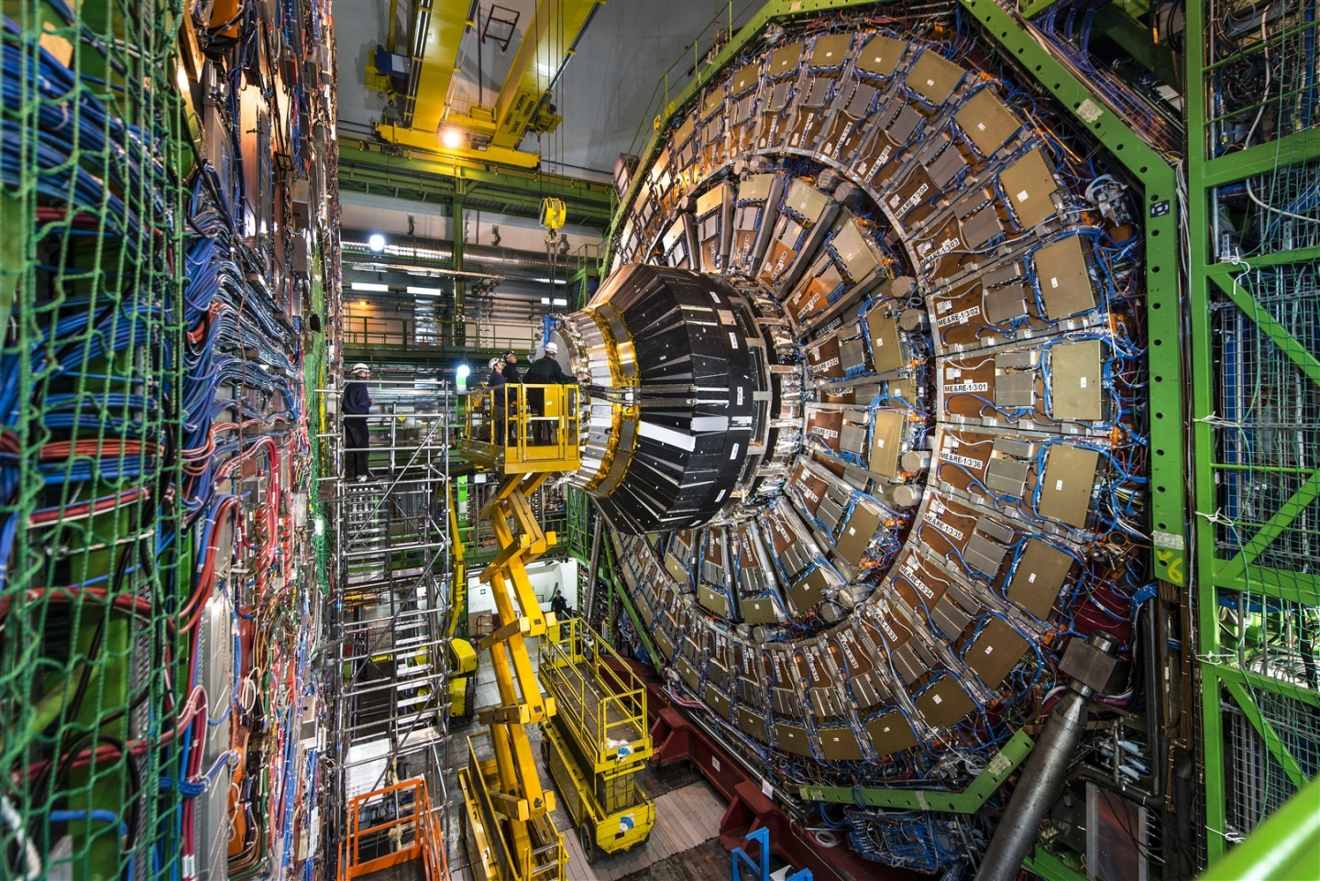
CMS experiment at LHC in CERN
Notes:
The CMS detector has millions of components
The physics of these components must be described correctly to describe the results and interpret them correctly
Just like the detector “screen” in the Tomomura double slit experiment
Einstein and Bohr treated the detector screen as “just a screen with a fluorescent film”
They assumed that the physics happening inside it can be ignored
As it can be in classical measurement devices for basic experiments

Slide 23
Notes:
Consider early space flight and the use of Kepler’s laws up to 1960
It works fine to go to space
Burns are short, minutes, compared to orbit times, which are hours (1.6 hours at 640 km = 400 miles)
But coming back is a problem, if you want to land with accuracy
Say near the recovery aircraft carrier ship

Slide 24

Beyond Kepler’s laws for space flight
Notes:
From the 2016 movie “Hidden figures”
Katherine Johnson mathematician engineer, played by Taraji P. Henson
Paul Stafford head engineer, played by Jim Parsons (also plays Sheldon Cooper in “the big bang theory”)
Katherine Johnson and Ted Skopinski wrote the report talked about in the movie
“Determination of Azimuth Angle at Burnout for Placing a Satellite Over a Selected Earth Position“ NASA Report D-233 Sept 1960
https://ntrs.nasa.gov/archive/nasa/casi.ntrs.nasa.gov/19980227091.pdf

Slide 25
Empirical approach
Space flight with Kepler’s laws
Measurement with Born’s rule
Compose known pieces of trajectory
Changes are fast and small
Accurate for many cases
NO INTERPRETATION PROBLEM
NEED NEWTON’S LAW
Use known wave functions for stationary states
Measurement is fast and short
Accurate for many cases
BIG INTERPRETATION PROBLEMS
NEED SCHRÖDINGER’S LAW
Notes:
The conceptual stature and use of Kepler’s Laws is in some ways similar to the stature and use of Born’s rule
Both focus on phenomena and how to describe them accurately to get work done

Slide 26
Realist approach
Classical mechanics
Quantum mechanics
System ↔ (q,p) in phase space M
Dynamics ↔ Newton’s Law
System ↔ ψ(q) in Hilbert space H
Dynamics ↔ Schrödinger’s Law
Notes:
In classical mechanics, we have a clear conceptual foundation from which Kepler’s laws are derived.
We try to do the same for Born’s rule
Allahverdyan, Ballian, Nieuwenhuizen did the derivation in 2013 in the context of an empirical viewpoint
We build from the ground up
We start with the wave function

Slide 27
Probabilities
Classical statistics
Quantum statistics
Probability density ρ(q,p)
Probability measure μ on M
Not density matrix
No probability density on ∞-dim
Probability measure μ on H
Notes:
Then we add probabilities and statistics

Slide 28
Detector statistics and dynamics
Electron statistical state – sharp – one wave function
Detector statistical state – broad – very many wave functions – many superpositions
Electron interacts with all mini detectors – all in different wave functions – some: fly through – some: excite few molecules, not enough to see – one: excites 500 molecules and send 500 photons
Photons are captured – fly through optical fiber – excite secondary electrons – current detected – write bit in RAM – display dot on screen
Notes:
What happens in the detector using the realist viewpoint?

Slide 29
Emergence of classical systems
One mini detector has 500 molecules with 30 atoms – 15,000 degrees of freedom
Variance of the collective variable that tracks excitation of mini detector is square root of N=15,000 which is 122 – two orders less than one molecule
That makes the collective variable effectively dispersionless=classical
We define this to be a q-classical variable
Q-classical variables form a q-classical system
By Ehrenfest’s theorem, its evolution follows Newton’s Law
Notes:
We define classical variables in the mathematical framework of quantum mechanics

Slide 30
Where do probabilities come from?
From the statistical state of the quantum system
It gives many random wave functions for every macroscopic system – all mini detectors
The mini detector collective variable of excitation of 500 photons follows classical dynamics
The one that gets excited is randomly selected by the statistical state
The measurement then proceeds classically – the result is recorded

Slide 31
What about the electron?
Its wave function keeps going
It keeps doing what it does
It may excite other quantum systems – even other macroscopic measurement systems
We do not get to watch the video – we only capture some frames

Slide 32
What does the experiment record?
The detector records
the effect
of the interaction with the electron
The detector does not record much about the electron wave function
We can reconstruct the wave function by computation from data obtained from many identical measurements

Slide 33
Summary
Wave functions are fundamental – functions (movies!)
  Deterministic dynamics by Schrödinger Law
Probability distribution on Hilbert space of wave functions
  Evolution of quantum statistical state
Derive q-classical variables and systems – values (photographs!)
  Deterministic dynamics by Newton Law follows from Ehrenfest’s theorem
  → Recover classical mechanics
Probability distribution on q-classical phase space
  Liouville equation for evolution of q-classical statistical state
  → Recover classical statistical mechanics
  → Describe probabilistic quantum measurement process

Slide 34
Questions and discussion

Slide 35
Schmidt decomposition and density matrix

Slide 36
Wave function collapse in space
Position is an operator
Time is a parameter/coordinate
  That is inconsistent
  Attempts to make time an operator have been made
Make position a coordinate of events
Same as time
  Does work well
  Even in non-relativistic quantum mechanics

