Slide 1
The Effect of Multiple Unskilled Competitors on the Success of a Skilled Player in a Model Spelling Bee-Like Game
Robert Monahan
Dr. Jeff Groff

Slide 2
Outline
Purpose
The Model
2 - Players
3 - Players
The Method
Matrix Formulation
Monte Carlo Simulation
Direct vs Simulation
Results
Questions?

Slide 3
Purpose
How much does ability matter?
Will the most qualified succeed?
What role does randomness play?

Slide 4
The Model – 2 Players
$(P_{1} ,P_{2})$ with a “skill” level of ${(h}_{1} ,h_{2})$
$$(P_{1} ,P_{2})$$
Where $h_{i}$ is a value between $0$ and $1$
Binary Representation
1 = active player
0 = inactive player
$$h_{1}h_{2}+(1−h_{1})(1−h_{2})$$
$$(1 ,1)$$
$$h_{1}(1−h_{2})$$
$$\left(1−h_{1}\right)h_{2}$$
$$(1 ,0)$$
$$(0 ,1)$$

Slide 5
The Model – 3 Players
$(P_{1} ,P_{2} ,P_{3})$ with a “skill” level of ${(h}_{1} ,h_{2} ,h_{3})$
Binary Representation
1 = active player
0 = inactive player
$$(P_{1 }, P_{2} ,P_{3})$$
Where $h_{i}$ is a value between $0$ and $1$
$$(1, 1, 1)$$
$$(1, 1, 0)$$
$$(0, 1, 1)$$
$$(1, 0, 1)$$
$$(0, 1, 0)$$
$$(1, 0, 0)$$
$$(0, 0, 1)$$

Slide 6
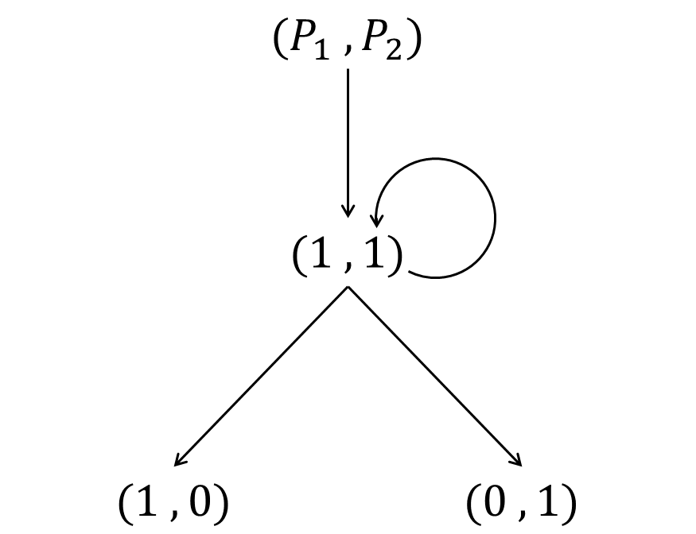
Matrix Formulation
$$P=\left(\begin{matrix}⋄ & h_{1}(1−h_{2}) & {(1−h}_{1})h_{2} \\ 0 & ⋄ & 0 \\ 0 & 0 & ⋄\end{matrix}\right)$$
For N players, the Markov Chain takes the form of a matrix with $2^{N}−1$ rows and $2^{N}−1$ columns.
Example: For 12 players, the size of the Markov Chain Matrix is 4095 rows by 4095 columns – called State Space Explosion!

Slide 7
Monte Carlo Simulation
Simulates a game at a time and tracks the results
Required to ensure that the Direct Matrix Calculation is accurate
Faster than Direct Calculation for games with lots of players - still only an approximation

Slide 8
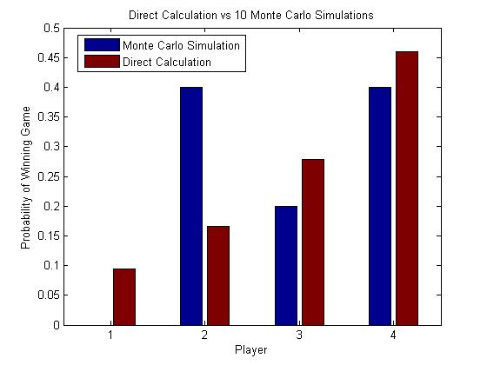
Monte Carlo vs Direct Calculation
$$h=\left[h_{1} h_{2} h_{3} h_{4}\right]=[0.4 0.5 0.6 0.7]$$

Slide 9
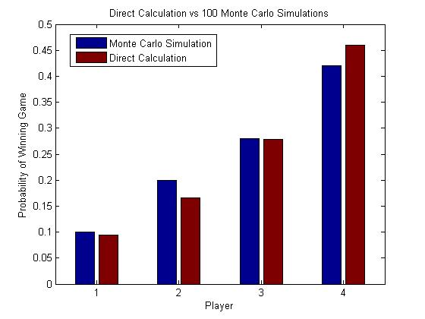
Monte Carlo vs Direct Calculation

Slide 10
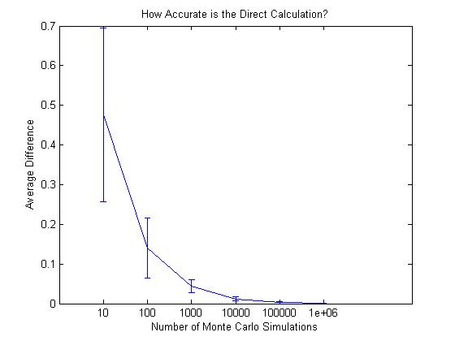
Monte Carlo vs Direct Calculation

Slide 11
Direct Calculation Valid?
✓

Slide 12
Results – A Diamond in the Rough
Two types of players:
Ace (high skill)
Joker (low skill)
Consists of 1 Ace and many Jokers
$\left(P_{1},P_{2},P_{3},P_{4},⋯\right)→\left(A_{1},J_{1},J_{2},J_{3},⋯\right)$
How “skilled” must the Ace be to win at least 50% of the competitions?

Slide 13
Results – A Diamond in the Rough

Slide 14
Results – A Diamond in the Rough
Diamond in the Rough Summary

Slide 15
Results – A Diamond in the Rough
How many Jokers does it take to overwhelm the Ace?
21 Jokers
33 Jokers
61 Jokers
127 Jokers
330 Jokers

Slide 16
Conclusion
How much does ability matter?
Will the most qualified succeed?
What role does randomness play?

Slide 17
Questions?

